Slide 1
Science Math Masters

Slide 2
Model Lesson
Colleen Beaudoin
Tina Cloke

Slide 3
MACC.912.G-SRT.3.6: Understand that by similarity, side ratios in right triangles are properties of the angles in the triangle, leading to definitions of trigonometric ratios for acute angles. MACC.912.G-SRT.3.7: Explain and use the relationship between the sine and cosine of complementary angles. MACC.912.G-SRT.3.8: Use trigonometric ratios and the Pythagorean Theorem to solve right triangles in applied problems.
Standards Addressed In Lesson

Slide 4
Warm-up (to access prior knowledge)
4.
5.
13
5
18
22
Fun Fact: The word "hypotenuse" comes from two Greek words meaning "to stretch“ because it is the longest side.
Notes:
http://www.grc.nasa.gov/WWW/k-12/airplane/sincos.html

Slide 5
Application (to motivate/hook)
Identify this structure.
Notes:
Sayers, A. T. (2007). Critical Analysis of Sunshine Skyway Bridge. Proceedings of Bridge Engineering 2 Conference. Bath, UK: University of Bath.

Slide 6
Sunshine Skyway Bridge in Tampa, Florida
What things do you think were taken into consideration when the bridge was being designed and built? Why are these things important?
Sayers, A. T. (2007). Critical Analysis of Sunshine Skyway Bridge. Proceedings of Bridge Engineering 2 Conference. Bath, UK: University of Bath.
Audio: http://www.youtube.com/watch?v=PtaBhDlFl60
Notes:
Sayers, A. T. (2007). Critical Analysis of Sunshine Skyway Bridge. Proceedings of Bridge Engineering 2 Conference. Bath, UK: University of Bath.
Possible answers: Weight of building materials, cars, etc.. Weight of cables, force, angles, lengths,…

Slide 7
Sunshine Skyway Bridge in Tampa, Florida
*Refer to Sunshine Skyway Handout.*
The cable-stays that connect the deck to the pylons are arranged in a single plane with 21 cables spanning out from each pylon. Each stay is formed using bundles of high-tension steel cables that have been spun together. The largest stay consists of 82 strands and weighs approximately 37tons. These are then sheathed using steel tubing to provide protection from corrosion in the harsh marine environment. The stays are bolted to the desk segments through anchorages that are embedded below the road level. They then pass up through the corresponding section on the opposite site. This creates a symmetrical system that balances the loads and reduces the bending moments induced in the pylon.
(Sayers, 2007)
Notes:
Sayers, A. T. (2007). Critical Analysis of Sunshine Skyway Bridge. Proceedings of Bridge Engineering 2 Conference. Bath, UK: University of Bath.

Slide 8
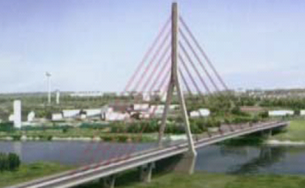
Sunshine Skyway Bridge in Tampa, Florida
L
Each cable supports two of the pre-cast concrete segments, each weighing approximately 200t. (Sayers, 2007)
Calculate the length, L, of the longest cable (to nearest tenth of a meter) and the measure of angle (Ɵ) that the cable makes with the bridge.
Notes:
Sayers, A. T. (2007). Critical Analysis of Sunshine Skyway Bridge. Proceedings of Bridge Engineering 2 Conference. Bath, UK: University of Bath.

Slide 9
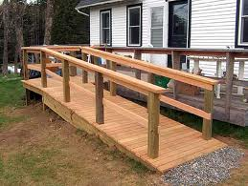
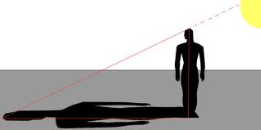
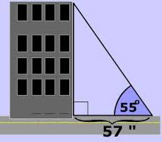
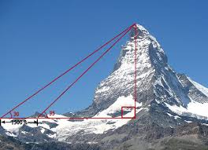
Right Triangles in Everyday Life
Application (to motivate/hook)

Slide 10
Objective: Students will use trigonometric ratios and Pythagorean theorem to solve right triangles and applied problems.
Lesson (Note inclusion of multiple representations
and use of discovery methods)

Slide 11
What does opposite mean in English? Exp. Prenav’s house is on the opposite side of the street from where the playground is. What does adjacent mean in English? Exp. Alli’s project is hung adjacent to mine.
Opposite and Adjacent
Notes:
Opposite – across from; like opposite side of the street
Adjacent – next to

Slide 12
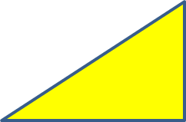
Opposite and Adjacent
What side is the hypotenuse?
What angle is opposite the hypotenuse?
What is the measure of the angle opposite the hypotenuse?
What leg is opposite angle 1?
What leg is adjacent to angle 1?
What leg is opposite angle 3?
What leg is adjacent to angle 3?
y
Note: The other two sides are called the “legs”
1
2
x
z
3
8. Describe the relationship between the legs that are
opposite and adjacent to angles 1 and 3.
The leg that is opposite angle 1 is adjacent to angle ____
The leg that is opposite angle 3 is adjacent to angle ____
Notes:
Opposite – across from; like opposite side of the street
Adjacent – next to

Slide 13
Each group should have a handout: Discovering Trigonometric Ratios(Form A, B, or C), a sheet of chart paper with grids, graph paper, rulers, yardstick, protractors, and markers.
Group Activity (Groups of 3)
Follow the directions and work through the activity with your group.

Slide 14
Discussion
#3. Find the length of side . Justify your answer two ways.
Notes:
Possible answers include using the Pythagorean Theorem and tearing off a strip of the grid and counting.

Slide 15
Discussion
#7. Find the measure of angle B without using a protractor. Justify your answer.
#8. Complete the statement: When the sum of two angles is $90°$, the angles are called __________________________ angles.

Slide 16
Trigonometric Ratios for Right Triangles

Slide 17
Discussion
#14. Based on your observations of the values of the trigonometric ratios of similar triangles, answer the following questions about right triangles.
a. Do you need to be given the dimensions of a right triangle to determine the values of sine, cosine, and tangent of a given angle? Explain your answer.
b. If you are given the measurements of the sides of a right triangle, do you need to be given the angle measures to determine the values of sine, cosine, and tangent? Explain your answer.

Slide 18
Discussion
#14. c, d, and e: Each group has different numbers to calculate different angle measures. Have groups share general concepts and explanations.

Slide 19
Discussion
#15. Examine your answers to #13. Then, walk around and look at the work of your classmates as they post it. It’s important to examine more than one triangle before drawing a conclusion. Look for a relationship between some of the trigonometric values. Do any of them have the same value? If so, what is the relationship between the angles? Make a hypothesis regarding these types of angles. Test your hypothesis and record your work below. Is your hypothesis correct? Justify your answer.

Slide 20
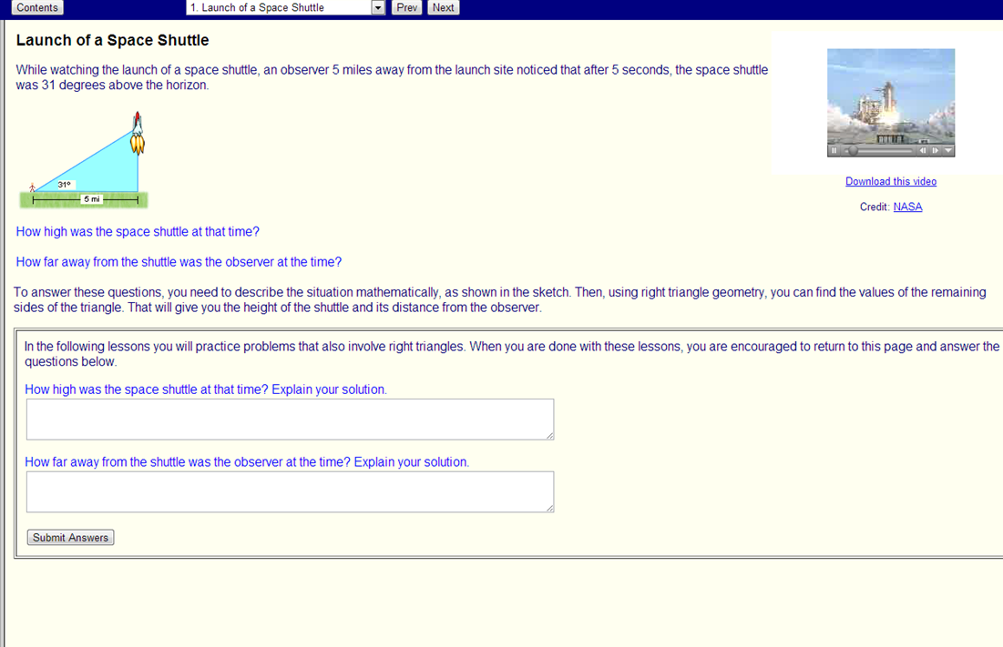
Application
Click on image to link problem and additional application problems.
Note: A full lesson available at this site.
Notes:
http://enlvm.usu.edu/ma/nav/activity.jsp?sid=__shared&cid=emready@right_triangles&lid=1

Slide 21
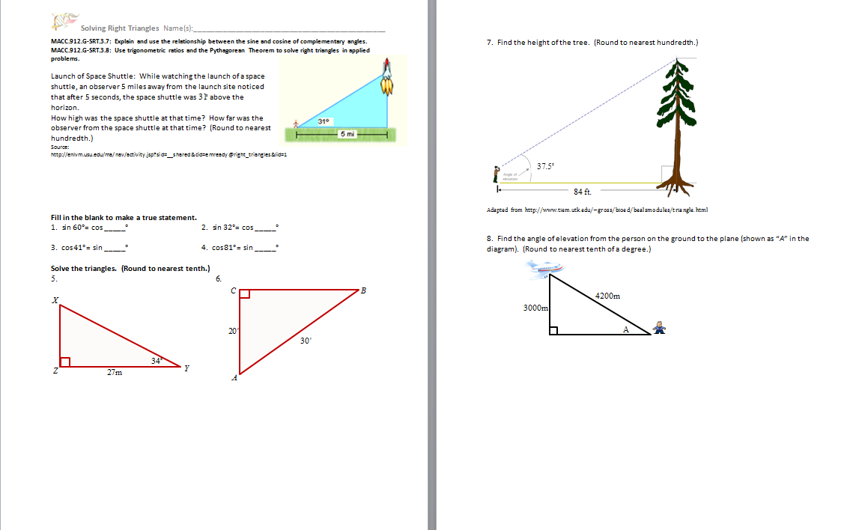
Refer to handout: Solving Right Triangles
Notes:
Do #1 together. Have participants do #2 - #5 in pairs.

Slide 22
Right Triangle Trigonometry Applets
Use of online applets for demonstration:
Click on image to link to applet.
Notes:
http://www.univie.ac.at/future.media/moe/galerie/wfun/wfun.html

Slide 23
Right Triangle Trigonometry Applets
Use of online applets for demonstration:
Click on image to link to applet.
Notes:
http://www.mathsisfun.com/sine-cosine-tangent.html
Discussion can include right triangles inscribed in semi-circles.

Slide 24
Assessment
Sunshine Skyway Bridge in Tampa, Florida
L
Calculate the length, L, of the longest cable (to nearest tenth of a meter) and the measure of angle (Ɵ) that the cable makes with the bridge.
Notes:
Sayers, A. T. (2007). Critical Analysis of Sunshine Skyway Bridge. Proceedings of Bridge Engineering 2 Conference. Bath, UK: University of Bath.

Slide 25
Assessment
Sunshine Skyway Bridge in Tampa, Florida
Calculate the length, L, of the longest cable (to nearest tenth of a meter).
L
Notes:
Sayers, A. T. (2007). Critical Analysis of Sunshine Skyway Bridge. Proceedings of Bridge Engineering 2 Conference. Bath, UK: University of Bath.

Slide 26
Assessment
Sunshine Skyway Bridge in Tampa, Florida
Calculate the measure of angle (Ɵ) that the cable makes with the bridge.
L
Notes:
Sayers, A. T. (2007). Critical Analysis of Sunshine Skyway Bridge. Proceedings of Bridge Engineering 2 Conference. Bath, UK: University of Bath.

Slide 27
Enrichment/Differentiating Instruction
Refer to handout: Exploring the Building of the Sunshine Skyway Bridge (Alternative for differentiating instruction)
Sayers, A. T. (2007). Critical Analysis of Sunshine Skyway Bridge. Proceedings of Bridge Engineering 2 Conference. Bath, UK: University of Bath.
http://www.bath.ac.uk/ace/uploads/StudentProjects/Bridgeconference2007/conference/mainpage/Sayers_Sunshine_Skyway.pdf
See Page 4 for solutions to the enrichment exercises.
Notes:
”.

Slide 28
- Emphasis on students drawing conclusions about relationships - Multiple representations (formulas, measuring, ratios, decimals, online applets) - Emphasis on students making and testing conjectures. - Formal Definitions AFTER activities - Aiming for conceptual before procedural understanding.
Discussion:
Trigonometric Ratios

Slide 29
General Information
Click on image to link to DOE site.

Slide 30
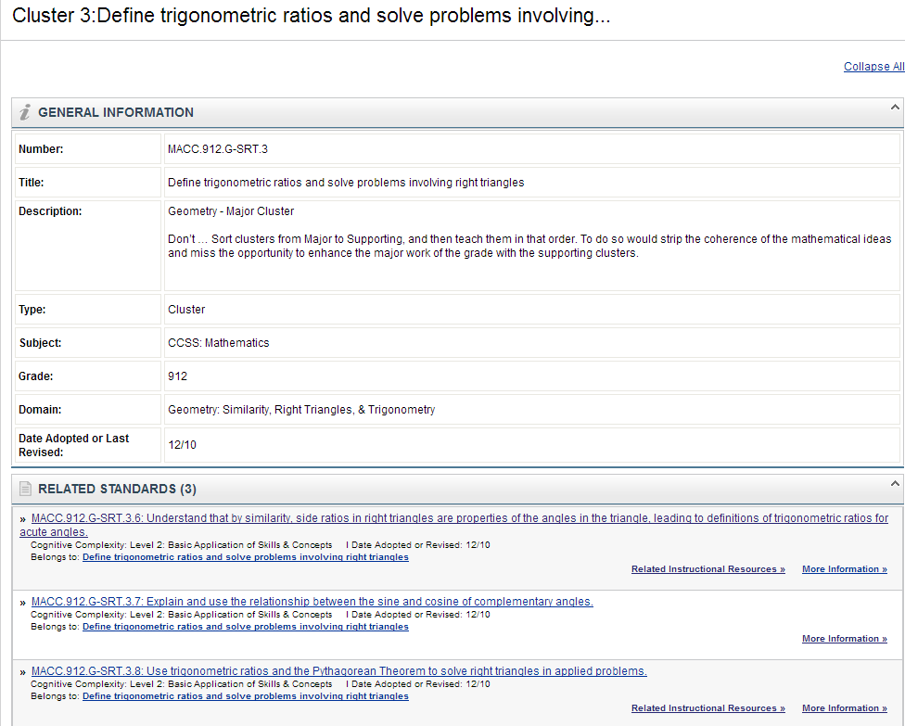
General Information

Slide 31
General Information

Slide 32
Engagement Evaluation & Break

Slide 33
Each person will be assigned to a group. The group will be given a concept and a group color.
Group Project
Congruence
Similarity, Right Triangles, and Trigonometry
Circles
Expressing Geometric Properties with Equations
Geometric Measurement and Dimension

Slide 34
There are several standards for each concept. As a group, you will choose the standard(s) you wish to teach. Refer to handouts: Group Activity and CCSS: Geometry Mathematics Standards by Domain.
Group Project
Congruence
Similarity, Right Triangles, and Trigonometry
Circles
Expressing Geometric Properties with Equations
Geometric Measurement and Dimension

Slide 35
Group Project
After choosing standard(s), your group will write a lesson that includes each of the following components.
Activity to Activate Prior Knowledge
Hook/Motivation for Lesson
Multiple Representations
Discovery Learning Technique
Assessment

Slide 36
Time for group work has been built into the schedule. Lecture Hall A (next door) is available for groups to meet.
On Thursday, each person will have 30 minutes present the lesson to members of the other groups and students.
Sample Presentation Schedule

Slide 37
Rooms for presentations are in HSHP.
Go in door on right – before the main doors into the athletic building.
We are here - in the Lecture Halls.

