Slide 1
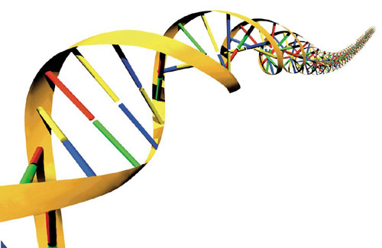
Animal Face Off:
Otter vs. Pufferfish

Slide 2
Math & Nature
The universe is written in the language of mathematics
Galileo Galilei, 1623
Quantitative analysis of natural phenomena is at the heart of scientific inquiry
Nature provides a tangible context for mathematics instruction

Slide 3
The Importance of Context
Context
The part of a text or statement that surrounds a particular word or passage and determines its meaning.
The circumstances in which an event occurs; a setting.

Slide 4
The Importance of Context
Context-Specific Learning
Facilitates experiential and associative learning
Demonstration, activation, application, task-centered, and integration principles (Merrill 2002)
Facilitates generalization of principles to other contexts

Slide 5
Math & Nature
Geometry & Biology
Biological structures vary greatly in geometry and therefore represent a platform for geometric education
Geometric variability → functional variability
Mechanism for illustrating the consequences of geometry

Slide 6
Math & Nature
Geometry & Biology
Ecological interactions can be affected by the geometry of anatomical structures
Competition
Two organisms in pursuit of the same resource
Principle of Competitive Exclusion
Ecological niche
Geometric variability is the “ghost of competition past” (Reece et al. 2009)

Slide 7
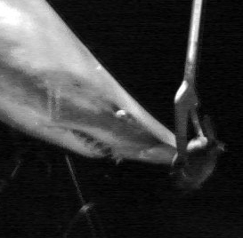
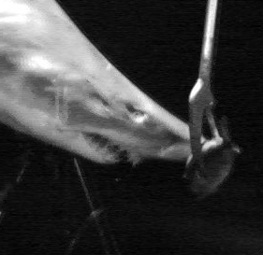
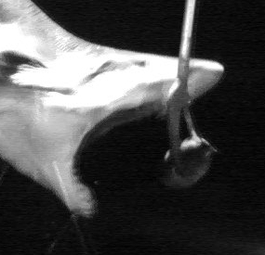
Math & Nature
Geometry & Biology
Ecological interactions can be affected by the geometry of anatomical structures
Mouth size is an extremely important geometric parameter
Predators with large mouths have a competitive advantage
Large prey → greater energetic return per unit effort (Herrel et al., 2001; Roughgarden,1995)
© D.Huber (2012)

Slide 8
Math & Nature
Geometry & Biology
Ecological interactions can be affected by the geometry of anatomical structures
Mouth size is an extremely important geometric parameter
Predators with large mouths have a competitive advantage
Large prey → greater energetic return per unit effort (Herrel et al., 2001; Roughgarden,1995)
Geometric winners and losers
Large-mouthed predators out compete small-mouthed predators
Large prey outlast small prey

Slide 9
Math & Nature
Geometry & Biology
Ecological interactions can be affected by the geometry of anatomical structures
But what about prey that change geometry???
Otter
vs.
Pufferfish
Insert Video of Pufferfish here
Pufferfish.mpg

Slide 10
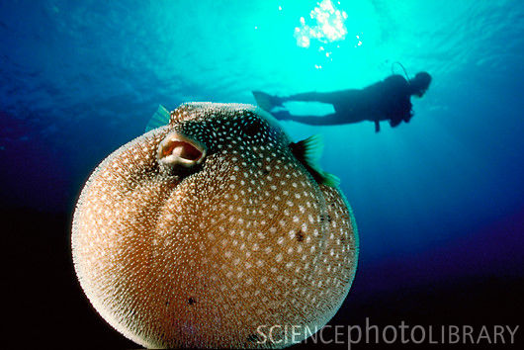
Math & Nature
The incredible, inflatable pufferfish
Inflation mechanism (Wainwright and Turingan 1997)
Water pumped into expandable stomach
Extensible skin, no ribs

Slide 11
Math & Nature
The incredible, inflatable pufferfish
Inflation mechanism (Wainwright and Turingan 1997)
Water pumped into expandable stomach
Extensible skin, no ribs
vs.
M. Dowland (2006)
Flippers 'n' Fins (2004)

Slide 12
Math & Nature
Geometry & Biology
Geometry Objectives
MA.912.G.4.6 Prove that triangles are congruent or similar and use the concept of corresponding parts of congruent triangles.
MA.912.G.6.4 Determine and use measures of arcs and related angles (central, inscribed, and intersections of secants and tangents).

Slide 13
Math & Nature
Geometry & Biology
Geometry Objectives
MA.912.G.6.5 Solve real-world problems using measures of circumference, arc length, and areas of circles and sectors.
MA.912.G.8.2 Use a variety of problem-solving strategies, such as drawing a diagram, making a chart, guess-and-check, solving a simpler problem, writing an equation, and working backwards.

Slide 14
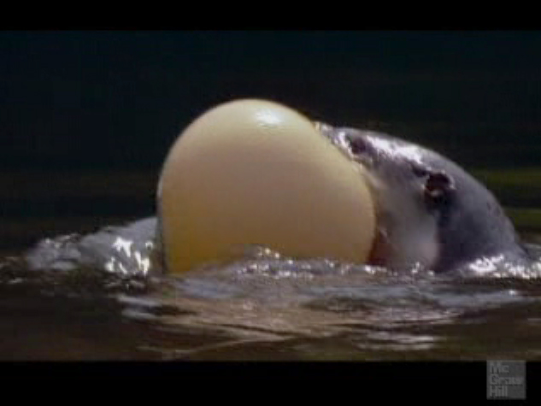
Math & Nature
The incredible, inflatable pufferfish
The otter’s jaws are modeled as tangents to the pufferfish.
Otter Jaw
Gape Angle
Pufferfish

Slide 15
Math & Nature
The incredible, inflatable pufferfish
Given
The otter’s jaws are tangent to the pufferfish.
x₁ and x₂ represent arc measurements in degrees.
What is the measurement of x₁ + x₂?
360°
Otter Jaw
Gape Angle
Pufferfish

Slide 16
Math & Nature
The incredible, inflatable pufferfish
Given
The otter’s jaws are tangent to the pufferfish.
x₁ and x₂ represent arc measurements in degrees.
Write an equation relating x₁ and x₂ to the measure of ∠ABC.
$\frac{x_{1}−x_{2}}{2}=46°$
Otter Jaw
Gape Angle
Pufferfish

Slide 17
Math & Nature
The incredible, inflatable pufferfish
Given
The otter’s jaws are tangent to the pufferfish.
x₁ and x₂ represent arc measurements in degrees.
Use your answers to the previous questions to find x₁ and x₂.
$x_{1}+x_{2}=360°$
$\frac{x_{1}−x_{2}}{2}=46°$
Otter Jaw
Gape Angle
Pufferfish

Slide 18
Math & Nature
The incredible, inflatable pufferfish
Given
The otter’s jaws are tangent to the pufferfish.
x₁ and x₂ represent arc measurements in degrees.
Use your answers to the previous questions to find x₁ and x₂.
$x_{1}+x_{2}=360°$
$\frac{x_{1}−x_{2}}{2}=46°$
$x_{1}=226°$
$x_{2}=134°$

Slide 19
Math & Nature
The incredible, inflatable pufferfish
Given
The otter’s jaws are tangent to the pufferfish.
x₁ and x₂ represent arc measurements in degrees.
Draw AC and label its midpoint H. Draw DB.
Otter Jaw
Gape Angle
Pufferfish

Slide 20
Math & Nature
The incredible, inflatable pufferfish
Given
The otter’s jaws are tangent to the pufferfish.
x₁ and x₂ represent arc measurements in degrees.
Draw AC and label its midpoint H. Draw DB.

Slide 21
Math & Nature
The incredible, inflatable pufferfish
Given
The otter’s jaws are tangent to the pufferfish.
x₁ and x₂ represent arc measurements in degrees.
Name every triangle drawn in the picture that is similar to △BHA.
△BHC
△AHD
△CHD
△BAD
△BCD

Slide 22
Math & Nature
The incredible, inflatable pufferfish
Given
The otter’s jaws are tangent to the pufferfish.
x₁ and x₂ represent arc measurements in degrees.
Find the radius, r, of the circle to two decimal places.
r = 3.82 cm

Slide 23
Math & Nature
The incredible, inflatable pufferfish
Given
The otter’s jaws are tangent to the pufferfish.
x₁ and x₂ represent arc measurements in degrees.
What is the diameter of the largest pufferfish that this otter can eat?
d = 7.64 cm

Slide 24
Math & Nature
The incredible, inflatable pufferfish
Given
The otter’s jaws are tangent to the pufferfish.
x₁ and x₂ represent arc measurements in degrees.
What is the diameter of the largest pufferfish that this otter can eat?
d = 7.64 cm

Slide 25
Math & Nature
References
Galileo Galilei, The Assayer, as translated by Stillman Drake (1957), Discoveries and Opinions of Galileo pp. 237-8. New York: Doubleday & Company.
Herrel, A., R. Van Damme, B. Vanhooydonck and F. De Vree (2001) The implications of bite performance for diet in two species of lacertid lizards. Can. J. Zool. 79: 662-670.
Merrill, M.D. (2002). First principles of instruction. Educational Technology Research and Development. 50 (3): 43 – 59.
Reece, J.B., Urry, L.A., Cain, M.L., Wasserman, S.A., Minorsky, P.V., and Jackson, R.B. (2009). Campbell Biology, 9th Edition. Benjamin Cummings. San Francisco, CA.
Roughgarden, J. 1995. Anolis lizards of the Caribbean. Oxford University Press, New York.
Wainwright, P. C. and R. G. Turingan. 1997. Evolution of pufferfish inflation behavior. Evolution. 51:506-518.

