Slide 1
Science Math Masters

Slide 2
Icebreaker: Dots Activity
5 groups:
Hearts (Red back)
Diamonds (Red back)
Clubs (Red back)
Spades (Red back)
Hearts (Blue back)
Each group must have at least four people

Slide 3
Icebreaker: Dots Activity
Behind each partition is a structure made of
Dots and colored toothpicks.
Goal: To re-construct the structure with your
team within the given guidelines. Colors count!

Slide 4
Team Roles
Viewer/King: may view the sculpture and talk with the Runner only.
Runner(s)/Non-Facecard: may not view the sculpture and may listen to the Viewer and talk with the Builder only.
Builder/Queen: may listen to the Runner and may not talk to anyone.
Observer/Jack: may view everything and may not talk to anyone.

Slide 5
Discussion Questions
1. What was easy or challenging about this?
2. What worked well to overcome the challenges?
3. How was the communication process challenging? What does this activity tell us about our communication styles? What are the benefits of two-way communication?
4. How could this activity be used in your classroom?

Slide 6
Appointment Clock

Slide 7
Introductions
Meet your 9:00 appointment and find out the following information. You will be introducing each other to the group.
Name
School
Number of years teaching
Rating on a scale of 1 – 5 on how prepared your partner feels to implement MAFS (1 meaning not well-prepared and 5 meaning very prepared)

Slide 8
Shift to Florida Standards/Common Core

Slide 9
Where we’re headed with the Florida Standards/Common Core…
Today’s lesson addresses part of MAFS.912.G-GMD.2.4
MAFS.912.G-GMD.2.4: | Identify the shapes of two-dimensional cross-sections of three-dimensional objects, and identify three-dimensional objects generated by rotations of two-dimensional objects.
How was this topic addressed in the “Old” NGSSS Geometry Course?
It wasn’t….
Link to course

Slide 10
A Closer Look at MAFS
MAFS.7.G.1.3: | Describe the two-dimensional figures that result from slicing three-dimensional figures, as in plane sections of right rectangular prisms and right rectangular pyramids.
Note: The incoming geometry students probably did not have this standard taught in 7th grade. It was not in NGSSS.
MAFS.912.G-GMD.2.4: | Identify the shapes of two-dimensional cross-sections of three-dimensional objects, and identify three-dimensional objects generated by rotations of two-dimensional objects.
Notes:
The incoming geometry students probably did not have this standard taught in 7th grade. It was not in NGSSS.

Slide 11
CPALMS Resources
MAFS.912.G-GMD.2.4: | Identify the shapes of two-dimensional cross-sections of three-dimensional objects, and identify three-dimensional objects generated by rotations of two-dimensional objects.
CPALMS RESOURCES:
http://www.cpalms.org/Public/PreviewStandard/Preview/5637#/#icts-toggle
Note: There are lesson plans here for this standard. However, knowing that the current students were not taught this concept in 7th grade, calls for a way to address it.
Our lesson takes a current MAFS 7th grade lesson from CPALMS for us to use and build on to incorporate the high school MAFS standards.
http://www.cpalms.org/Public/PreviewStandard/Preview/5476#/#icts-toggle

Slide 12
Warm-up (activity to access prior knowledge)
Refer to Warm-up Questions 1

Slide 13
Warm-up (activity to access prior knowledge)
Identify the figure to the right.
How many faces are there?
What shape are the bases? How many are there?
What shapes are the lateral faces? How many are there?
How many edges are there?
How many vertices are there?

Slide 14
Warm-up (activity to access prior knowledge)
7. Identify the figure to the right.
8. What shapes are the bases? How many are there?
9. What shape is the lateral surface?
10. How many edges are there?
11. How many vertices are there?

Slide 15
Hook/Motivation for Lesson
What is a cross section?
What are cross sections used for?
Ice cores and earthen cores are dug up, and each section is viewed as a period in history
Trees are cut and the cross sections are examined to estimate the age of the tree, and get environmental information
MRIs view cross sections of the human body
Cross sections of cells preserved and examined by scientists
Chefs experiment with cross sections of food (cutting with grain vs. against gain impacts “toughness”; different shapes and angles of fruits and vegetables for displays)

Slide 16
CPALMS Hook
Hook: Can you make a hexagon from a cube with just one slice?

Slide 17
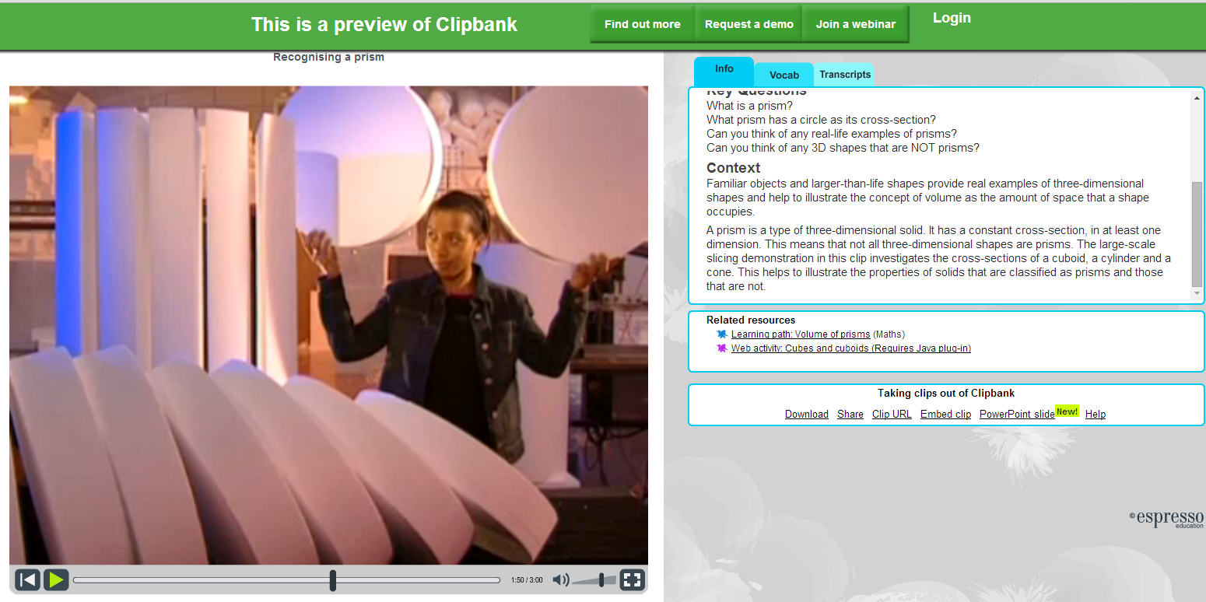
Additional Hook/Motivation for Lesson
http://preview.channel4learning.com/espresso/clipbank/servlet/link?macro=setresource&template=vid&resourceID=2676

Slide 18
Activity
Work with your team-building group.
Each person in the group needs:
Rectangular prism (clay)
Plastic knife
Piece of dental floss
2 sheets of plain paper
Activity sheet

Slide 19
Activity
Complete activity sheet (#1 - 7) with your group.
Discussion

Slide 20
Activity
Groups by Cards: Kings, Queens, Jacks, 10s, others
8. Compare and contrast your group’s triangles to other group’s triangles. Are the cross-sections the same? Are different types of triangles created? How would you classify these triangles by their angles and their sides?

Slide 21
Activity
Go back to your team-building group to do #9-10
Create other cross-sections. Can you make a parallelogram? pentagon? hexagon? octagon? List the shapes you made and explain your steps in creating them.
Name at least one shape you cannot make, explain why it can’t be done.

Slide 22
Activity
Appointment Buddies to review answers to 9 and 10.

Slide 23
Extended Group Activity
Each group needs: 4 different shapes, a bag of Play-Doh, and 4 sheets of paper
Create as many cross sections as you can and write them on a piece of paper (1 paper per shape)
Be prepared to explain your steps in creating the shapes.
Tape your paper under the headings posted about the room.

Slide 24
Activity
Gallery walk
Write comments on the paper if you have questions or have anything to add.

Slide 25
Virtual Activity
http://nlvm.usu.edu/en/nav/frames_asid_126_g_3_t_3.html?open=instructions&from=category_g_3_t_3.html
Notes:
http://nlvm.usu.edu/en/nav/frames_asid_126_g_3_t_3.html?open=instructions&from=category_g_3_t_3.html

Slide 26
Virtual Activity
http://www.learner.org/courses/learningmath/geometry/session9/part_c/index.html
Notes:
http://www.learner.org/courses/learningmath/geometry/session9/part_c/index.html

Slide 27
More Applets!
Click on image to link to site:
http://www.shodor.org/interactivate/activities/CrossSectionFlyer/

Slide 28
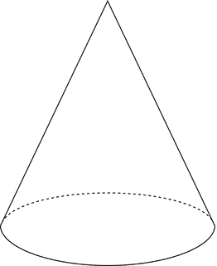
Assessment
Sketch three different cross-sections of a plane intersecting a right circular cone. Identify each cross-section and describe how it was created.

Slide 29
CPALMS Assessment

Slide 30
Discussion
What suggestions do you have for taking this activity to the next level? How could you add to this to address the high school standard?
MAFS.7.G.1.3: | Describe the two-dimensional figures that result from slicing three-dimensional figures, as in plane sections of right rectangular prisms and right rectangular pyramids.
MAFS.912.G-GMD.2.4: | Identify the shapes of two-dimensional cross-sections of three-dimensional objects, and identify three-dimensional objects generated by rotations of two-dimensional objects.

Slide 31
Discussion
One option could be….
Put the prism back together and create a non-right (oblique) rectangular prism. Create cross-sections as done previously. Compare and contrast cross-sections of right vs. oblique rectangular prisms.

Slide 32
Which mathematical practices were demonstrated in this activity?

Slide 33
Identify Parts of the Lesson
Activity to Activate Prior Knowledge
Hook/Motivation for Lesson
Multiple Representations: concrete/hands-on models, applets, sketches
Discovery Learning Technique
Assessment

Slide 34
CPALMS is an online toolbox of information, vetted resources, and interactive tools that helps educators effectively implement teaching standards. It is the State of Florida’s official source for standards information and course descriptions. http://www.cpalms.org We will use CPALMS resources for group projects.
CPALMS

Slide 35
Group Project
Refer to hand-out titled Culminating Group Projects
Activity to Activate Prior Knowledge
Hook/Motivation for Lesson
Multiple Representations
Discovery Learning Technique
Assessment

Slide 36
Sign up on sheets posted around classroom (limit to number of people stated per group). These are the groups you will be working closely with for the next two days. Move to sit with Groups.
Sign Up For Groups

Slide 37
Tuesday Discussion

Slide 38
Additional Resources: Videos and Lessons on LearnZillion
http://learnzillion.com/lessons/3488-predict-3d-results-of-rotating-simple-figures

