Slide 1
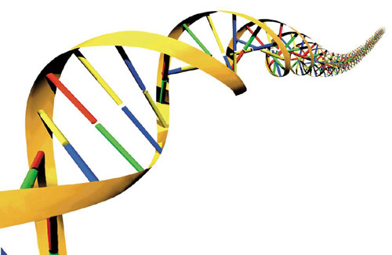
Geometric Analysis of
Jaw Protrusion

Slide 2
Math & Nature
The universe is written in the language of mathematics
Galileo Galilei, 1623
Quantitative analysis of natural phenomena is at the heart of scientific inquiry
Nature provides a tangible context for mathematics instruction

Slide 3
The Importance of Context
Context
The part of a text or statement that surrounds a particular word or passage and determines its meaning.
The circumstances in which an event occurs; a setting.

Slide 4
The Importance of Context
Context-Specific Learning
Facilitates experiential and associative learning
Demonstration, activation, application, task-centered, and integration principles (Merrill 2002)
Facilitates generalization of principles to other contexts

Slide 5
Math & Nature
Geometry & Biology
Biological structures vary greatly in geometry and therefore represent a platform for geometric education
Geometric variability → functional variability
Mechanism for illustrating the consequences of geometry

Slide 6
Math & Nature
Geometry & Biology
Changing geometry as the basis of behavior
What is behavior?
The results of commands issued by the nervous system
Movements are behaviors caused by communication between the nervous and musculoskeletal systems
Movements represent changes in the geometric orientation of skeletal elements

Slide 7
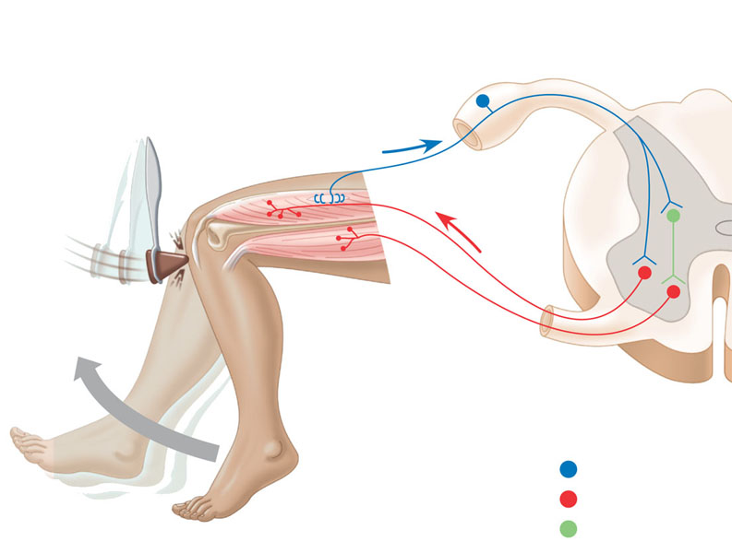
Math & Nature
Geometry & Biology
Changing geometry as the basis of behavior
Reflexive behaviors
Sensory neuron
Motor neuron
Interneuron
Reece et al. (2009)

Slide 8
Math & Nature
Geometry & Biology
Geometry Objectives
MA.912.G.3.1 Describe, classify, and compare relationships among quadrilaterals including the square, rectangle, rhombus, parallelogram, trapezoid, and kite.
MA.912.G.4.4 Use properties of congruent and similar triangles to solve problems involving lengths and areas.
MA.912.G.4.6 Prove that triangles are congruent or similar and use the concept of corresponding parts of congruent triangles.

Slide 9
Math & Nature
Geometry & Biology
Geometry Objectives
MA.912.G.8.2 Use a variety of problem-solving strategies, such as drawing a diagram, making a chart, guess-and-check, solving a simpler problem, writing an equation, and working backwards.
MA.912.T.2.1 Define and use the trigonometric ratios (sine, cosine, tangent, cotangent, secant, cosecant) in terms of angles of right triangles.

Slide 10
Math & Nature
Geometry & Biology
Behavior of interest = jaw protrusion
a.k.a., throwing your face at your food
See video sttoothangle.avi
Available on the website:
http://utweb.ut.edu/rwaggett/lessons.html
© D. Huber (2012)

Slide 11
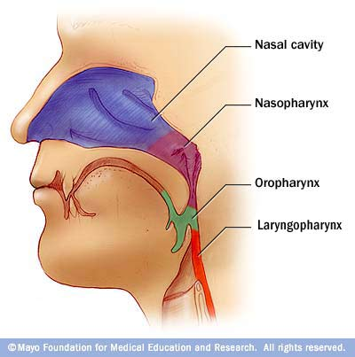
Math & Nature
Geometry & Biology
Evolution of jaws
Jaws evolved from skeletal arches that supported the pharynx
Mayo Foundation for Medical
Education and Research (2012)

Slide 12
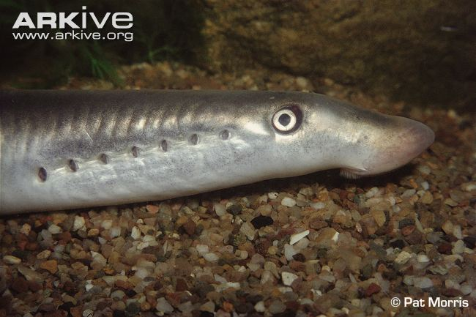
Math & Nature
Geometry & Biology
Evolution of jaws
Jaws evolved from skeletal arches that supported the pharynx
Gill slits
Cranium
Mouth
Skeletal rods
Reece et al. (2009)
River Lamprey Lampetra fluviatilis

Slide 13
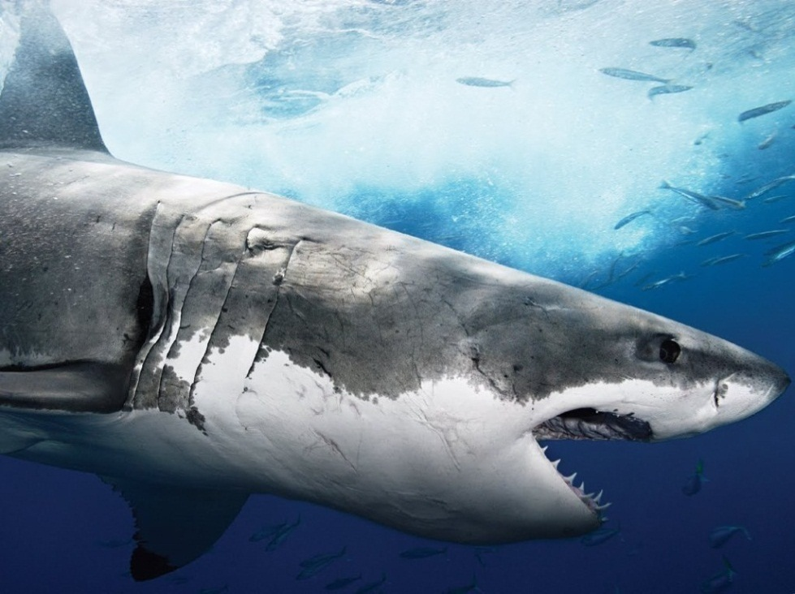
Math & Nature
Geometry & Biology
Evolution of jaws
Jaws evolved from skeletal arches that supported the pharynx
Totalwallpapers (2012)
Reece et al. (2009)
White shark Carcharodon carcharias

Slide 14
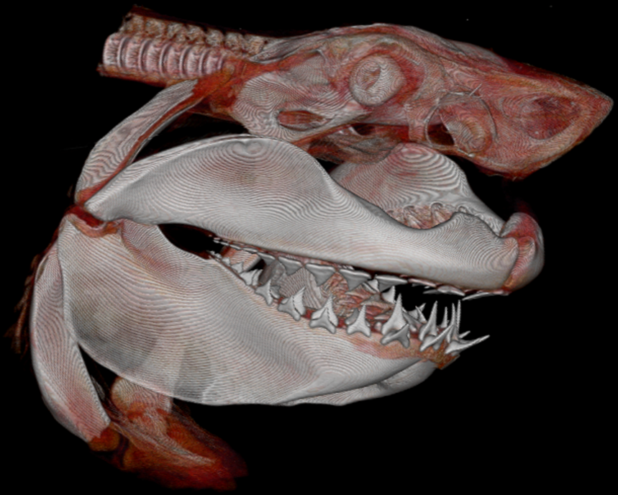
Math & Nature
Geometry & Biology
Evolution of jaws
Jaws evolved from skeletal arches that supported the pharynx
Reece et al. (2009)
© S. Wroe (2012)
White shark Carcharodon carcharias

Slide 15
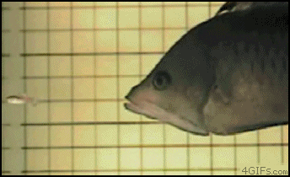
Math & Nature
Geometry & Biology
Evolution of jaws
Jaws evolved from skeletal arches that supported the pharynx
Slingjaw wrasse Epibulus insidiator

Slide 16
Math & Nature
Geometry & Biology
Evolution of jaws
Jaws evolved from skeletal arches that supported the pharynx
Transition from suspension feeding to active predation in vertebrate evolutionary history
The upper jaw became fused to the cranium in terrestrial vertebrates

Slide 17
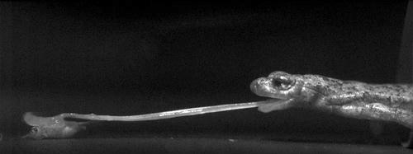
Math & Nature
Geometry & Biology
However…
Tongue protrusion in amphibians and reptiles
Visit www.debanlab.org/movies for feeding videos
© S. Deban (2012)

Slide 18
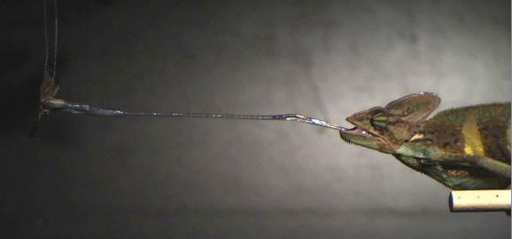
Math & Nature
Geometry & Biology
However…
Tongue protrusion in amphibians and reptiles
Visit www.debanlab.org/movies for feeding videos
© S. Deban (2012)

Slide 19
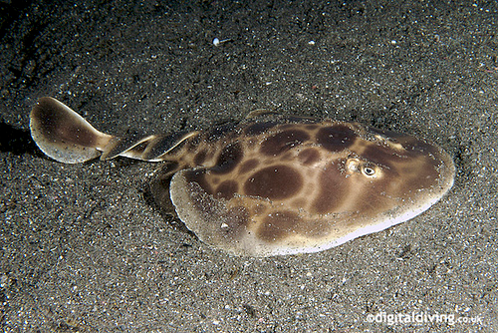
Math & Nature
Batoid jaw protrusion
Some batoids (stingrays and their relatives) protrude their jaws in a manner analogous to a “scissor-jack”
Lesser electric ray Narcine brasiliensis

Slide 20
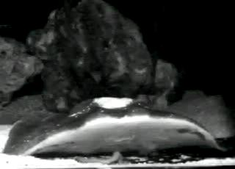
Math & Nature
Batoid jaw protrusion
Some batoids (stingrays and their relatives) protrude their jaws in a manner analogous to a “scissor-jack”
Lesser electric ray Narcine brasiliensis
© M. Dean (2012)

Slide 21
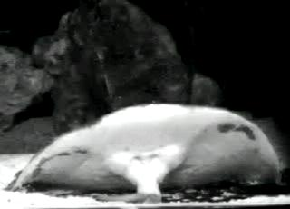
Math & Nature
Batoid jaw protrusion
Some batoids (stingrays and their relatives) protrude their jaws in a manner analogous to a “scissor-jack”
Lesser electric ray Narcine brasiliensis
© M. Dean (2012)

Slide 22
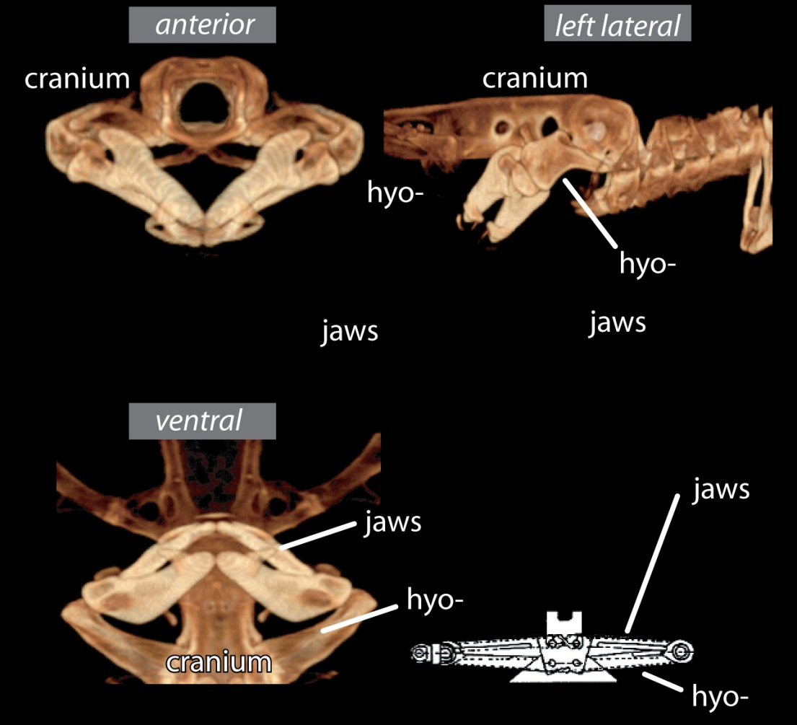
Math & Nature
Batoid jaw protrusion
Some batoids (stingrays and their relatives) protrude their jaws in a manner analogous to a “scissor-jack”
Lesser electric ray Narcine brasiliensis
© M. Dean (2012)

Slide 23
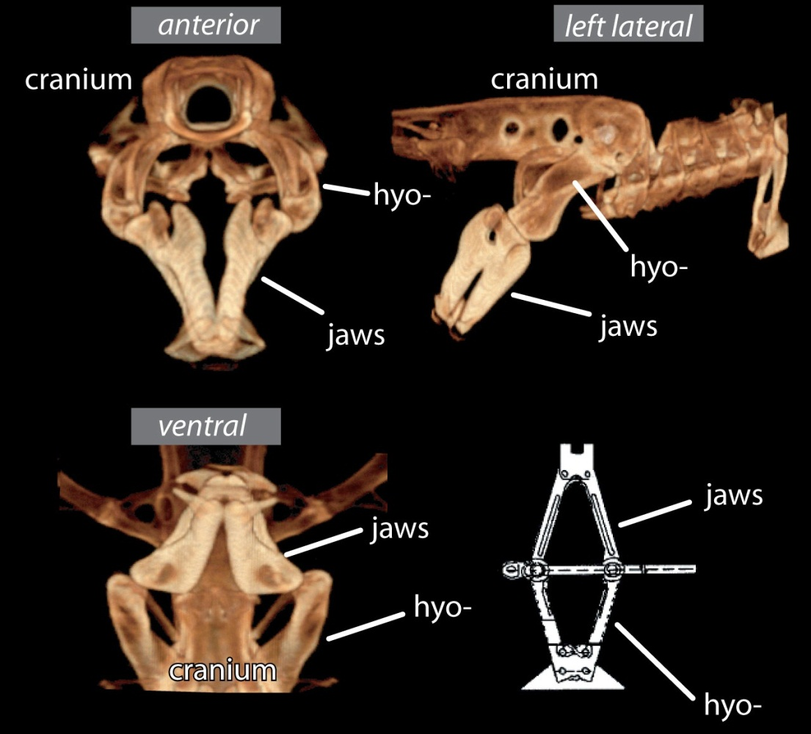
Math & Nature
Batoid jaw protrusion
Some batoids (stingrays and their relatives) protrude their jaws in a manner analogous to a “scissor-jack”
Lesser electric ray Narcine brasiliensis
© M. Dean (2012)

Slide 24
Math & Nature
Batoid jaw protrusion
“Scissor-jack” mechanism can be modeled as a pair of isosceles trapezoids
Jaws in resting state
Jaws in protruded state
© M. Dean (2012)

Slide 25
Math & Nature
Batoid jaw protrusion
“Scissor-jack” mechanism can be modeled as a pair of isosceles trapezoids
Jaws in resting state
Jaws in protruded state

Slide 26
Math & Nature
Batoid jaws in the resting state
Given
ABCF and DEFC are isosceles trapezoids.
FC bisects angle AFE and angle BCD.
Find the measurement of each angle not already given.

Slide 27
Math & Nature
Batoid jaws in the resting state
Given
ABCF and DEFC are isosceles trapezoids.
FC bisects angle AFE and angle BCD.
Find the measurement of each angle not already given.

Slide 28
Math & Nature
Batoid jaws in the resting state
Given
ABCF and DEFC are isosceles trapezoids.
FC bisects angle AFE and angle BCD.
Are quadrilaterals ABCF and DEFC similar? Explain.

Slide 29
Math & Nature
Batoid jaws in the resting state
Given
ABCF and DEFC are isosceles trapezoids.
FC bisects angle AFE and angle BCD.
Are △CGB and △CHD similar? Explain.

Slide 30
Math & Nature
Batoid jaws in the resting state
Given
ABCF and DEFC are isosceles trapezoids.
FC bisects angle AFE and angle BCD.
Find the length of the batoid feeding mechanism from back to front.

Slide 31
Math & Nature
Batoid jaws in the resting state
Given
ABCF and DEFC are isosceles trapezoids.
FC bisects angle AFE and angle BCD.
Find the length of the batoid feeding mechanism from back to front.
1.29 + 1.45 = 2.74 cm

Slide 32
Math & Nature
Batoid jaws in the protruded state
Given
JKLP and NMPL are isosceles trapezoids.
Find the measurement of each angle not already given.

Slide 33
Math & Nature
Batoid jaws in the protruded state
Given
JKLP and NMPL are isosceles trapezoids.
Find the measurement of each angle not already given.

Slide 34
Math & Nature
Batoid jaws in the protruded state
Given
JKLP and NMPL are isosceles trapezoids.
Find the length of the batoid feeding mechanism from back to front.

Slide 35
Math & Nature
Batoid jaws in the protruded state
Given
JKLP and NMPL are isosceles trapezoids.
Find the length of the batoid feeding mechanism from back to front.
1.81 + 2.11 = 3.92 cm

Slide 36
Math & Nature
Batoid jaws in the protruded state
From how far above the sea floor can the batoid reach its food?

Slide 37
Math & Nature
Batoid jaws in the protruded state
From how far above the sea floor can the batoid reach its food?
3.92 - 2.74 = 1.18 cm

Slide 38
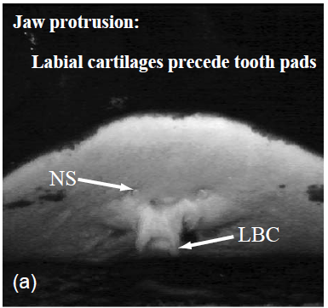
Math & Nature
Batoid jaws in the protruded state
From how far above the sea floor can the batoid reach its food?
3.92 - 2.74 = 1.18 cm
1 cm
Dean &Motta (2004)

Slide 39
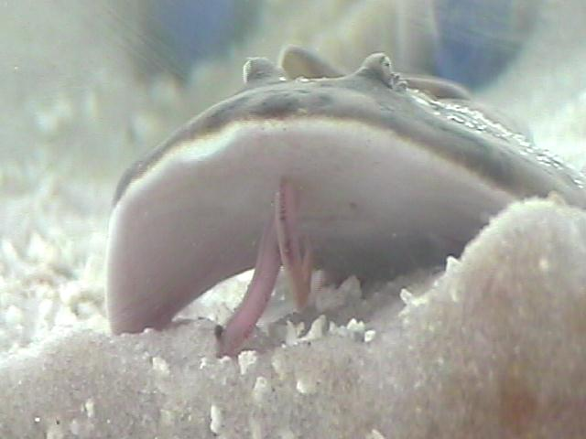
Math & Nature
Batoid jaws in the protruded state
From how far above the sea floor can the batoid reach its food?
3.92 - 2.74 = 1.18 cm
1 cm
Dean &Motta (2004)
© M. Dean (2012)

Slide 40
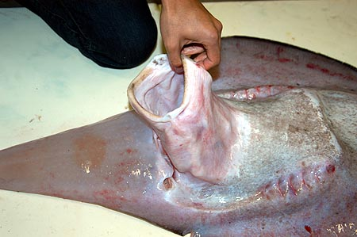
Math & Nature
Batoid jaws in the protruded state
From how far above the sea floor can the batoid reach its food?
Sixgill stingray Hexatrygon bickelli
© Laboratory of Marine Biology, Kochi University (2004)

Slide 41
Math & Nature
References
Dean, M.N. and Motta, P.J. (2004). Feeding behavior and kinematics of the lesser electric ray, Narcine brasiliensis (Elasmobranchii: Batoidea). Zoology. 107: 171 – 189.
Galileo Galilei, The Assayer, as translated by Stillman Drake (1957), Discoveries and Opinions of Galileo pp. 237 – 238. New York: Doubleday & Company.
Merrill, M.D. (2002). First principles of instruction. Educational Technology Research and Development. 50 (3): 43 – 59.
Reece, J.B., Urry, L.A., Cain, M.L., Wasserman, S.A., Minorsky, P.V., and Jackson, R.B. (2009). Campbell Biology, 9th Edition. Benjamin Cummings. San Francisco, CA.

