Slide 1
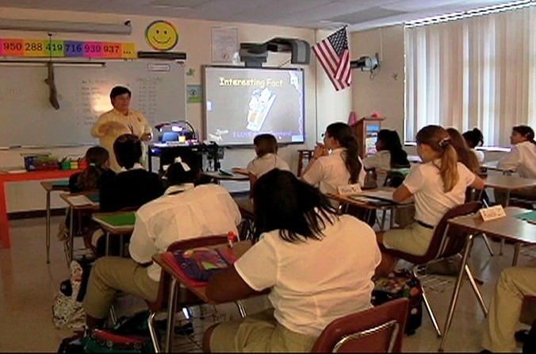
Informal Assessment Strategies for the Classroom
What to do to make you stand out when you are being evaluated

Slide 2
Informal Assessment
These assessments should be quick and easy ways to get a snapshot view of individual comprehension of the topic covered.
They should be done regularly but it is best practice to vary informal assessments and to align the assessment to the task.

Slide 3
Examples of Informal Assessments that may be used regularly in the classroom and during formal evaluations of your teaching
The following is a list of informal assessments and a brief description of each one.

Slide 4
Activity | Description
Quick Write | Student writes for 2-3 minutes about what he heard from a lecture or explanation/read/learned. Could be an open ended question from teacher.
12 Word Summary | In 12 words or less, have students summarize important aspects of a particular chunk of instruction or reading.
3-2-1 | Students jot down 3 ideas, concepts, or issues presented. Students jot down 2 examples or uses of idea or concept. Students write down 1 unresolved question or a possible confusion.
Muddiest Point | Students are asked to write down the muddiest point in the lesson (up to that point, what was unclear)
Quick class check | Give students paper plates, index cards, whiteboard, or large sheets of paper when they enter. When asking a question have ALL students write the answer and at your signal, have ALL students hold up the plate (or whatever) so that you can see who/ how many got the answer. Discussion to elaborate can follow.

Slide 5
Activity | Description
Class vote | Present several possible answers or solutions to a question or problem and have students vote on what they think is best.
Idea Wave | Each student lists 3-5 ideas about the assigned topic. One volunteer begins the “idea wave” by sharing his idea. The student to the right of the volunteer shares one idea; the next student to rights shares one idea. Teacher directs the idea wave until several different ideas have been shared. At the end of the formal idea wave, a few volunteers who were not included may contribute.
Tickets to enter and exit | Teacher asks students a specific question about the lesson. Students then respond on the ticket and gives to teacher, either on their way out or on their way in the next day. Teacher can then evaluate the need to re-teach or questions that need to be answered.
Four Corners | Teacher posts questions, concepts, or vocabulary words in each of the corners of the room. Each student is assigned a corner. Once in the corner, the students discuss the focus of the lesson in relation to the question, concept, or words. Students may report out or move to another corner and repeat. After students have moved, as a writing assignment they should be encouraged to reflect on changes in opinion or what they have learned.

Slide 6
Activity | Description
Give One/Get One | Students are given papers and asked to list 3-5 ideas about the learning. Students draw a line after their last idea to separate his/her ideas from classmate’s lists. Students get up and interact with one classmate at a time. Exchange papers, read your partner’s list, and then ask questions about new or confusing ideas.
Concept Mapping | Explain/ model a concept map. After lecture, explanation, or reading, have students fill in concept map (partner or individually). Report out.
Flash Cards | After 10 minutes into a lecture or concept presentation, have students create a flash card that contains the key concept or idea. Toward the end of the class, have students work in pairs to exchange ideas and review the material.
Learning Cell | Students develop questions and answers on their own (possibly using the Q-Matrix). Working in pairs the first student asks a question and the partner answers and vice versa. Each student can correct the other until a satisfactory answer is reached. (Good way to encourage students to go back to the text book).

Slide 7
Activity | Description
One Minute Paper | Teacher decides what the focus of the paper should be. Ask students “What was the most important thing you learned? What important question remains unanswered? Set aside 5-10 minutes of next class to discuss the results. May be used in the middle of a class also.
Signal Cards/thumbs up-thumbs down | Create cards to check for understanding. green means “I got it”, yellow means “I’m not sure, Maybe”, and blue means “I’m lost. I have questions”
Transfer and Apply | Students list what they have learned and how they might apply it to their real lives. Students list interesting ideas, strategies, concepts learned in class or chunk of class. They then write some possible way to apply this learning in their lives, another class, or in their community.
Circular check | Students in groups are given a problem with a definite answer (good for math & science). First students completes first step without contribution from others in group and passes it to the next student. Second student corrects any mistakes and completes next step, again with out input from the group. Problem gets passed to next student and the process continues until the group has the correct answer.

