Slide 1
Geometric Analysis of Muscle Function

Slide 2
Math & Nature
The universe is written in the language of mathematics
Galileo Galilei, 1623
Quantitative analysis of natural phenomena is at the heart of scientific inquiry
Nature provides a tangible context for mathematics instruction

Slide 3
The Importance of Context
Context
The part of a text or statement that surrounds a particular word or passage and determines its meaning.
The circumstances in which an event occurs; a setting.

Slide 4
The Importance of Context
Context-Specific Learning
Facilitates experiential and associative learning
Demonstration, activation, application, task-centered, and integration principles (Merrill 2002)
Facilitates generalization of principles to other contexts

Slide 5
Math & Nature
Geometry & Biology
Biological structures vary greatly in geometry and therefore represent a platform for geometric education
Geometric variability → functional variability → ecological variability
Mechanism for illustrating the consequences of geometry

Slide 6
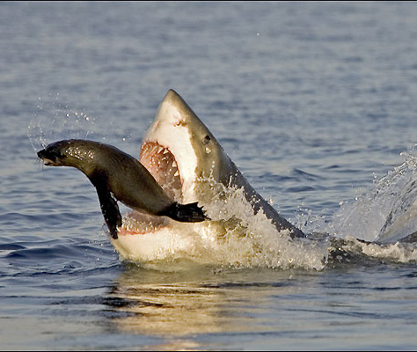
Math & Nature
Muscle performance determines animal behavior and ecology
Magnitude of force production
White shark bite force
4,095 lbs.
© Barcroft Media
Wrote et al. 2008

Slide 7
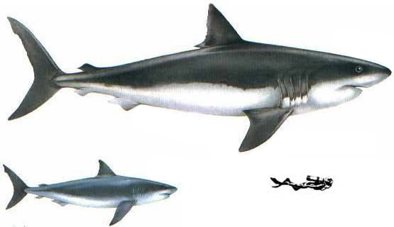
Math & Nature
Muscle performance determines animal behavior and ecology
Magnitude of force production
White shark bite force
4,095 lbs.
Megalodon bite force
40,960 lbs.
Wrote et al. 2008; © dinosaurs.wikia.com

Slide 8
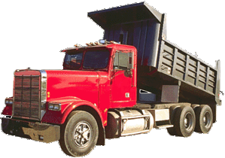
Math & Nature
Muscle performance determines animal behavior and ecology
Magnitude of force production
White shark bite force
4,095 lbs.
Megalodon bite force
40,960 lbs.
Wrote et al. 2008; © www.alwaystrucking.com

Slide 9
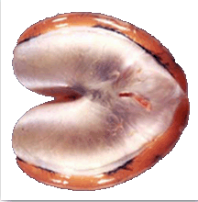
Math & Nature
Muscle performance determines animal behavior and ecology
Frequency of force production
Toadfish sonic muscle
2,000 Hz
Rice et al. 2011; © A. Rice, J. Luczkovich, J. Flemming

Slide 10
Math & Nature
Muscle performance determines animal behavior and ecology
Amplification of force production
Mantis shrimp striking
Patek and Caldwell (2005), Patek et al. (2013)

Slide 11
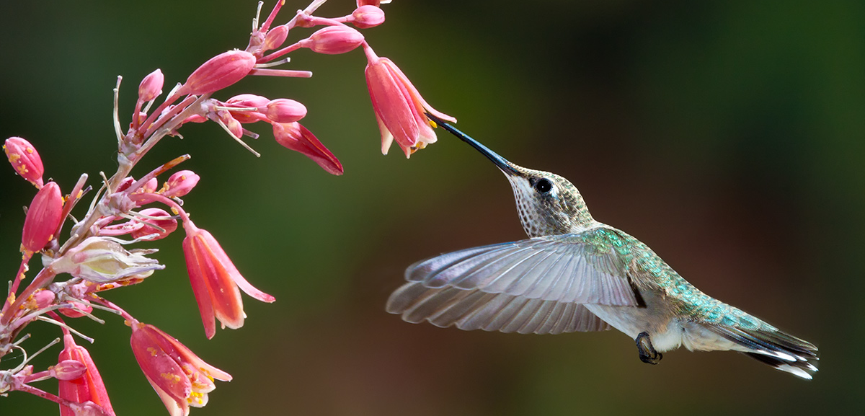
Math & Nature
Muscle performance determines animal behavior and ecology
Power generation
Hummingbird flight
$Power=\frac{Work}{Time}=\frac{Force×Distance}{Time}$
Chai and Millard 1997; © K. Bauer

Slide 12
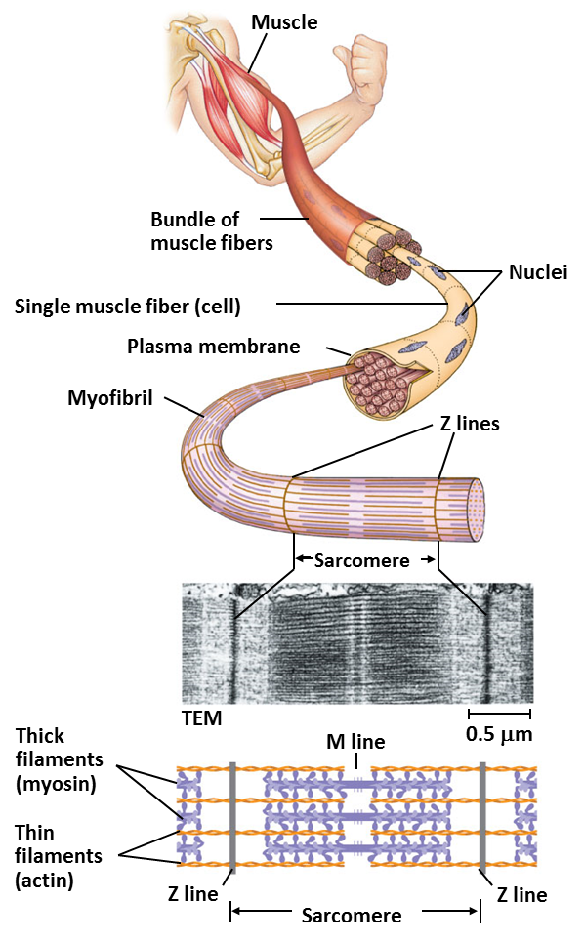
Math & Nature
Muscle structure and function
Actin and myosin
Sarcomeres
© Pearson Education Ltd.

Slide 13
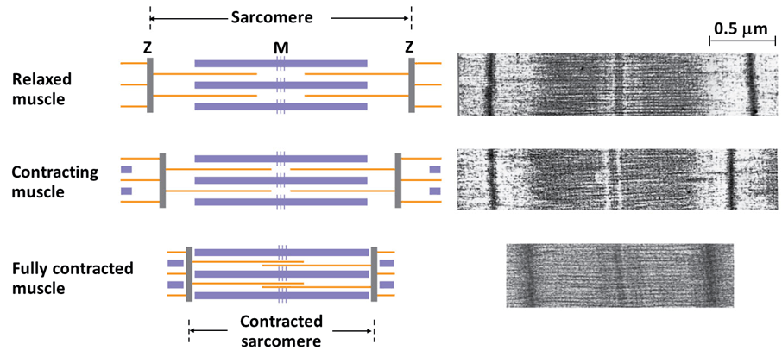
Math & Nature
Muscle structure and function
Sarcomere shortening → muscle shortening
© Pearson Education Ltd.

Slide 14
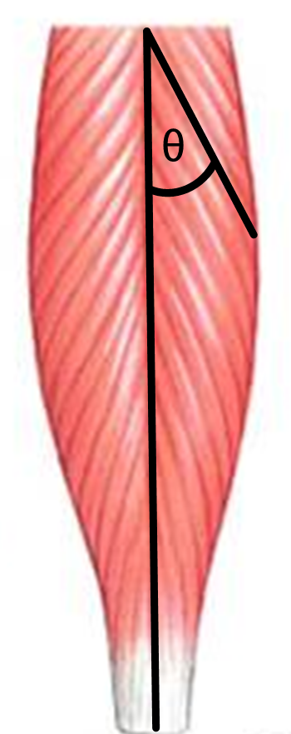
Math & Nature
Muscle structure and function
Muscle force is proportional to cross-sectional area
$F_{m}=\left({CSA}_{m}×T_{s}\right)×\cos{θ}$
$F_{m}=$ muscle force
${CSA}_{m}=$ muscle cross-sectional area
$T_{s}=$ specific tension
$θ=$ muscle fiber angle
© Pearson Education

Slide 15
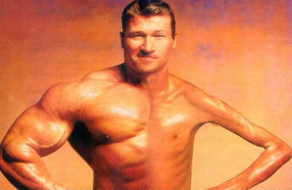
Math & Nature
Muscle structure and function
Muscle force is proportional to cross-sectional area
$F_{m}=\left({CSA}_{m}×T_{s}\right)×\cos{θ}$
$F_{m}=$ muscle force
${CSA}_{m}=$ muscle cross-sectional area
$T_{s}=$ specific tension
$θ=$ muscle fiber angle
© www.onproductmanagement.net

Slide 16
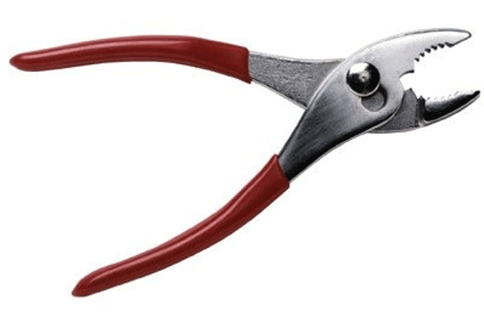
Math & Nature
Muscle structure and function
Muscle force is transmitted to the environment by bones
Lever mechanics
$F_{o}=F_{i}×\frac{L_{i}}{L_{o}}$
$F_{o}=$ Force output
$F_{i}=$ Force input
$L_{i}=$ In-lever length
$L_{o}=$ Out-lever length
$$L_{i}$$
$$L_{o}$$
$$F_{o}$$
$$F_{i}$$
© www.diylife.com

Slide 17
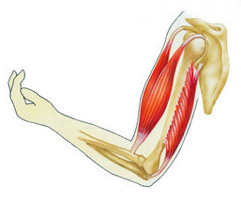
Math & Nature
Muscle structure and function
Muscle force is transmitted to the environment by bones
Lever mechanics
$F_{o}=F_{i}×\frac{L_{i}}{L_{o}}$
$F_{o}=$ Force output
$F_{i}=$ Force input
$L_{i}=$ In-lever length
$L_{o}=$ Out-lever length
$$F_{i}$$
$$F_{o}$$
$$L_{o}$$
$$L_{i}$$
© www.fotolibra.com

Slide 18
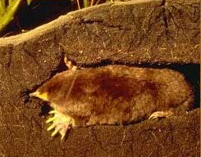
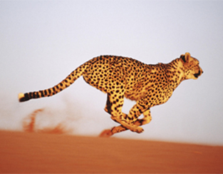
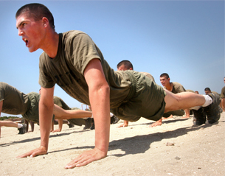
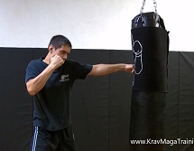
Math & Nature
Muscle structure and function
Triceps lever system
Uses
Digging
Running
Pushups
Punching
school.discoveryeducation.com, www.wallibs.com,
www.wikipedia.com, www.kravmagatraining.com

Slide 19
Math & Nature
Muscle structure and function
Triceps lever system
Question
How much force does your triceps lever system generate?
$$F_{i}$$
$$F_{o}$$
$$L_{o}$$
$$L_{i}$$
© www.fotolibra.com

Slide 20
Math & Nature
Geometry & Biology
NGSSS
MA.912.G.4.4 Use properties of congruent and similar triangles to solve problems involving lengths and areas.
MA.912.G.5.3 Use special right triangles (30⁰-60-90⁰ and 45⁰- 45⁰-90⁰) to solve problems.
MA.912.G.7.5 Explain and use formulas for lateral area, surface area, and volume of solids.

Slide 21
Math & Nature
Geometry & Biology
NGSSS
MA.912.G.8.2 Use a variety of problem-solving strategies, such as drawing a diagram, making a chart, guess-and-check, solving a simpler problem, writing an equation, and working backwards.
MA.912.T.2.1 Define and use the trigonometric ratios (sine, cosine, tangent, cotangent, secant, and cosecant) in terms of angles of right triangles.

Slide 22
Math & Nature
Geometry & Biology
CCSS
MACC.912.G-GMD.1.3 Use volume formulas for cylinders, pyramids, cones and spheres to solve problems.
MACC.912.G-GMD.2.4 Identify the shapes of two-dimensional cross-sections of three-dimensional objects, and identify three-dimensional objects generated by rotations of two-dimensional objects.

Slide 23
Math & Nature
Geometry & Biology
CCSS
MACC.912.G-MG.1.1 Use geometric shapes, their measures, and their properties to describe objects (e.g. modeling a tree trunk or a human torso as a cylinder.)
MACC.912.G-SRT.2.5 Use congruence and similarity criteria for triangles to solve problems and to prove relationships in geometric figures.

Slide 24
Math & Nature
Geometry & Biology
CCSS
MACC.912.G-SRT.3.8 Use trigonometric ratios and the Pythagorean Theorem to solve right triangles in applied problems.
MACC.K12.MP.4.1 Model with mathematics

Slide 25
Math & Nature
Triceps lever system model
Objective
Determine the amount of force generated by your triceps lever system
Procedure
Calculate triceps cross-sectional area (CSA_{t})
${CSA}_{t}=\frac{Triceps Volume}{Triceps Muscle Fiber Length}$
Calculate triceps muscle force (F_{t})
$F_{t} =({CSA}_{t}×T_{s})×\cos{θ}$
Calculate triceps lever system force (F_{tls})
$F_{tls}=F_{t}×\frac{L_{i}}{L_{o}}$

Slide 26
Math & Nature
Triceps lever system model
Measurements
C = Circumference of upper arm
L = Length of upper arm
Elbow to shoulder
W = Width of tip of elbow
$$C$$
$$L$$
© www.fotolibra.com

Slide 27
Math & Nature
Triceps lever system model
Measurements
C = Circumference of upper arm
L = Length of upper arm
Elbow to shoulder
W = Width of tip of elbow
L_{i} = In-lever length
Center to tip of elbow
L_{o} = Out-lever length (L_{o})
Center of elbow to wrist
$$L_{o}$$
$$L_{i}$$
© www.fotolibra.com

Slide 28
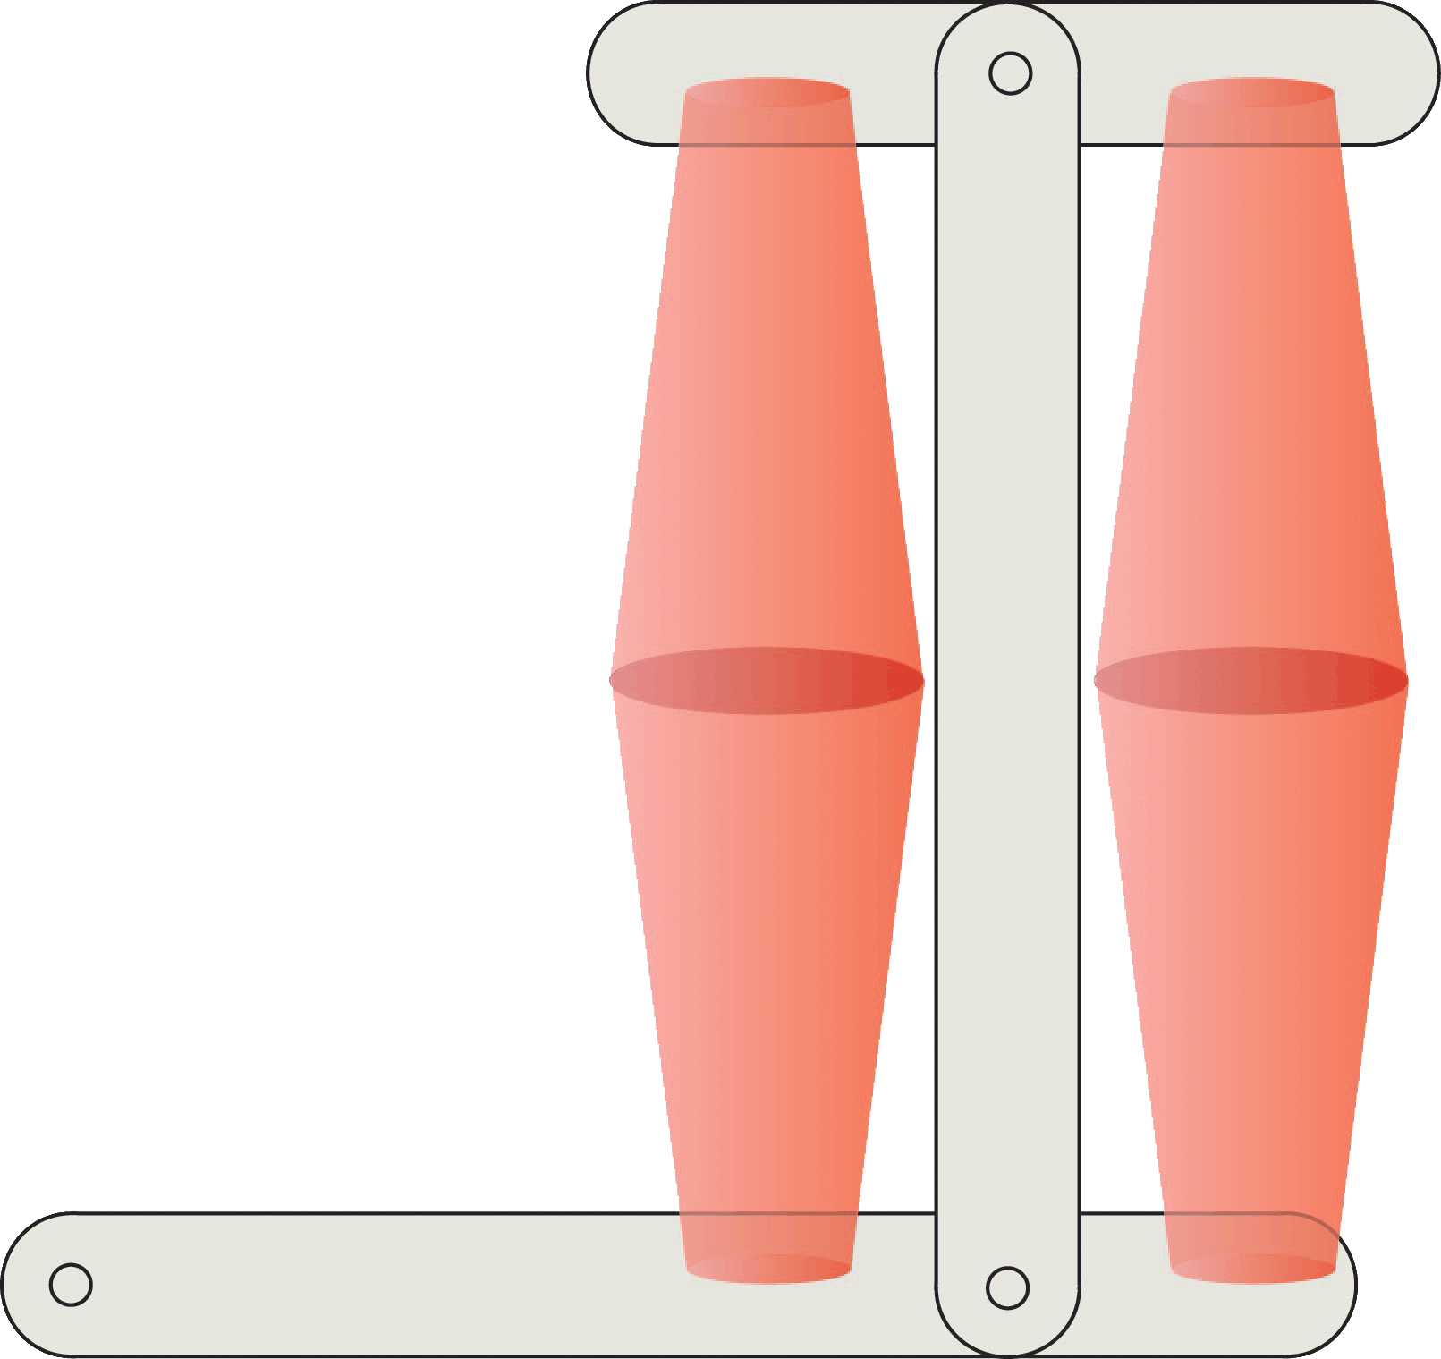
Math & Nature
Triceps lever system model
Given
Circumference of upper arm (C)
Length of upper arm from elbow to shoulder (L)
Width of tip of elbow (W)
Calculate triceps volume (V_{t})
Determine triceps radius (R_{t})
$D_{arm}=\frac{C}{π}$
$R_{arm}=\frac{D_{arm}}{2}$
$R_{t}=\frac{R_{arm}}{2}$
$$C$$
Notes:
USE GEOMETRIC FIGURE

Slide 29
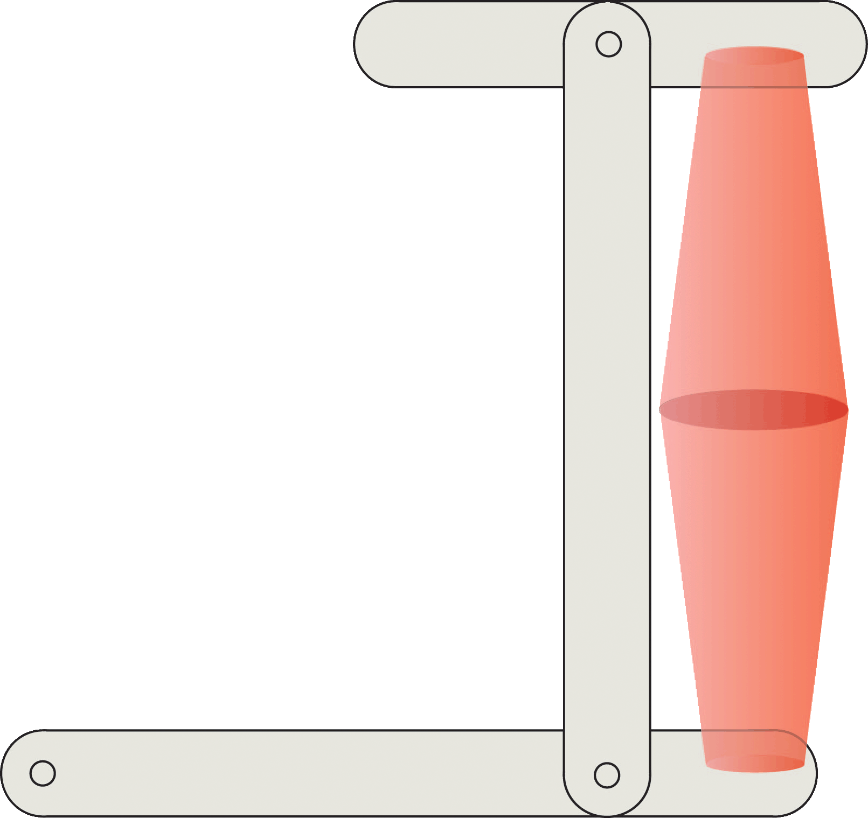
Math & Nature
Triceps lever system model
Given
Circumference of upper arm (C)
Length of upper arm from elbow to shoulder (L)
Width of tip of elbow (W)
Calculate triceps volume (V_{t})
Use similar triangles to determine full height of cone (H)
$\frac{H}{R_{t}}=\frac{H−\frac{L}{2}}{\frac{W}{2}}$
$$R_{t}$$
$$L$$
Notes:
USE GEOMETRIC FIGURE

Slide 30
Math & Nature
Triceps lever system model
Use similar triangles to determine full height of cone (H)
$$R_{t}$$
$$\frac{L}{2}$$
$$\frac{H}{R_{t}}=\frac{H−\frac{L}{2}}{\frac{W}{2}}$$
$$\frac{W}{2}$$
$$R_{t}$$
$$H$$
$$L$$
$$H−\frac{L}{2}$$
$$\frac{L}{2}$$
$$\frac{W}{2}$$
Notes:
USE GEOMETRIC FIGURE

Slide 31
Math & Nature
Triceps lever system model
Calculate triceps volume (V_{t})
Determine volume of truncated cone
$V=\frac{1}{3}π\left[\left({R_{t}}^{2}H\right)−\left({\left(\frac{W}{2}\right)}^{2}\left(H−\frac{L}{2}\right)\right)\right]$
$$R_{t}$$
$$\frac{L}{2}$$
$$H$$
$$\frac{W}{2}$$
$$H−\frac{L}{2}$$
Notes:
USE GEOMETRIC FIGURE

Slide 32
Math & Nature
Triceps lever system model
Calculate triceps volume (V_{t})
Determine volume of truncated cone
$V=\frac{1}{3}π\left[\left({R_{t}}^{2}H\right)−\left({\left(\frac{W}{2}\right)}^{2}\left(H−\frac{L}{2}\right)\right)\right]$
Account for top and bottom cones of triceps
$V_{t}=2×V$
$$R_{t}$$
$$L$$
$$\frac{L}{2}$$
$$\frac{W}{2}$$
Notes:
USE GEOMETRIC FIGURE

Slide 33
Math & Nature
Triceps lever system model
Given
Triceps radius (R_{t})
Triceps muscle fiber angle (Θ) = 45°
Calculate triceps muscle fiber length (FL_{t})
${FL}_{t}=\frac{R_{t}}{\sin{θ}}=R_{t}\sqrt{2}$
θ
FL_{t}
R_{t}

Slide 34
Math & Nature
Triceps lever system model
Given
Triceps volume (V_{t})
Triceps muscle fiber length (FL_{t})
Calculate triceps cross-sectional area (CSA_{t})
${CSA}_{t}=\frac{V_{t}}{{FL}_{t}}$
θ
FL_{t}
R_{t}

Slide 35
Math & Nature
Triceps lever system model
Given
Triceps cross-sectional area (CSA_{t})
Specific tension (T_{s}) = 51 lb/in²
Triceps muscle fiber angle (Θ) = 45°
Calculate triceps muscle force (F_{t})
$F_{t} =({CSA}_{t}×T_{s})×\cos{θ}$
θ
FL_{t}
R_{t}

Slide 36
Math & Nature
Triceps lever system model
Given
Triceps muscle force (F_{t})
In-lever length (L_{i}) from center of elbow to tip of elbow
Out-lever length (L_{o}) from center of elbow to wrist
Calculate triceps lever system force production (F_{tls})
$F_{tls}=F_{t}×\frac{L_{i}}{L_{o}}$
$$F_{tls}$$
$$F_{t}$$
$$L_{o}$$
$$L_{i}$$

Slide 37
Math & Nature
References
Chai, P. and Millard, D. (1997). Flight and size constraints: Hovering performance of large hummingbirds under maximal loading. Journal of Experimental Biology. 200: 2757 – 2763.
Patek, S.N. and Caldwell, R.L. (2005). Extreme impact and cavitation forces of a biological hammer: strike forces of the peacock mantis shrimp Odontodactylus scyllarus. Journal of Experimental Biology. 208: 3655-3664.
Patek, S.N., Rosario, M.V., and Taylor, J.R.A. (2013). Comparative spring mechanics in mantis shrimp. Journal of Experimental Biology. 216: 1317-1329.
Rice, A.N., Land, B.R., and Bass, A.H. (2011). Nonlinear acoustic complexity in a fish ‘two-voice’ system. Proceedings of the Royal Society B: Biological Sciences. 278: 3762 – 3768.
Wroe, S., Huber, D., Lowry, M., McHenry, C., Moreno, K., Clausen, T.L. Ferrara, P., Cunningham, E., Dean, M., and Summers, A. (2008). Three-dimensional computer analysis of white shark jaw mechanics: How hard can a great white bite? Journal of Zoology. 276: 336 – 342.

