Slide 1
Science Math Masters

Slide 2
Icebreakers: Webs
1. Sit or stand in large circle
2. First person holds the ball of twine and shares the following information:
Name
Number of years teaching
Rate yourself on scale of 1 – 5 on how prepared you feel to implement CCSS (1 meaning not well-prepared and 5 meaning very prepared)
One interesting fact about yourself
3. Toss the ball of twine to a person across the circle and that person will share the same information.
4. Continue tossing the ball around the room until every person in the team has a chance to participate.
Notes:
http://lc.wayne.edu/pdf/icebreakers_teambuilders.pdf

Slide 3
Icebreakers: Webs
By tossing the string around the group, participants have woven a web, which connects all the members of the team in the same manner.
The group facilitator then asks two or three members to “drop” their string. The web begins to sag and appears to be very weak and vulnerable. The facilitator can then discuss how important each participant is to the team and the effect that low levels of involvement and commitment has on the entire team.
If time allows, the team can unravel the string and talk about another topic or issue while rewinding the twine. Group members can also cut a piece of the string from the web to keep as a reminder of the exercise and the thoughts the group shared.
Notes:
http://lc.wayne.edu/pdf/icebreakers_teambuilders.pdf

Slide 4
NGSSS: MA.912.G.6.6: Given the center and the radius, find the equation of a circle in the coordinate plane or given the equation of a circle in center-radius form, state the center and the radius of the circle. MA.912.G.6.7: Given the equation of a circle in center-radius form or given the center and the radius of a circle, sketch the graph of the circle.
Equations of Circles

Slide 5
What does a typical textbook problem look like?
What differences do you expect to see in the CCSS?

Slide 6
Where we’re headed with the Common Core…
MACC.912.G-GMD.2.4: Identify the shapes of two-dimensional cross-sections of three-dimensional objects, and identify three-dimensional objects generated by rotations of two-dimensional objects.
MACC.912.G-GPE.1.1: Derive the equation of a circle of given center and radius using the Pythagorean Theorem; complete the square to find the center and radius of a circle given by an equation.

Slide 7
In what course do you think the prerequisite skills are taught in the Common Core curriculum?
The algebraic skills required for this problem are covered by the following Algebra I Common Core State Standard.

Slide 8
MACC.912.A-REI.2.4 : Solve quadratic equations in one variable. (a)Use the method of completing the square to transform any quadratic equation in x into an equation of the form (x – p)² = q that has the same solutions. Derive the quadratic formula from this form. (b) Solve quadratic equations by inspection (e.g., for x² = 49), taking square roots, completing the square, the quadratic formula and factoring, as appropriate to the initial form of the equation. Recognize when the quadratic formula gives complex solutions and write them as a ± bi for real numbers a and b.
MACC.912.F-IF.3.8: Write a function defined by an expression in different but equivalent forms to reveal and explain different properties of the function.
(a) Use the process of factoring and completing the square in a quadratic function to show zeros, extreme values, and symmetry of the graph, and interpret these in terms of a context. (b)Use the properties of exponents to interpret expressions for exponential functions.

Slide 9
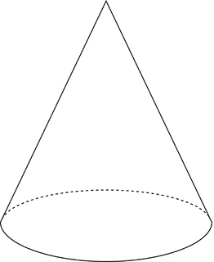
Where we’re headed with the Common Core…
Explain that definitions of conic sections come from the intersection of a plane with a double-napped right circular cone.
Have students predict the shapes found by the following:
the intersection of a double-napped right circular cone and a plane perpendicular to the axis of the cone.
the intersection of a double-napped right circular cone and a plane neither parallel nor perpendicular to the axis of the cone.
Notes:
Clarify that it does not go through the intersection point of the two cones.

Slide 10
Ideas for Lesson Components

Slide 11
Warm-up (to access prior knowledge)
Factor to solve.
1.
2.
3.
4. What do problems 1 through 3 have in common?
In the quadratic equations of form ax²+bx+c=0
given in problems 1 through 3 above, what is the relationship between “b” and “c”?
6. Solve by completing the square:
Refer to Handout 1
Notes:
Refer to Circles Activity 1 Handout

Slide 12
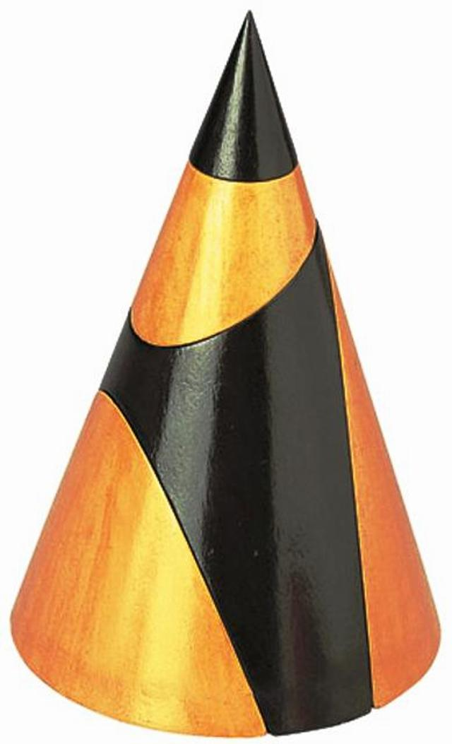
Concrete/Hands-on Model

Slide 13
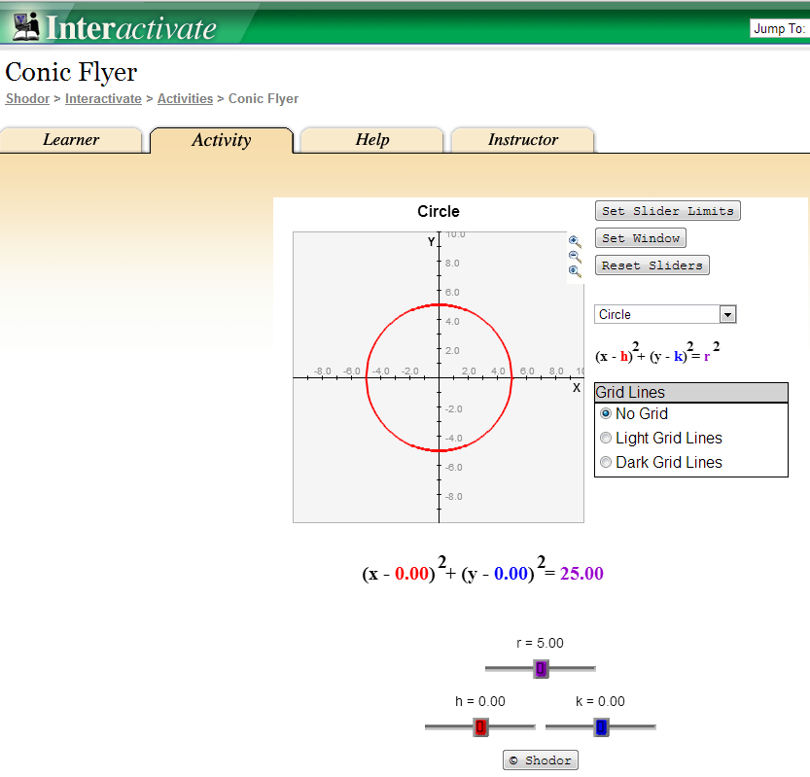
Applet
Notes:
http://www.shodor.org/interactivate/activities/ConicFlyer/

Slide 14
More Advanced Applet
Notes:
http://cs.jsu.edu/~leathrum/Mathlets/conics.html#instr

Slide 15
YouTube
Notes:
http://www.youtube.com/watch?v=bFOnicn4bbg

Slide 16
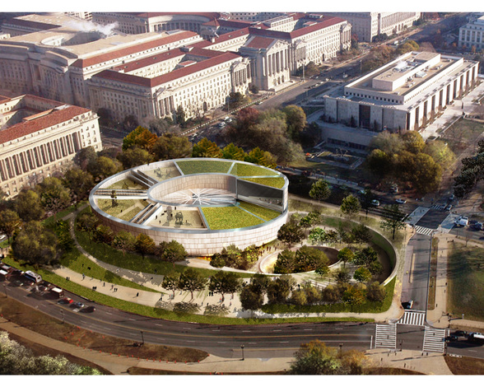
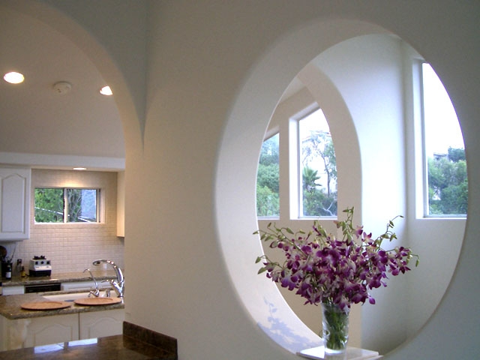
Application (to motivate/hook)
Museum design – washingtonpost.com
http://www.prweb.com/releases/2006/01/prweb338844.htm
Notes:
http://www.crystalinks.com/day8circlemagic.html

Slide 17
Work in pairs to complete question #1 of the activity Analyzing Equation of a Circle. Use chart paper and markers to display a visual representation.
Equations of Circles
Notes:
Venn diagrams, tables, etc., can be used.

Slide 18
Now complete the activity Analyzing Equation of a Circle and post the second page to share with your peers.
Equations of Circles
A. Center: (2,-1); r = 3
B. Center: (-3,-4); r = 4
C. Center: (1,-3); r = 5

Slide 19
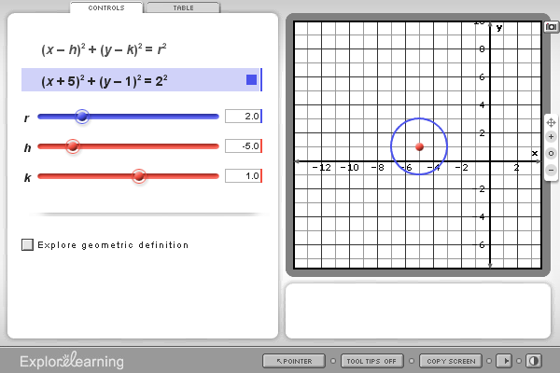
Check the solutions to determine if your hypothesis was correct.
Equations of Circles
The graph shows the circle with center (-5,1) and radius 2.

Slide 20
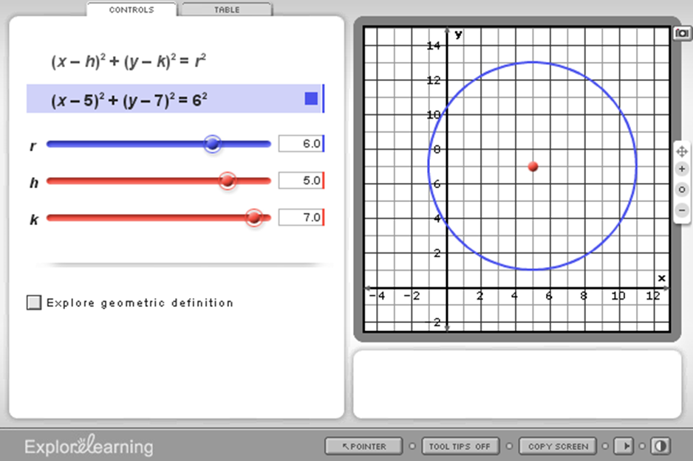
Check the solutions to determine if your hypothesis was correct.
Equations of Circles
The graph shows the circle with center (5,7) and radius 6.

Slide 21
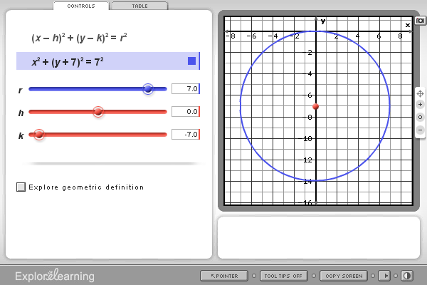
Check the solutions to determine if your hypothesis was correct.
Equations of Circles
The graph shows the circle with center (0,-7) and radius 7.
Note: The circles applet from explorelearning.com was used to create the graphs.

Slide 22
Work in groups to complete activity Deriving Equation of Circle & Identifying Center and Radius .
Equations of Circles
Solutions

Slide 23
CPALMS is an online toolbox of information, vetted resources, and interactive tools that helps educators effectively implement teaching standards. It is the State of Florida’s official source for standards information and course descriptions. http://www.cpalms.org
CPALMS

Slide 24
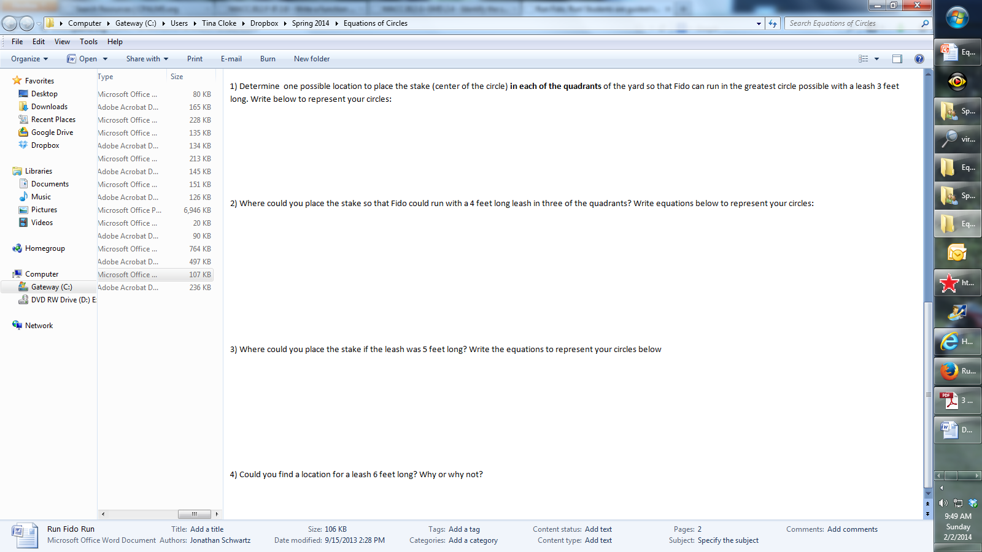
Run Fido, Run!
Work in pairs to complete activity Run Fido, Run!

Slide 25
Run Fido, Run!
Guiding Questions:
How can we pinpoint an exact location in this diagram using mathematical tools or concepts?
we can setup a Cartesian coordinate system
How many dimensions can Fido run?
2
If Fido wasn't confined in the back yard, what shape will give the greatest amount of area Fido can run in if tethered to a stake in the ground?
a circle
Where do you think the stake should be placed? And why? (after completing activity) Were you correct? How did you find the best location?

Slide 26
Run Fido, Run!
Work in pairs to write three additional questions for the activity Run Fido, Run!

