Slide 1
Science Math Masters: Activities

Slide 2
Activity I: Creature Project

Slide 3
MACC.912.G-MG.1.1: Use geometric shapes, their measures, and their properties to describe objects (e.g., modeling a tree trunk or a human torso as a cylinder). MACC.912.G-MG.1.3: Apply geometric methods to solve design problems (e.g., designing an object or structure to satisfy physical constraints or minimize cost; working with typographic grid systems based on ratios)

Slide 4
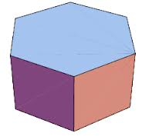
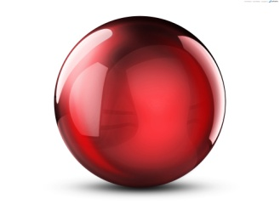
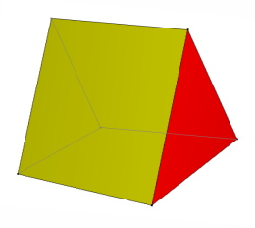
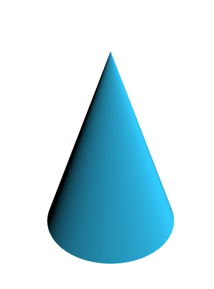
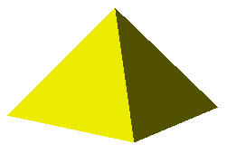
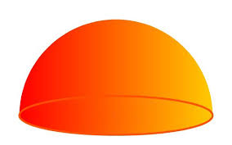
Review: Use the examples below to help you define Polyhedra and Non-Polyhedra.
Polyhedra Non-Polyhedra
Polyhedra: a solid with flat faces
Non-Polyhedra: solid with any surface that is not flat

Slide 5
Working with your shoulder partner, sort your shapes into polyhedra and non-polyhedra.

Slide 6
Hook
Halo 4 - Return of the Forerunners
Video Documentary Part 2
Click above text to link to video

Slide 7
Creature Contest
Working with a partner, you are going to create a toy creature that could be a character in a video game.
You must:
Use at least ten 3-dimensional shapes
Have at least 3 polyhedra and 3 non-polyhedra
All shapes must be complete (no partial shapes)
Your shapes must be independent, as your creature must be able to be assembled, disassembled, and reassembled. It will become part of a set (like Legos!)
No weapons or inappropriate language are allowed!
But…. There’s a catch….

Slide 8
Creature Contest
The game developer is giving you one piece of sheet metal from which all your shapes must be cut. The dimensions are equal to the size of the poster board you will be given.
Your job is to have the least amount of wasted material.
The group that follows all the parameters and has the least amount of waste is the winner!
*Refer to Contest Information Sheet*

Slide 9
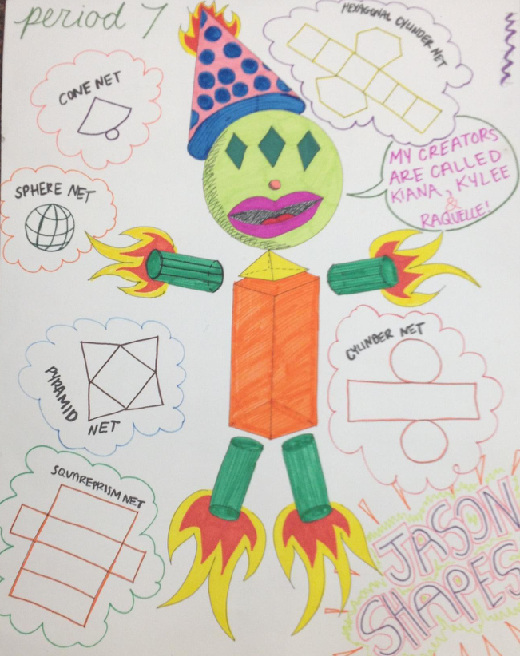
Creature Contest

Slide 10
Which mathematical practices were demonstrated in this activity?
Image copied from The Charles A. Dana Center at the University of Texas at Austin
Notes:
Review after going over project.
Image copied from The Charles A. Dana Center at the University of Texas at Austin

Slide 11
Activity II: Mira

