Slide 1
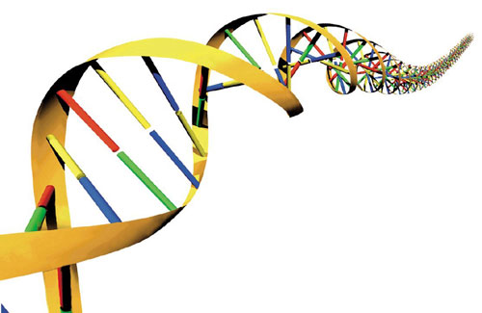
Geometric Analysis of Shell Morphology

Slide 2
Math & Nature
The universe is written in the language of mathematics
  Galileo Galilei, 1623
Quantitative analysis of natural phenomena is at the heart of scientific inquiry
Nature provides a tangible context for mathematics instruction

Slide 3
The Importance of Context
Context
  The part of a text or statement that surrounds a particular word or passage and determines its meaning.
  The circumstances in which an event occurs; a setting.

Slide 4
The Importance of Context
Context-Specific Learning
  Facilitates experiential and associative learning
    Demonstration, activation, application, task-centered, and integration principles (Merrill 2002)
  Facilitates generalization of principles to other contexts

Slide 5
Math & Nature
Geometry & Biology
  Biological structures vary greatly in geometry and therefore represent a platform for geometric education
  Geometric variability → functional variability → ecological variability
    Mechanism for illustrating the consequences of geometry

Slide 6
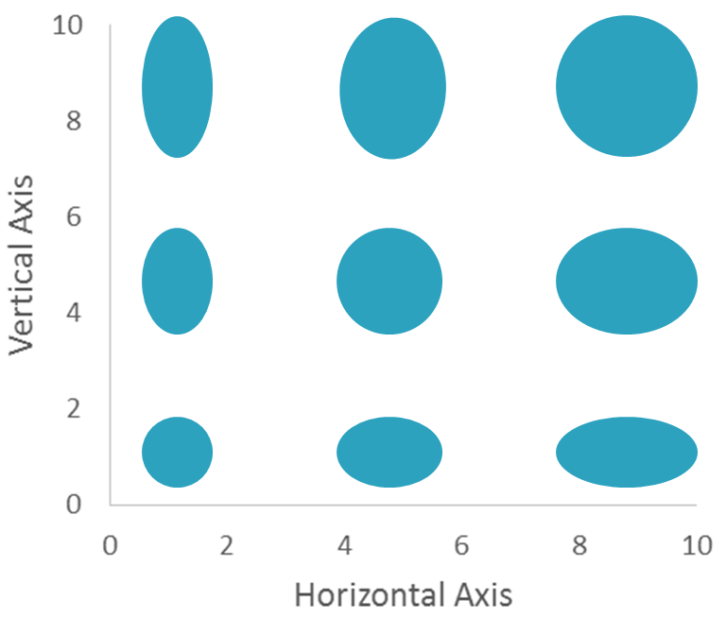
Math & Nature
Morphospace is the range of possible geometries found in organisms
  Variability of ellipse axes

Slide 7
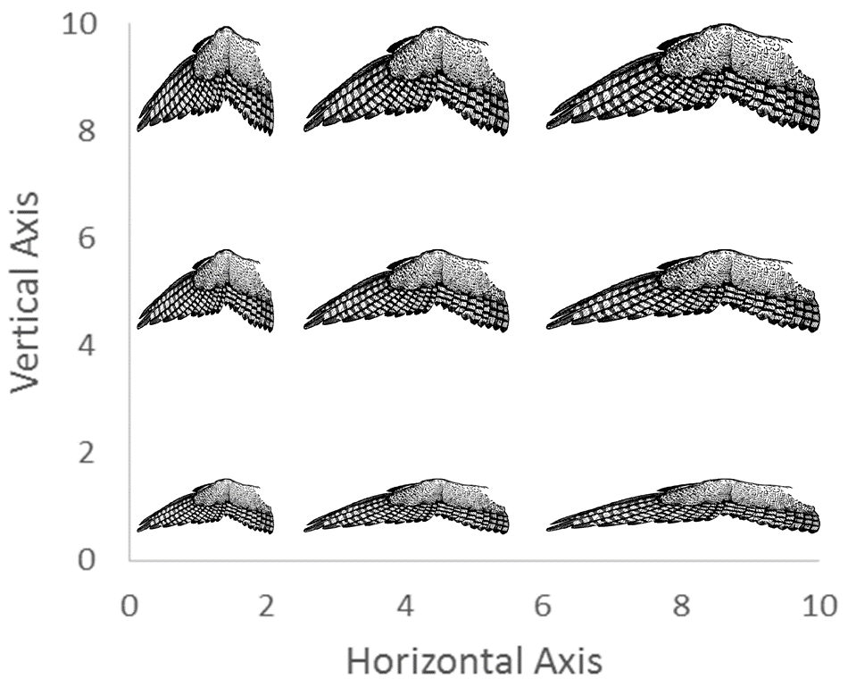
Math & Nature
Morphospace is the range of possible geometries found in organisms
  Bird wing geometry

Slide 8
Math & Nature
Morphospace is the range of possible geometries found in organisms
  Why are only certain portions of morphospace occupied?
    Evolution has not produced all possible geometries
    Extinction has eliminated certain geometries
    Functional constraints exist on morphology

Slide 9
Math & Nature
Morphospace is the range of possible geometries found in organisms
  Functional constraints on morphology
    Bird wing shape

Slide 10
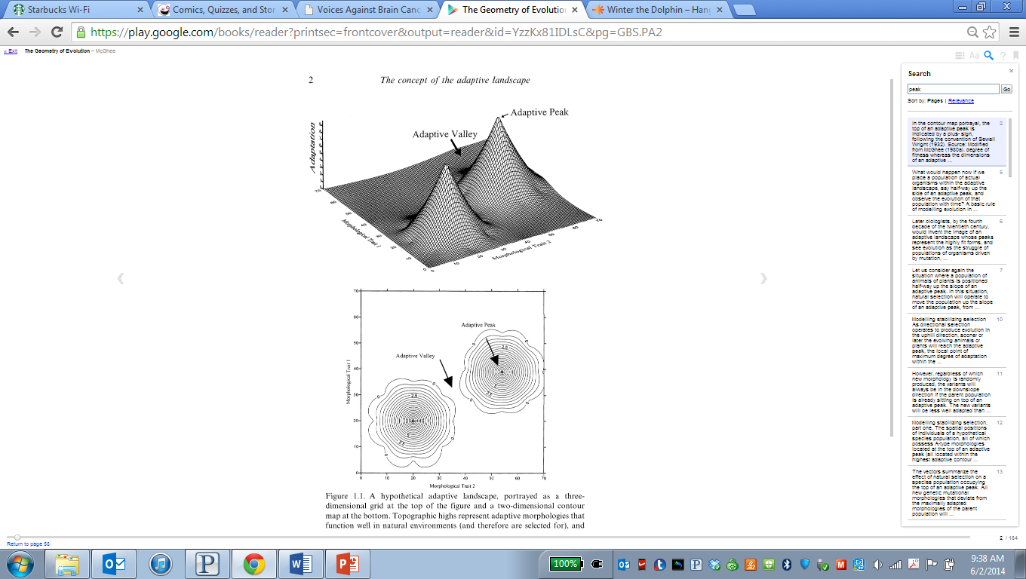
Math & Nature
Morphospace is the range of possible geometries found in organisms
  Adaptive peaks in morphospace
    “Life is a high-country adventure” (Kauffman 1995)
McGhee 2006

Slide 11
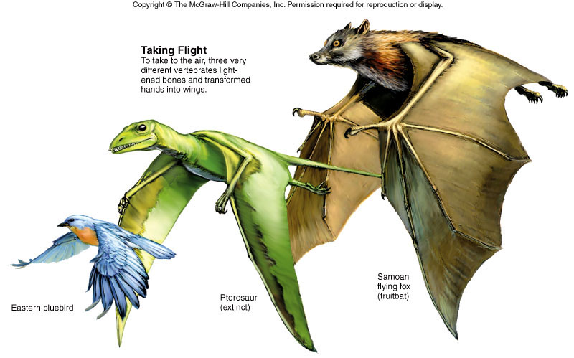
Math & Nature
Morphospace is the range of possible geometries found in organisms
  Adaptive peaks in morphospace
    Convergent evolution
Reece et al. 2009

Slide 12
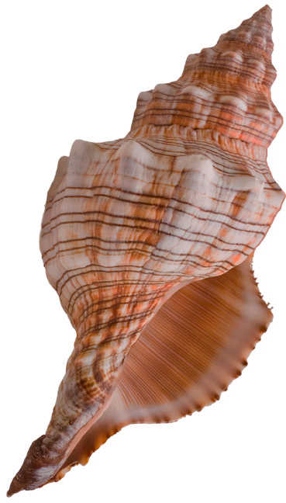
Math & Nature
Spiral shell geometry
  Convergent evolution
Foraminiferans
Cephalopods
Nautilids
Gastropods
soer.justice.tas.gov.au,
www.nationalgeographic.com,
alfaenterprises.blogspot.com

Slide 13
Math & Nature
Spiral shell geometry
  Cephalopods past & present
Ammonites
Nautilids
lgffoundation.cfsites.org,
www.nationalgeographic.com

Slide 14
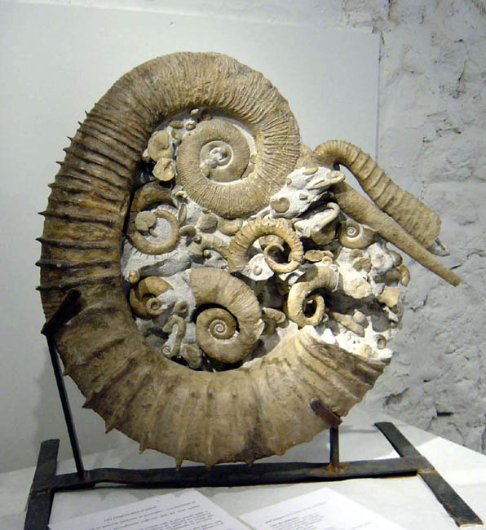
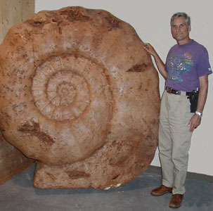
Math & Nature
Ammonite shell geometry
  Size
www.dailykos.com

Slide 15
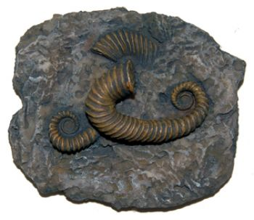
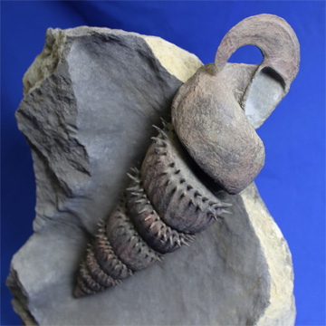
Math & Nature
Ammonite shell geometry
  Shape
lgffoundation.cfsites.org,
www.paleoart.com,
www.fossilrealm.com

Slide 16
Math & Nature
Ammonite shell geometry
  Spiral dimensions
    W = whorl expansion rate
      ↓ W ↑ W
    D = distance from axis
      ↓ D ↑ D
    T = translation rate
      ↓ T ↑ T

Slide 17
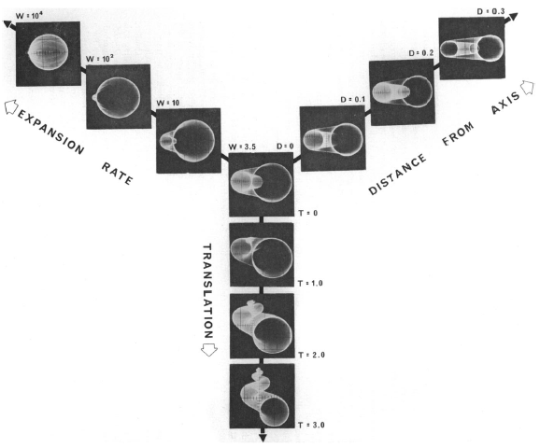
Math & Nature
Ammonite shell geometry
  Spiral dimensions
W
D
T
Raup 1966

Slide 18
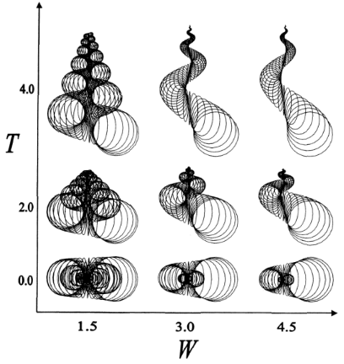
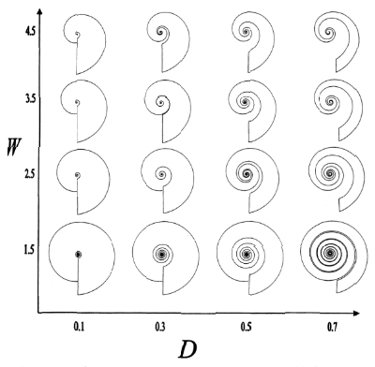
Math & Nature
Ammonite shell geometry
  Morphospace
McGhee 2006

Slide 19
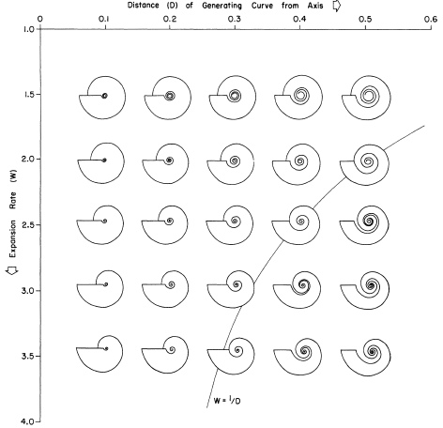
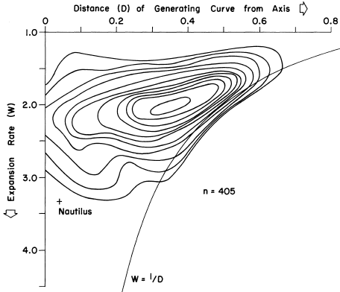
Math & Nature
Ammonite shell geometry
  Which parts of ammonite morphospace are most occupied?
Raup 1967

Slide 20
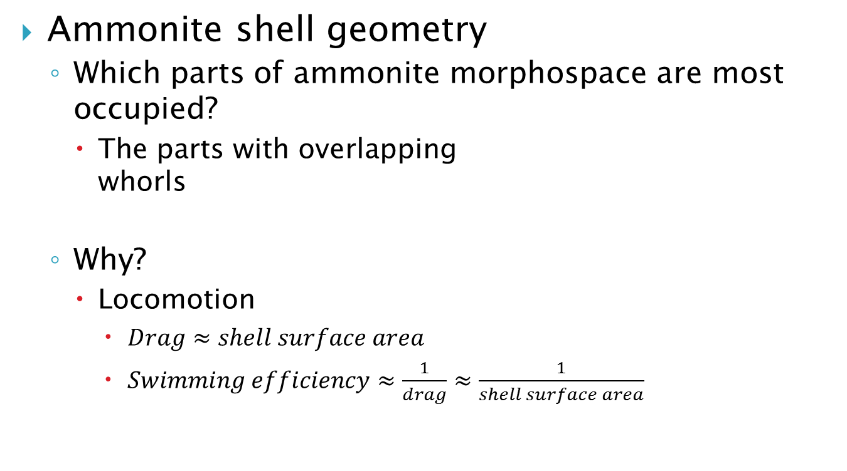
Math & Nature
Ammonite shell geometry
  Which parts of ammonite morphospace are most occupied?
    The parts with overlapping whorls
  Why?
    Locomotion
      $Drag≈shell surface area$
      $Swimming efficiency≈\frac{1}{drag}≈\frac{1}{shell surface area}$

Slide 21
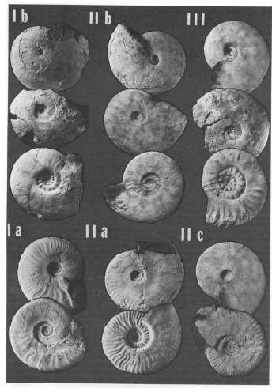
Math & Nature
Ammonite shell geometry
  How has ammonite morphospace changed over evolutionary history?
    Sea level changes
      Shallow water forms
      Deep water forms
Bayer & McGhee 1984

Slide 22
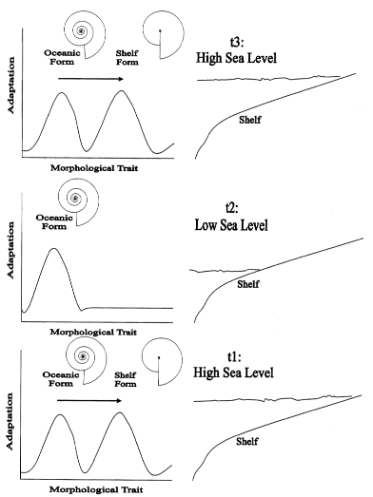
Math & Nature
Ammonite shell geometry
  How has ammonite morphospace changed over evolutionary history?
    Sea level changes
      Shallow water forms
      Deep water forms
      Convergent evolution x 3
    Why?
      ↑ coiling = ↑ strength in deep (high pressure) environment
      ↓ ornamentation = ↓ drag in shallow (high flow) environment
McGhee 2006

Slide 23
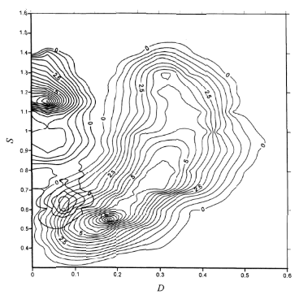
Math & Nature
Ammonite shell geometry
  What happened when the ammonites went extinct?
    Nautilids invaded their morphospace!
X
Ward 1980

Slide 24
Math & Nature
Ammonite shell geometry
  Question
    How do shell surface area and volume differ among ammonites with overlapping and non-overlapping whorls?
lgffoundation.cfsites.org,
www.paleoart.com

Slide 25
Math & Nature
Geometry & Biology
  Florida Standards
    MAFS.912.G-GMD.1.3: Use volume formulas for cylinders, pyramids, cones, and spheres to solve problems.

Slide 26
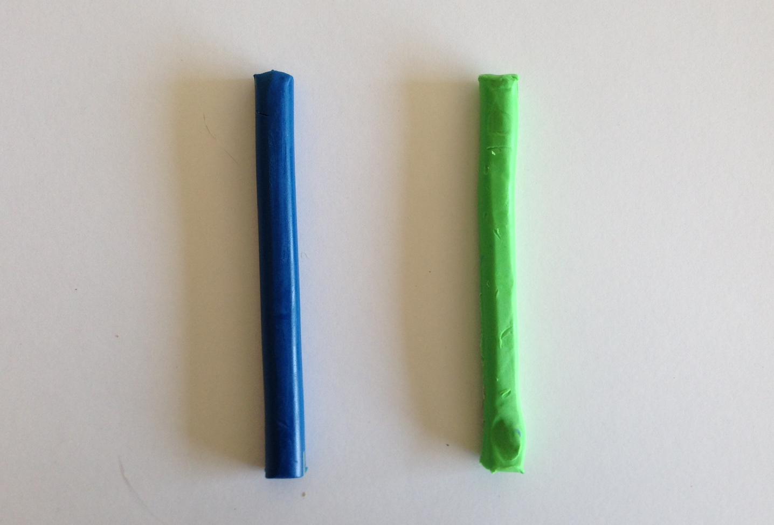
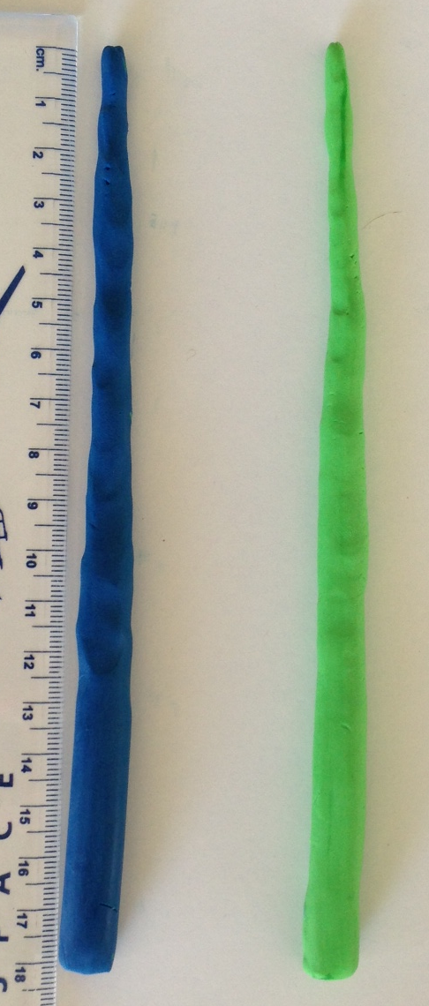
Math & Nature
Ammonite shell models
  Non-overlapping and overlapping whorls
    Procedure
      Use clay to create two shell models of equal size
      Measure their height and radius

Slide 27
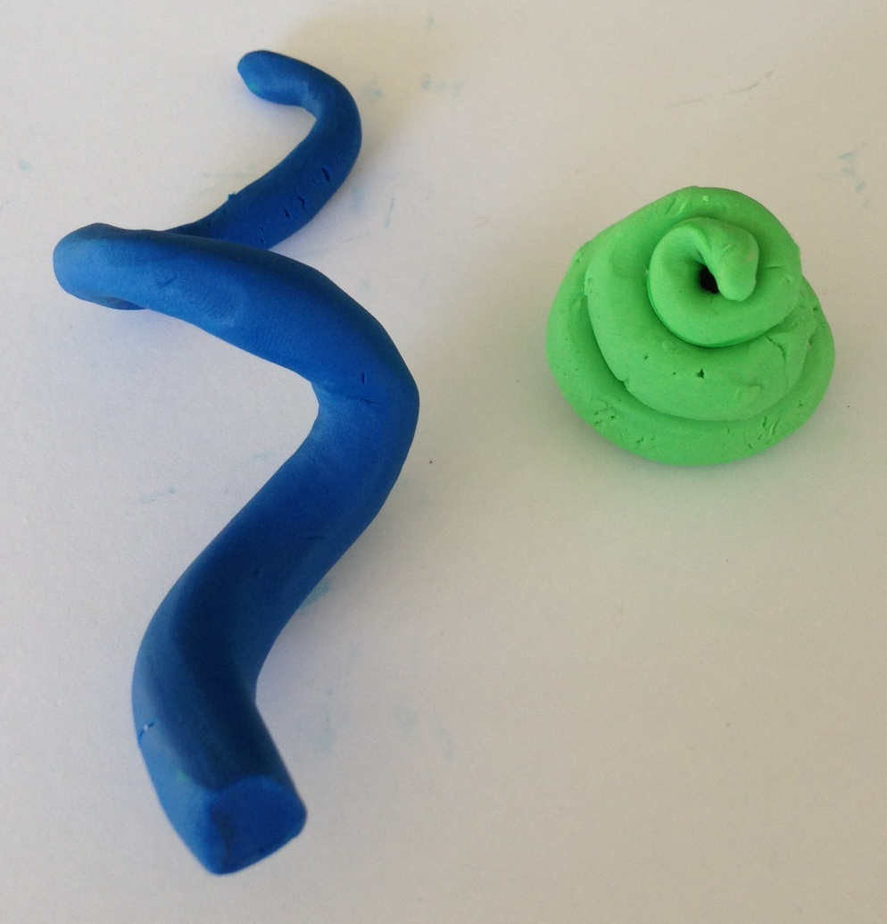
Math & Nature
Ammonite shell models
  Non-overlapping and overlapping whorls
    Procedure
      Twist one of the cones into a model with non-overlapping whorls and the other into a model with overlapping whorls

Slide 28
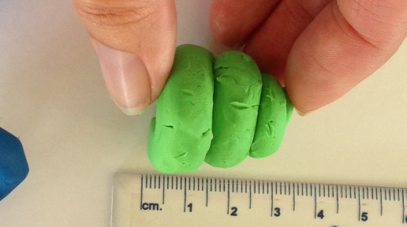
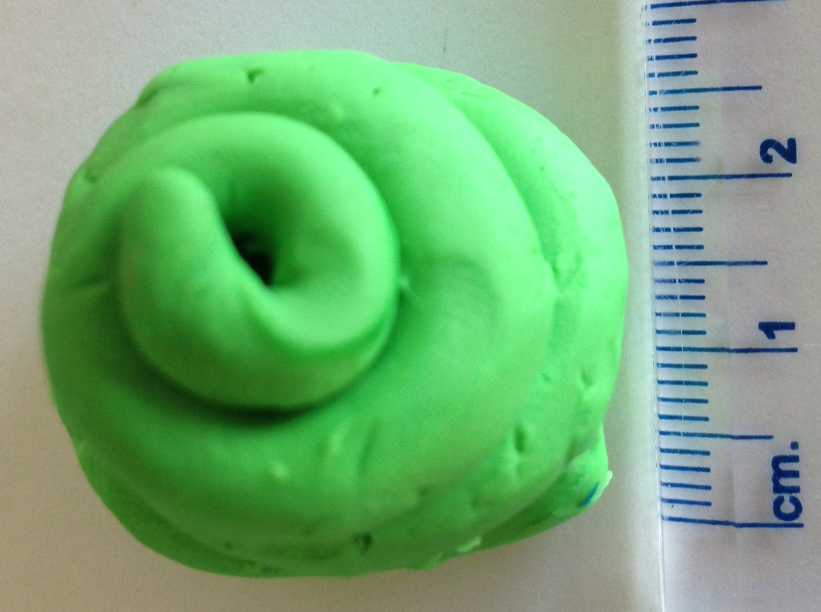
Math & Nature
Ammonite shell models
  Non-overlapping and overlapping whorls
    Procedure
      Measure the height and radius of the model with overlapping whorls

Slide 29
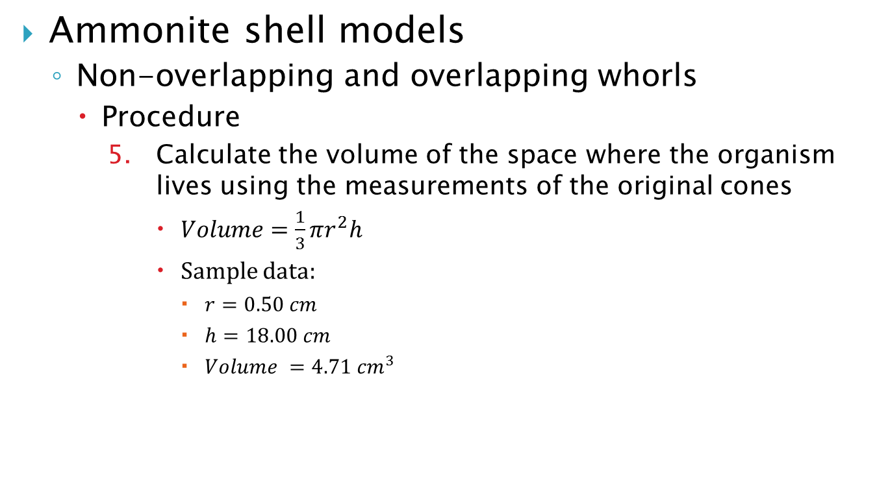
Math & Nature
Ammonite shell models
  Non-overlapping and overlapping whorls
    Procedure
      Calculate the volume of the space where the organism lives using the measurements of the original cones
        $Volume=\frac{1}{3}πr^{2}h$
        Sample data:
          $r=0.50 cm$
          $h=18.00 cm$
          $Volume =4.71 {cm}^{3}$

Slide 30
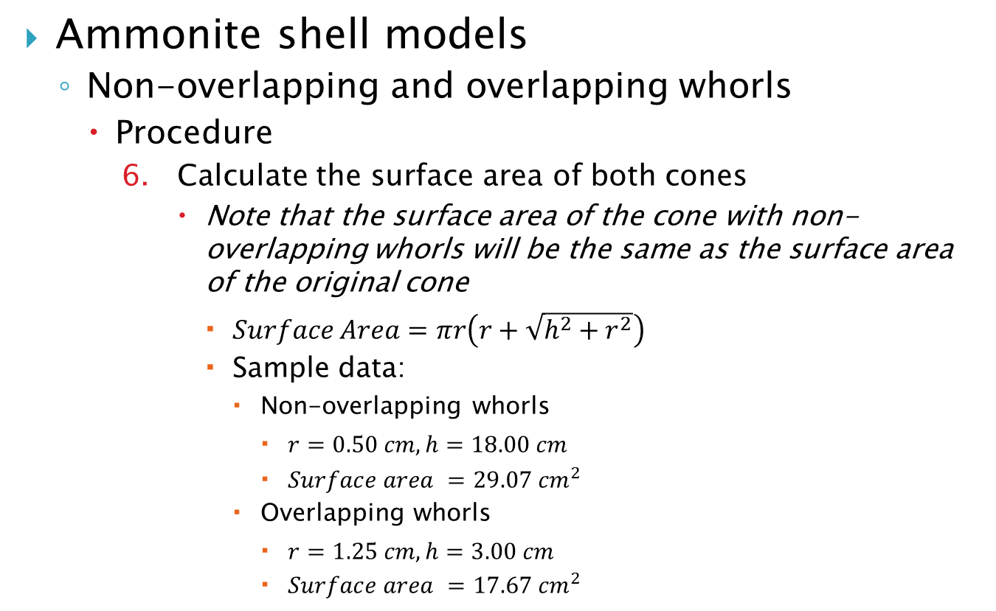
Math & Nature
Ammonite shell models
  Non-overlapping and overlapping whorls
    Procedure
      Calculate the surface area of both cones
        Note that the surface area of the cone with non-overlapping whorls will be the same as the surface area of the original cone
          $Surface Area=πr\left(r+\sqrt{h^{2}+r^{2}}\right)$
          Sample data:
            Non-overlapping whorls
              $r=0.50 cm, h=18.00 cm$
              $Surface area =29.07 {cm}^{2}$
            Overlapping whorls
              $r=1.25 cm, h=3.00 cm$
              $Surface area =17.67 {cm}^{2}$

Slide 31
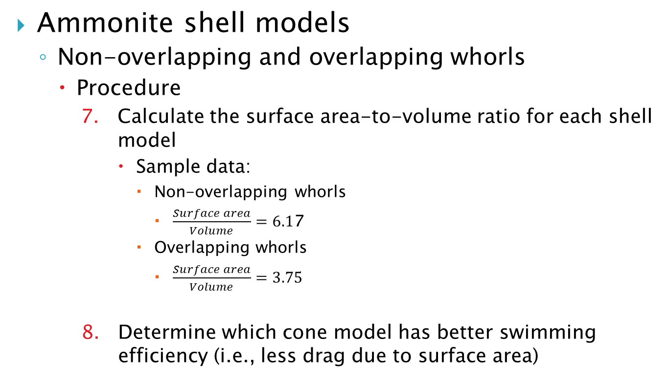
Math & Nature
Ammonite shell models
  Non-overlapping and overlapping whorls
    Procedure
      Calculate the surface area-to-volume ratio for each shell model
        Sample data:
          Non-overlapping whorls
            $\frac{Surface area}{Volume}=6.1$7
          Overlapping whorls
            $\frac{Surface area}{Volume}=3.75$
      Determine which cone model has better swimming efficiency (i.e., less drag due to surface area)

Slide 32
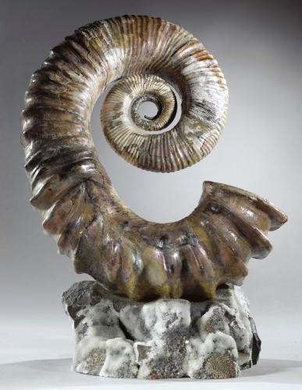
Math & Nature
Ammonite shell models
  Additional work
    Surface area and volume comparisons of deep water and shallow water shell types
      Question
        Why is ornamentation less common in shallow (low flow) environment?
www.fossilrealm.com,
www.thefossilstore.com

Slide 33
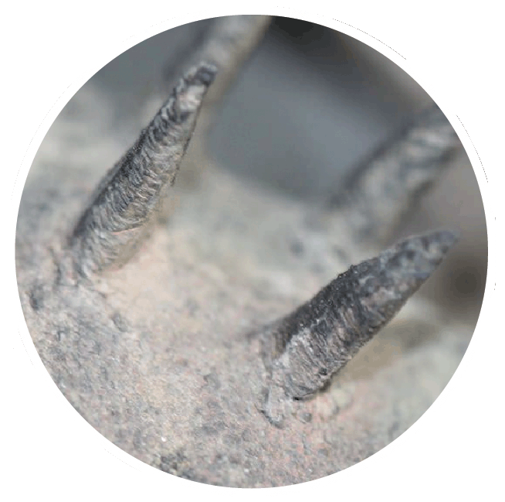
Math & Nature
Ammonite shell models
  Additional work
    Surface area and volume comparisons of deep water and shallow water shell types
      Procedure
        Simulate ornamentation by adding geometric objects to surface of cone and measuring changes in surface area
www.fossilrealm.com

Slide 34
Math & Nature
References
  Bayer, U. and McGhee, G.R. (1984). Iterative evolution of Middle Jurassic ammonite faunas. Lethaia. 17: 1-16.
  Kauffman, S. (1995). At Home in the Universe: The Search for Laws of Self-Organization and Complexity. Oxford University Press.
  McGhee, G.R. (2006). The Geometry of Evolution. Cambridge University Press.
  Raup, D. M. (1966). Geometric analysis of shell coiling: general problems. Journal of Paleontology. 40: 1178 – 1190.
  Raup, D. M. (1967). Geometric analysis of shell coiling: coiling in ammonoids. Journal of Paleontology. 41: 42-65.
  Reece, J.B., Urry, L.A., Cain, M.L., Wasserman, S.A., Minorsky, P.V., and Jackson, R.B. (2009). Campbell Biology, 9th Edition. Benjamin Cummings. San Francisco, CA.

