Slide 1
Science Math Masters

Slide 2
Agenda
Getting Connected
Informational Slides
Bones, Muscles and Math
Transitioning to Common Core Thinking: Circles

Slide 3
Informational Slides

Slide 4
How do students in Florida compare to the rest of the nation educationally?

Slide 5
Education Week
State rankings in the annual report, Quality Counts
2007: FL ranked #31
2011: FL jumped to #5
2012: FL dropped to #11
http://www.edweek.org/ew/qc/2012/16src.h31.html?intc=EW-QC12-LFTNAV
Notes:
Florida’s dramatic climb from 31st to 5th in just four years – the only state in the nation to experience such a stunning rise in the ranks – illustrates the progress achieved by schools under a system of high expectations for students, accountability for schools and an array of educational choices for families
Needs Assessment:
All students are below 50% proficiency on FCAT Science at all grade levels
33% gap between African-American students and White students
21% gap between Hispanic students and White students

Slide 6
In Mathematics?
National Assessment for Educational Progress (NAEP), 2011
Congressionally authorized project
Compares performance of 8th grade students
Used for international comparison
Trends in International Mathematics and Science Study (TIMSS) – just released
http://nationsreportcard.gov/reading_math_2013/#/state-performance
Notes:
NAEP is a congressionally authorized project of the National Center for Education Statistics (NCES) within the Institute of Education Sciences of the U.S. Department of Education. The Commissioner of Education Statistics is responsible for carrying out the NAEP project. The National Assessment Governing Board oversees and sets policy for NAEP.
For instance, approximately 122,000 eighth-graders from 7,290 schools participated in the 2011 grade 8 science assessment.

Slide 7
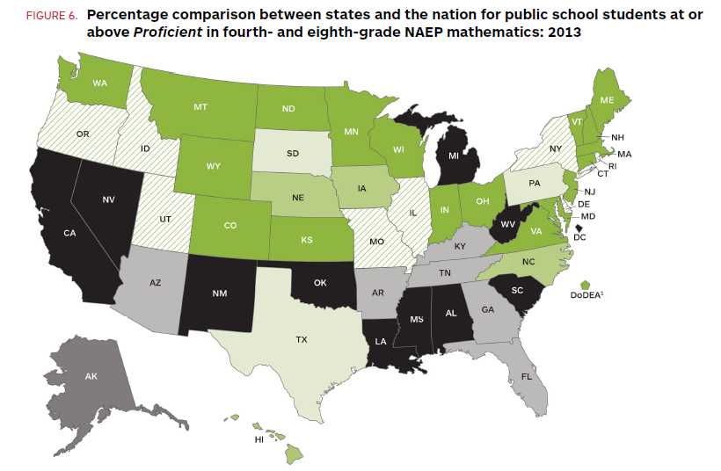

Slide 8
State Results in Geometry Spring 2013

Slide 9
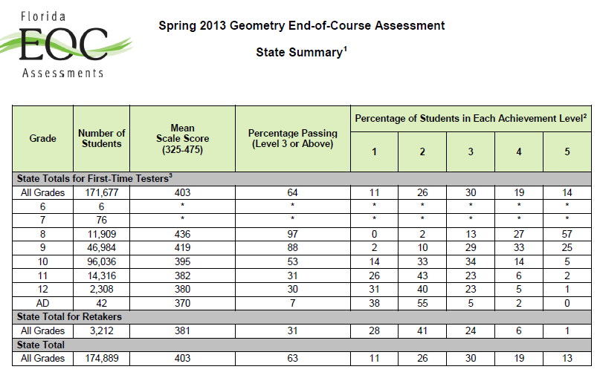

Slide 10
Graduation Requirements

Slide 11
Education Bill CS/CS/HB 7091
Passed April 2013
Effective July 1, 2013
New High School Diploma Requirements
Notes:
passed as CS/CS/SB 1720. The bill establishes new standard high school diploma requirements for students entering 9th grade in the 2013-14 school year and thereafter, alters course and testing requirements for current high school students, and establishes Scholar and Merit diploma designations. Current students will no longer be required to pass the Biology I and Geometry end-of-course (EOC) assessments to earn course credit. Instead, except for students who already took these courses, the assessments count 30 percent of a student’s final course grade. These assessments also count 30 percent of a student’s final course grade for students entering 9th grade in the 2013-14 school year, and thereafter. No student is required to earn a credit in Algebra II and Chemistry or Physics in order to earn a standard high school diploma. High school students may earn a Scholar designation if they satisfy course and testing requirements above-and-beyond those required for a standard diploma, e.g., earn credits in Algebra II and Chemistry or Physics and an equally rigorous science course and pass the Biology I and U.S. History EOC assessments. Students pursuing a Merit designation must attain one or more industry certifications

Slide 12
Prior to CS/CS/HB 7091
Subject Area | Traditional 24-Credit Option Diploma
English | 4 credits ELA 1, 2, 3, 4 Pass 10th Grade FCAT Reading Mandatory FCAT Writing
Mathematics | 4 credits including: Algebra I, Geometry, & Algebra II Pass Algebra I and Geometry EOC assessments
Science | 3 credits, 2 credits must have a laboratory component, Biology I required Pass Biology EOC Assessment
Social Studies | 3 credits: 1 U.S. History; 1 World History; 0.5 Economics; 0.5 US Government US History EOC counts as 30% of the final course grade
Fine & Performing Arts | 1 credit
Physical Education | 1 credit
Electives | 8 credits

Slide 13
Students Entering Ninth Grade in 2012-2013
Standard Diploma
4 Credits in Mathematics
One in Algebra 1, pass Algebra I EOC
One in Geometry
Scholar Diploma Designation
One credit in Algebra 2, pass Algebra 2 assessment once implemented
One credit in statistics or an equally rigorous mathematics course
Merit Diploma Designation
Attain one or more industry certifications

Slide 14
Students Entering Ninth Grade in 2013-2014
Standard Diploma
4 Credits in Mathematics
One in Algebra I, pass Algebra I EOC
One in Geometry
Industry certification courses that lead to college credit may substitute for up to 2 mathematics credits
Scholar Diploma Designation
One credit in Algebra 2, pass statewide assessment
One credit in statistics or an equally rigorous mathematics course
Merit Diploma Designation
Attain one or more industry certifications

Slide 15
Comparison of Standard Diploma Mathematics Requirements
Prior to HB 7091
4 Mathematics credits to include Algebra I, Geometry and Algebra II, and pass the Algebra 1 EOC and the Geometry EOC
Freshmen entering in 2012-2013
4 Mathematics credits to include Algebra I and Geometry, pass the Algebra I EOC
Freshmen entering in 2013-2014
4 Mathematics credits to include Algebra I and Geometry, pass the Algebra I EOC
Industry certification courses that lead to college credit may substitute for up to 2 mathematics credits

Slide 16
Information about the upcoming geometry EOC

Slide 17
Highlights from the Geometry EOC Assessment Fact Sheet
Spring Administration Window:
April 21 – May 23
160-minute session, 10-minute break after the first 80 minutes
Any student not finished by the end of the 160 minutes may continue working.
Maximum of 65 items
35-40 multiple choice
20-25 fill-in response items
6 – 10 experimental (field test) items

Slide 18
Highlights from the Geometry EOC Assessment Fact Sheet
Students may request the use of an approved, hand-held scientific calculator
Schools may make copies of the reference sheet provided in the 2013-2014 EOC Assessments Test Administration Manual

Slide 19
Highlights from the Geometry EOC Assessment Fact Sheet

Slide 20
Highlights from the Test Design Summary for Geometry
Two-Dimensional Geometry 65%
Three-Dimensional Geometry 20%
Trigonometry and Discrete Mathematics 15%

Slide 21
Highlights from the Test Design Summary for Geometry
Percentage of Points by
Cognitive Complexity Level
Low 10-20%
Moderate 60-80%
High 10-20%

Slide 22
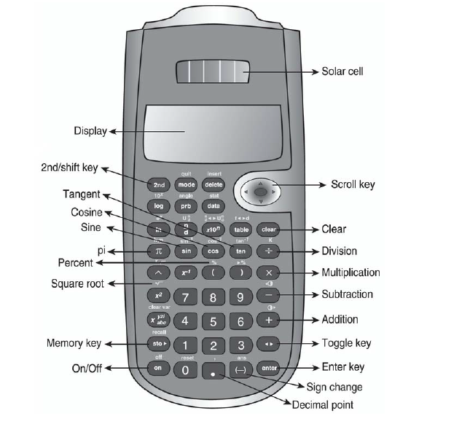
Highlights from “Calculator Tips”
“Students using the TI-30XS MultiView handheld calculator must set the mode to ‘CLASSIC.’”

Slide 23
Items in Your Folder
Agenda
Grad. Requirements: 2012-2013 9th graders
Grad. Requirements: 2013-2014 9th graders
Geometry EOC Assessment Fact Sheet
Test Design Summary
Sample ePats questions with calculator tips
Geometry Content Focus (2013) Forms 1,2,3
2014-2015 Standards as listed on cpalms

Slide 24
Resources

Slide 25
Resources
CPALMS
www.cpalms.org
Download the standards
Lesson plan ideas
The Science Math Masters (SM²) webpage
Model lessons
Assessment strategies
Calculator worksheet
Additional resources page
Registration for summer workshops

Slide 26
Science Math Master Website
http://utweb.ut.edu/rwaggett/science-math-master.html

Slide 27
ePats
Website for downloading ePats
http://www.pearsonaccess.com/cs/Satellite?c=Page&childpagename=Florida/flPALPLayout&cid=1205461226846&pagename=flPALPWrapper

Slide 28
Contact Information
lbjones@ut.edu
cbeaudoin@ut.edu
tina.cloke@sdhc.k12.fl.us
dhuber@ut.edu

