Slide 1
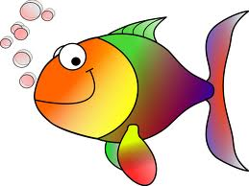
GO FISH

Slide 2
Chris Helminski (Math Teacher)
Linda Shepard (Media Specialist)
Linda and I work at an academy high school, Braden River High School, Manatee County, Florida. We were two of the teachers who opened this school, a school with an emphasis on interdisciplinary curriculum. We both enjoyed writing and implementing interdisciplinary curriculum and became partners in this endeavor. We have won three Bright House Star Teacher Awards and have been selected to present at several NCTM national conferences and at FCTM state conferences. Each year, we brainstorm a new idea for our annual collaborative project and spend countless hours in preparation for its implementation.

Slide 3
A Formula That Works For Us
Idea
Title
Create a calendar, reserve Media Center, computer labs, schedule guest speakers
Gather information
Plan research activity and culminating activity
Work independently and collaboratively to create power points, plan jumpstarts and activities
Implement unit

Slide 4
GO FISH
An Interdisciplinary Unit Of Mathematical Applications in the Aquatic Community

Slide 5



Mathematics – The Language
Mathematics is a language of pattern. Its linguistic structure seems to accurately reflect hidden, often unimaginable physical structures. It is about the relationship among numbers. Mathematicians analyze the basic language of arithmetic, and they use algebra to explore and generalize its grammatical rules. Mathematics is about grammar, structure, form and pattern which is why it is the language that is used to explain nature.

Slide 6
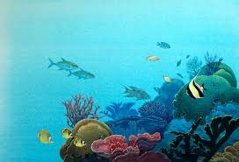
Applications of Mathematics
(Algebra and Geometry)
Stingray Behavior
Evolution of Shark Jaws
Incredible Puffer Fish
Escher Fish
Trout Pond Population
Fish Do Geometry
Fishing for the Best Prism
Which Fish Where?
Sounding the Sea
A Whale of a Scale
Sampling Fish Populations
Solving Fishy Problems

Slide 7
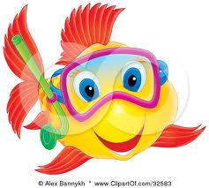
GO FISH PROJECTS

Slide 8
Select a Topic
Topics for the Report
Sea Turtle Tracking, Dolphin Prosthetics, Boat Building, Waves, Perfect Storm, Navigation, Tides, Beach Erosion, Shark Feeding, Fishing – Sport or Commercial, Maintaining
an Aquarium, The Coral
Reef, Climate Change
and Sea Level, and
Escher Fish.

Slide 9

Individual and Pair Student Projects
You and another student in your class will select a topic and conduct independent research to investigate a topic related to fish, marine mammals, or exploration of the ocean, its connection to mathematics and a famous person associated with the topic. You will each complete a two-page typed report about the topic and the related mathematics. You should use a 12 pt Times New Roman font in your report. The report must include a work-cited page in MLA format referencing a minimum of three Internet, text, video or interview sources. You must use more than one type of source.

Slide 10



Partner Project
Students will work in pairs to create a set of two “Go Fish” cards. One card will summarize the student research and one will illustrate the topic. Use the same title and initial image to facilitate matching during the game.
Materials: Oversized playing cards made of cardstock, student materials, scissors and glue. Art students from our school have created the uniform designs that will distinguish each class set of cards. I will show each group a sample pair to use as models.
We will be playing a “GO FISH” game as the culminating activity.
The game will require students to match cards that have
information from media specialist, student and teacher presentations
that showcase real-life connections between mathematics and
science, industry, music or art.

Slide 11

Essential Question: What is the Mathematics of your Topic?
1. Sea Turtle Tracking
Boat Design
Ocean Waves
Shark Feeding
Dolphin Prosthetics
Maintaining an Aquarium
Whale Communication
The Coral Reef
Climate Change and Sea Level
Escher “Fish”
Beach Erosion
Fishing (Sport or Commercial)
Tides
Navigation in Open Water
The “Perfect Storm”

Slide 12
Sign-Up Sheet for Each Class
Topic | 1st Student | 2nd Student
Sea Turtle Tracking
Boat Design
Ocean Waves
Shark Feeding
Dolphin Prosthetics
Maintaining an Aquarium
Whale Communication
The Coral Reef
Climate Change and Sea Level
Escher “Fish”
Beach Erosion
Fishing – Sport or Commercial
Tides
Navigation in Open Water
The “Perfect Storm”

Slide 13
Calendar of Events
Monday | Tuesday | Wednesday | Thursday | Friday
 |  |  |  | 3/1 (E) Media Center Research (A Dolphin Tail 2nd )
3/4 (O) Media Center Research | 3/5 (E) Media Center Research | 3/6 (O) Media Center Research) | 3/7 Media Center Research | 2/8 Media Center Research
2311 Spring Break | 3/12 Spring Break | 3/13 Spring Break | 3/14 Spring Break | 3/15 Spring Break
3/18 (E) Jumpstart # 6 | 3/19 (O) Jumpstart # 4 | 3/20 (E) Jumpstart 2nd (Mr. Ferrell) (4th A Dolphin Tale) | 3/21 (O) Jumpstart: 3rd (Dolphin Forensics) | 3/22 (E) Jumpstart
325 (O) Jumpstart # 1 | 3/26 (E) | 3/27(O) Practice Game Played | 3/28 (E) Practice Game Played | 3/29 Good Friday
4/1 Record Day | 4/2 (O) Jumpstart # 2 | 4/3 (E) Jumpstart #5 | 4/4 (O) Culminating Activity – Media Center | 4/5 Culminating Activity – Media Center

Slide 14
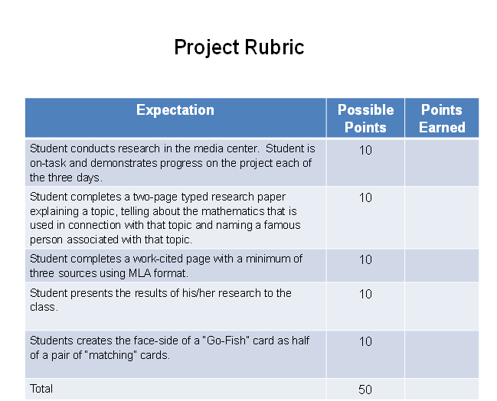

Slide 15
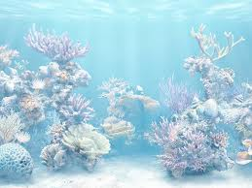
Summary of Important Points and Dates
March 1 – students sign up for topics.
March 1-8 – students conduct research
March 27, 28 – student projects are due
April 3, 4 – students participate in culminating activity.
This report and the cards are the 2nd semester project. (An assessment grade)
1st, 2nd and 3rd place will be awarded to teams in Algebra II Honors, Algebra II and Geometry Honors at a special pizza lunch.

Slide 16

Fish Trivia # 1
Approximately how many species of fish are there worldwide?
Choose Your Answer:
A: 9,000
B: 27,000
C: 56,000
D: 72,000

Slide 17
Media Specialist Jumpstart A

Slide 18
Media Specialist Jumpstart B

Slide 19
Media Specialist Jumpstart C

Slide 20
GO FISH ACTIVITIES

Slide 21
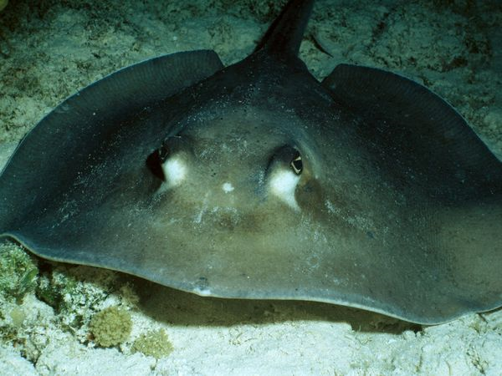
Jumpstart # 1 – Stingray Behavior
How close is close enough?
Some stingrays protrude their jaws in a manner analogous to a “scissor-jack.”
“Scissor-jack” mechanism can be modeled as a pair of isosceles trapezoids.

Slide 22
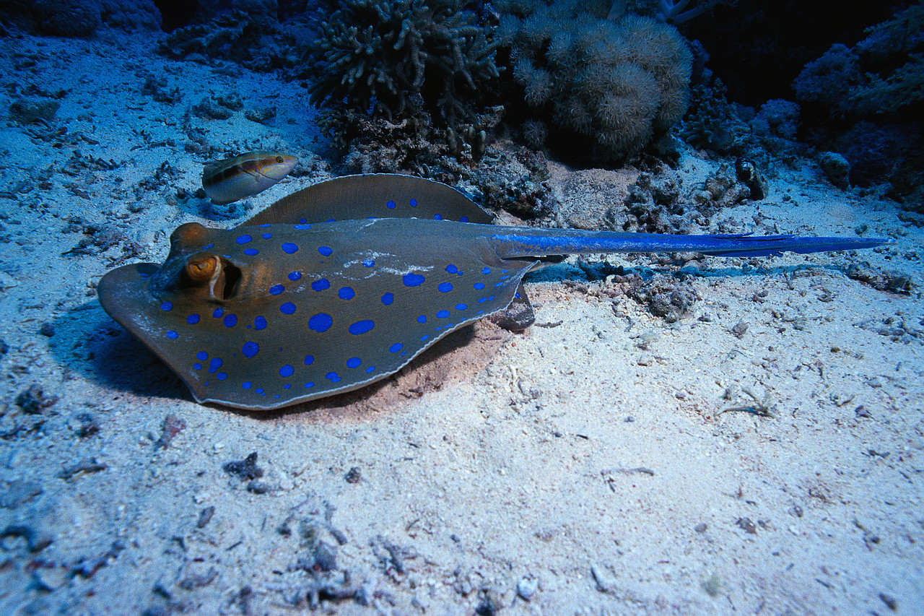
Jumpstart – Evolution of Jaws
Computing Measurement
Jaws evolved from skeletal arches that supported the pharynx.
Transition from suspension feeding to active predation to vertebrate evolutionary history.
The upper jaw became fused to the cranium in terrestrial vertebrates.
Tongue protrusion in amphibians and reptiles.

Slide 23
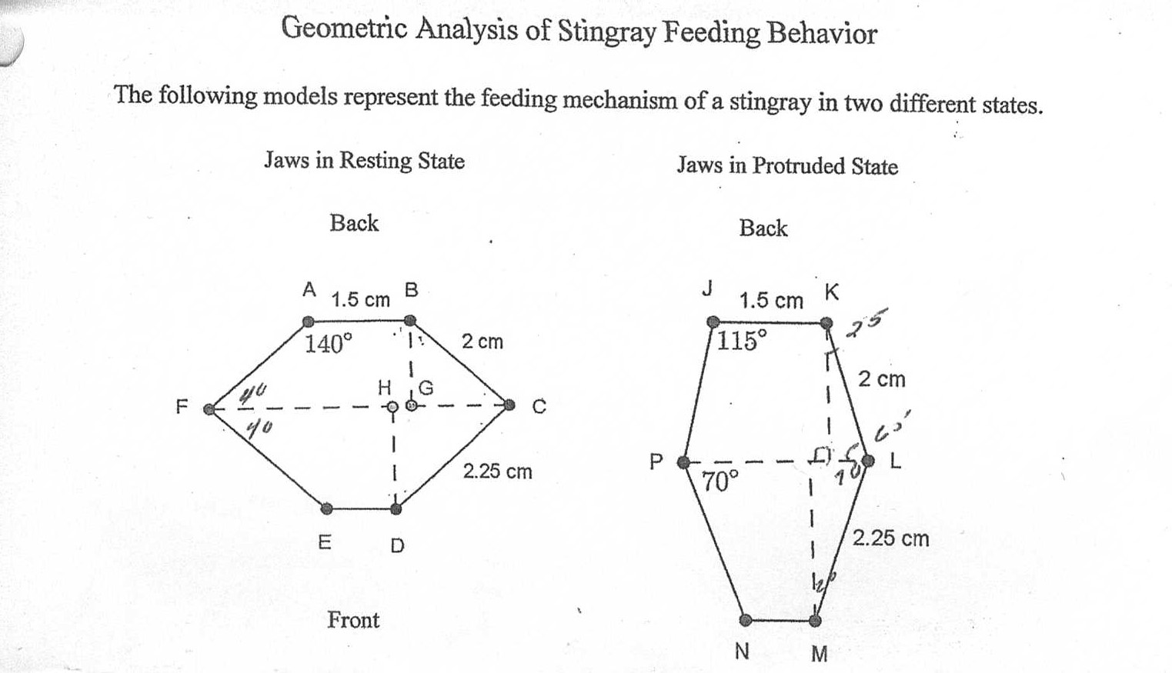
Stingray Jaws

Slide 24
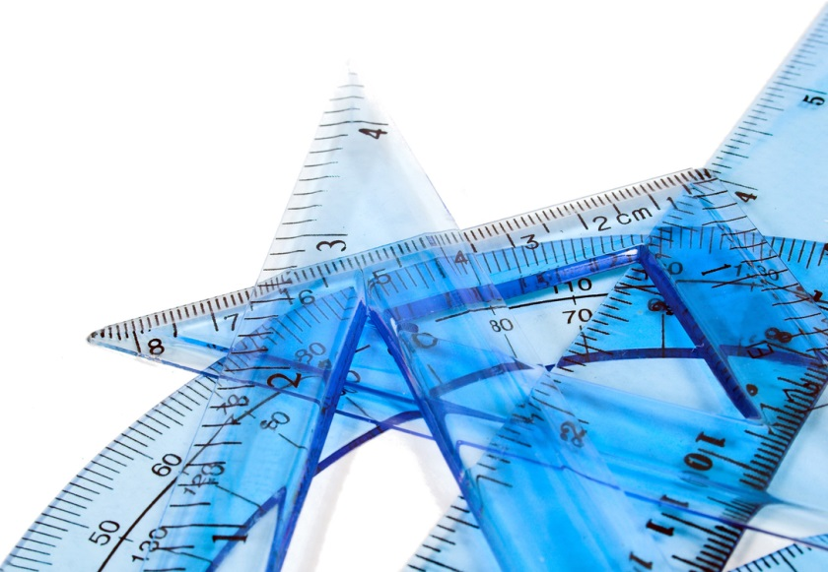
Stingray Investigation
1. ABCF and DEFC are isosceles trapezoids. FC bisects angle AFE and angle BCD. Fill in the measurements of the angles not given.
2. Are ABCF and DECF similar? Explain.
3. Are triangle CGB and triangle CHD similar? Explain
4. Find the length of the stingray feeding mechanism from front to back with the jaws in a resting state.
5. JKLP and NMPL are isosceles trapezoids. Fill in the measurement of each angle not already given.
6. Find the length of the feeding mechanism from front to back with the jaws in a protruded state.
7. From how far above the sea floor can the stingray reach its food?

Slide 25
Answers
1. ABCF and DEFC are isosceles trapezoids. FC bisects angle AFE and angle BCD. Fill in the measurements of the angles not given. (40 and 140)
2. Are ABCF and DECF similar? (No) Explain. ( Although corresponding angles are congruent, corresponding sides are not proportional)
3. Are triangle CGB and triangle CHD similar? (Yes) Explain.
(For two triangles, it is sufficient to have congruent corresponding angles)
4. Find the length of the stingray feeding mechanism from front to back with the jaws in a resting state.(1,2856 + 1.4463 = 2.7319)
5. JKLP and NMPL are isosceles trapezoids. Fill in the measurement of each angle not already given. (115, 65, 70, 110)
6. Find the length of the feeding mechanism from front to back with the jaws in a protruded state.(1.8126 + 2.1143 = 3.9269)
7. From how far above the sea floor can the stingray reach its food?
(3.9269-2.7319 = 1.1950 About 1.2 cm)

Slide 26

Jumpstart # 2 – The Incredible Puffer Fish
(Way to Fool That Otter)
Puffed up pride: The puffer fish's unique and distinctive natural defenses are necessary due to its slow speed. Puffer fish use a combination of pectoral, dorsal, anal, and caudal fins for propulsion, making it difficult to maneuver and an easy target for predators. As a defense mechanism, puffer fish have the ability to inflate rapidly, filling their extremely elastic stomachs with water (or air when outside the water) until they are almost spherical in shape. Thus, a hungry predator stalking the puffer fish may suddenly find itself facing what seems to be a much larger fish and pause, giving the pufferfish an opportunity to retreat to safety.
Download video from Tube and also activity scanned
from University of Tampa materials
http://www.youtube.com/watch?v=_tl2X8hBPEM

Slide 27
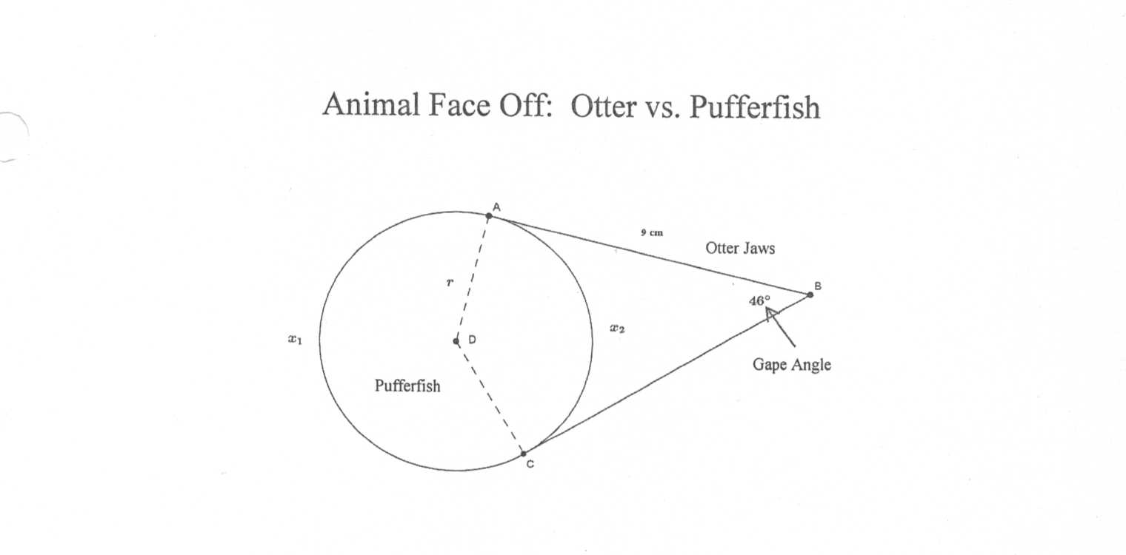
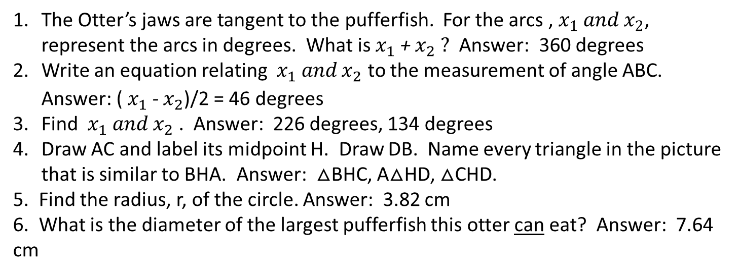
Otter vs. Puffer fish
The Otter’s jaws are tangent to the pufferfish. For the arcs , $x_{1} and x_{2}$, represent the arcs in degrees. What is $x_{1} \text{+} x_{2} ?$ Answer: 360 degrees
Write an equation relating ${ x}_{1} and x_{2}$ to the measurement of angle ABC. Answer: (${ x}_{1} \text{−} x_{2}$)/2 = 46 degrees
Find ${ x}_{1} and x_{2}$ . Answer: 226 degrees, 134 degrees
Draw AC and label its midpoint H. Draw DB. Name every triangle in the picture that is similar to BHA. Answer: $△$BHC, A$△$HD, $△$CHD.
5. Find the radius, r, of the circle. Answer: 3.82 cm
6. What is the diameter of the largest pufferfish this otter can eat? Answer: 7.64 cm

Slide 28
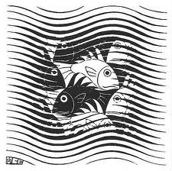
Jumpstart # 3 – Escher Fish
(Tessellations)
Guest Speaker: Mr. Ferrell
Video about Escher and his fish.
Students create tessellation on small scale.
Use clear polygons to determine which shapes tessellate.
Materials: clear polygons, cardstock, scissors, pencils, tape.
Students create tessellations.

Slide 29
Fish Trivia # 2
What is the fastest fish?
Choose Your Answer:
A: Swordfish
B: Racing Shark
C: Mako Shark
D: Sailfish

Slide 30
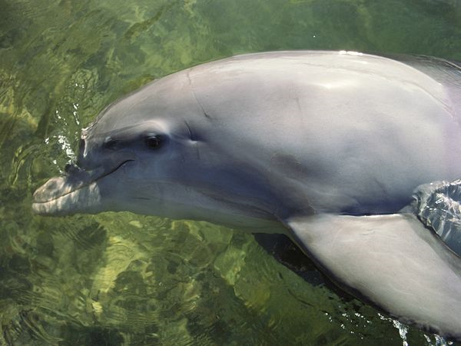

Dolphins Do Math
(A Bottlenose Dolphin)
Integrated Activity – Marine Biology and Algebra

Slide 31
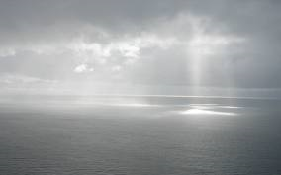
Dolphins Do Math (CON’T)
Dolphin Facts:
Maximum Life span : 40 - 50 years
Size: 10 to 14 ft (3 to 4.2 m)
Weight: 1,100 lbs (500 kg)
Did you know? Bottlenose dolphins have been observed to breach up to 16 feet (4.9 meters) out of the water, landing with a splash on their back or side.
Did you know? In the wild, dolphins can reach speeds of over 18 miles per hour.
Did you know? Bottlenose dolphins track their prey through the expert use of echolocation, making up to 1000 clicking sounds per second. These sounds bounce back from objects, revealing location, size and shape of their target.
Did you know? Dolphins are a member of the porpoise family which also includes whales.

Slide 32

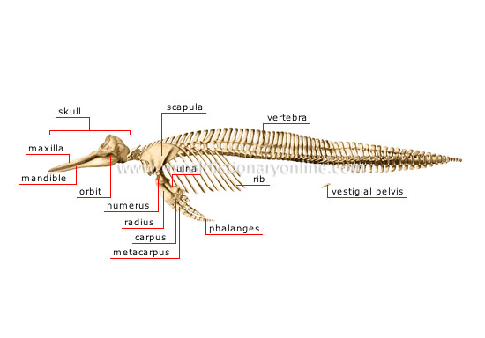
Dolphins Do Math (con’t)

Slide 33
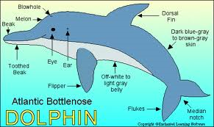
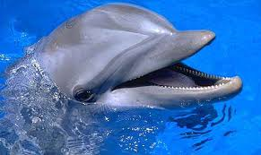
Questions About Dolphins
(Marine Mammals Master Math)
1. How many years ago did dolphins evolve?
http://animals.nationalgeographic.com/animals/mammals/bottlenose-dolphin/
2. How did Talon demonstrate a knowledge of numeracy?
http://news.discovery.com/animals/whales-dolphins/dolphins-math-geniuses-120717.htm
3. Based on the stated maximum speed of a bottlenose dolphin, how long would it take this dolphin to travel 5 miles?
4. What was the weight of the young-dolphin’s skull?
5. What was the length of the longest adult-dolphin rib?

Slide 34
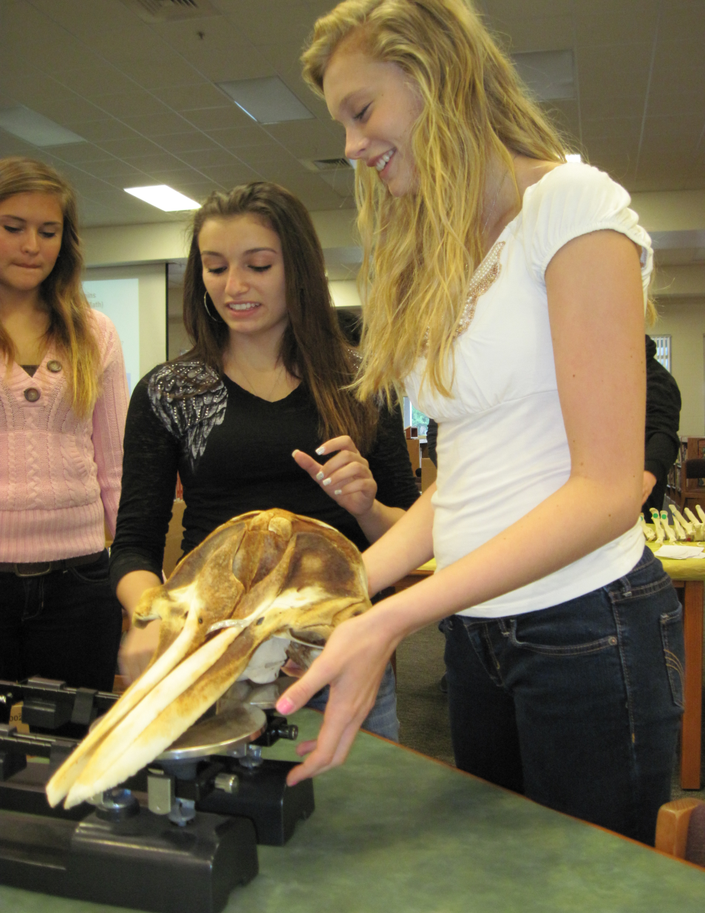
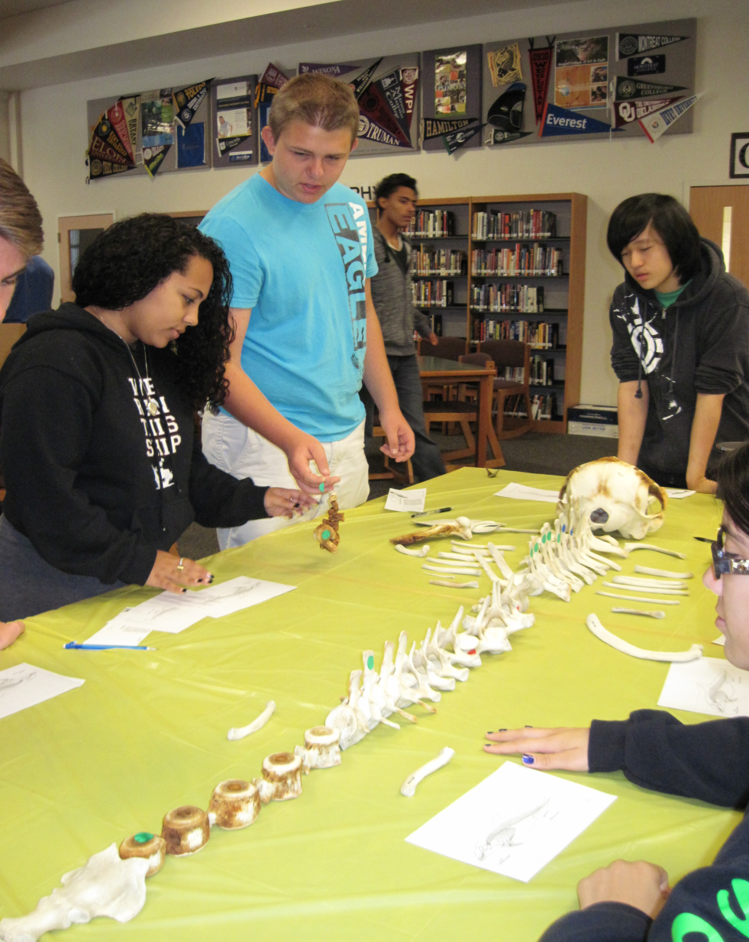
Students Involved in Dolphin Forensics

Slide 35
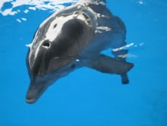
A Dolphin Tale
Winter was caught in a crab trap when she was a juvenile.
She was rescued and transferred to Clearwater Marine Aquarium.
She has become an inspiration to many children who wear prosthetics.
Due to the loss of circulation in her tail from being caught in the lines of the crab trap, it was necessary to amputate her tail. Hanger Prosthetics created a tail for Winter. She wears it part of each day as therapy so that she will not injure her spine from swimming like a fish instead of a mammal.

Slide 36
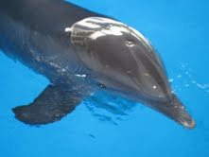
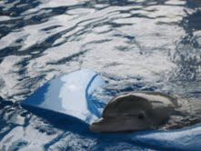
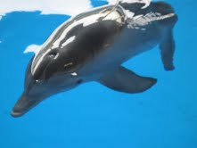
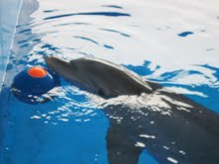
It’s a Dolphin’s Life
Winter is among several rescued dolphins at Clearwater Marine Aquarium. The animals ‘ health and behavior are monitored constantly as patients in a hospital would be.
The trainers reported that Winter loves all the attention. Her favorite toy is a floating pad as shown in the first photo. The trainers reported that she does not like rain.

Slide 37
Jumpstart # 4 – Trout Pond Population
Each spring a trout pond is restocked with fish. The population decreases each year due to natural causes, but at the end of each year more fish are added. Here is what you need to know.
There are currently 3000 trout in the pond.
Due to fishing, natural death, and other causes, the population decreases by 20% each year, regardless of restocking.
At the end of the year, 1000 trout are added to the pond.
1. Do you think the population will grow without bound, level off, oscillate, or die out? Explain why you think your conjecture is reasonable.
2. Write an equation using the information in bold print to write an equation to represent the fish population two years from now.

Slide 38
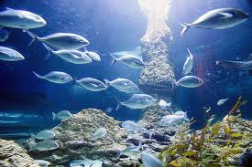
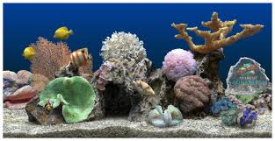
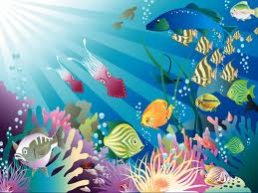
Jumpstart # 5 – The Perfect Aquarium
(Fishing For the Best Prism)
Each group will be assigned the three dimensions for the length, width and height of the tank. (2x2x2, 8x1x1, 4x2x1)
Create a 2-dimensional net, a 3 dimensional drawing, compute the volume of water and the surface area of each prism.
Repeat with tanks whose volume is 24 cubic units. Which design would cost the most to build? What do you base your answer on?

Slide 39
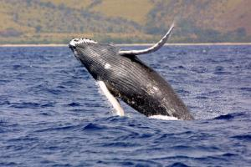
Jumpstart #6 - A Whale of a Scale
Science Daily, Apr. 10, 2007 — Marine scientists recently published a research paper in the science journal, biology letters, that found humpback whales migrate over 5,100 miles from Central America to their feeding grounds off Antarctica; a record distance undertaken by any mammal.

Slide 40
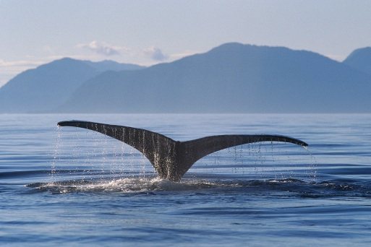
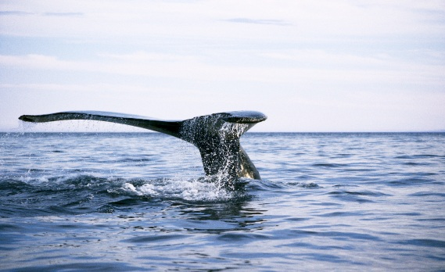
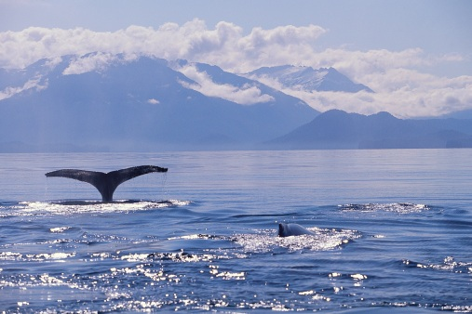
A Whale of a Scale (con’t)
If the ratio of the weight of an average student (125 pounds) to the weight of a humpback whale is 1/640, what is the weight of the humpback whale?
80,000 pounds
If humpback whales swim about 5 miles per hour while migrating, write an expression for the distance traveled in “x” hours, “x” days. If a whale migrated 1020 miles, how many days did the whale travel?
8.5 days
We will go outside. Divide into two teams. An average humpback whale is forty-four (44) feet long. Demonstrate the length of an average humpback whale.

Slide 41


Jumpstart #7 –
Sampling Fish Populations
500 fish were captured in the Gulf of Mexico in a designated area and tagged. The fish were released. 400 fish were captured in the same designated area. Of the 400, 12 were tagged. How can this help us estimate the fish population of the area?
$$\frac{12}{400} = \frac{500}{x}$$

Slide 42

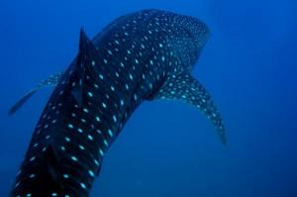
Jumpstart #8 – Whale Sharks Use Geometry
What movement do ocean animals have to consider in addition to travel speed?
How have scientists monitored the motion of whale sharks?
Why are sharks able to glide without using energy?
4. What part of their movement is
geometric?
Whale shark gliding off Sail Rock in the Gulf of Thailand. They are the largest fish species in the ocean, but the majestic gliding motion of the whale shark is, scientists argue, an astonishing feat of mathematics and energy conservation.

Slide 43
Whale Sharks Use Geometry to Avoid Sinking
1. What movement do ocean animals have to consider in addition to travel speed?
Answer: A second movement is vertical.
How have scientists monitored the motion of whale sharks?
Answer: They use animal-borne motion sensors.
Why are sharks able to glide without using energy?
Answer: Sharks have negative buoyancy.
What part of their movement is geometric?
Answer: Shallow and steep ascent angles optimize their energy when they are moving vertically.

Slide 44


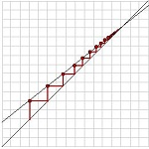
Technology-Based Activities
Classroom Activities - Texas Instruments - US
education.ti.com/en/us/activity
Texas Instruments
Classroom Activities: "Fishing for Points"-- Transformations Using Lists - Texas Instruments - US
) Fishing_for_PointsTI-83_ (PDF) Transforming_Fish.pdf FISH.73p FISH.8xp Alignment Standards Alignment Textbook Alignment
http://education.ti.com/en/us/activity/detail?id=136E9CDBAB0147D687E3E3243701BD38
Activities
http://illuminations.nctm.org/
Graphical Analysis
9-12
This investigation illustrates the use of iteration, recursion and algebra to model and analyze a changing fish population. Graphs, equations, tables, and technological tools are used to investigate the effect of varying parameters on the long-term population

Slide 45
Exit Slip for “Go Fish”
Exit Slip for “Go Fish” Project Presentation
Name ________________________________________Period ____________
What was the most interesting thing you learned while you were researching your topic?
2. What is one thing you learned today about another topic that you
did not know before?

Slide 46
Peer “Go Fish” Evaluation
Group’s “Go Fish” Topic:__________________________________________________________
Name of Student Presenting: __________________________________
Time of Presentation: _____________________________
Three Points Mentioned in Presentation:
1.
2.
3.
My favorite part of your power point was:
Signed _________________________________________________

Slide 47
Go Fish Quiz
Name ______________________________________________________Period _____
Information from Mrs. Shepard’s jpresentations:
What is the deepest place in the ocean? ____________________________
Currently, the names of the five oceans are Atlantic, Pacific, Indian, Arctic _____________________
The largest fish in the ocean is the ________________________________
Three major problems for the oceans are oil spills, pollution and ________________________.
Check the _________________________and authority of Internet sites before using the information.
Information from class members’ reports:
___________________________is a dolphin with a prosthetic tail.
A ___________________________________occurs when several storm fronts come together.
Tides are caused by the gravitational pull of the _________________.
____________________________can be expressed mathematically with sine functions.
Navigation in open water is aided today with the use of a ______________________.
Sea walls are constructed to slow ______________________________________________.
_____________________________was a famous artist who created “Fish” using tessellations.
Information from daily jumpstarts
The ______________________________migrates more than five thousand miles each year.
Sharks use ____________________________________________to glide using little energy.
The _________________________________________of a 6 by 4 by 2 rectangular prism is 88 square units.
If the ratio of tagged fish to total recaptured is 1/32, what is the total population estimate if 640 were captured? ____________________________________
_____________________________created the prosthetic tail for the dolphin using geometry and physics.
Word Bank: Mariana Trench, Southern, Accuracy, Perfect Storm, Antarctic, Volume, Escher, GPS, Hanger, Inc., Moon, Overfishing, Whale Shark, Winter, Beach Erosion, Humpback Whale, Waves, Meteors, Negative Buoyancy, Surface Area, Aquarium, Citation, 20, 480.
What was the topic of your report? ______________________________________________________________
How is math related to your topic? _____________________________________________________________
State a fact you learned during this unit that you did not know before. _________________________________
________________________________________________________________________________________

Slide 48

GO Fish
(A Culminating Activity)
Materials: 52 cards – one side is the same pattern. The other side is a card that has a match within the deck of cards. These cards are a review of the material covered in the unit.
Students are in teams of four playing the game sitting at the library tables.
Each team begins with four cards. There is a partial deck of extra cards in the middle of the room. The game is played in the traditional way, but each team plays as an individual would in the original game.

Slide 49
Congratulations to the Winners of the “Go Fish” Projects
Algebra II Honors: 1st Emma Chinault and Jenna Tippy
2nd Tiffany Campbell and Molly Sun
3rd Isabella Martinez and Caitlyn Mumma
Algebra II: 1st Dylan Cardozo and Jared Shaw
2nd Skyler Adkins and Paul Phung
3rd Jaron Douglas and Cody NiIver
Geometry Honors: 1st Asia Borman and Brittany Borman
2nd Inesse Chichou and Melodie Nelson
3rd Alexa Burczak and Diem Nguyen
Medals and ribbons will be awarded at the “Pizza Lunch” that will be held in the winners’ honor. (Date and time to be announced by invitation)

Slide 50
Fish Trivia # 3
What is the most poisonous fish?
A: Needle fish
B: Rice fish
C: Puffer fish
D: Snail fish

Slide 51
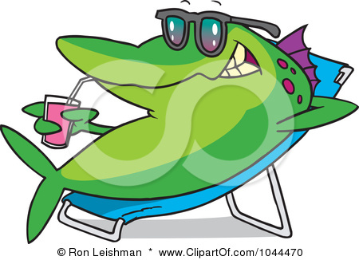
THE END
One of the power points from the unit, “Go Fish”, Linda Shepard and Chris Helminski, BRHS. Many of the activities were courtesy of the Science Math Masters Workshop, 2012, University of Tampa.

