Slide 1
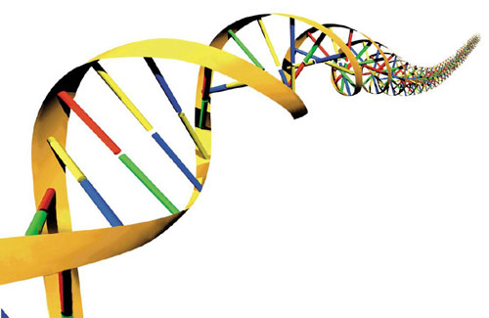
Water striders: Life on the edge

Slide 2
Math & Nature
The universe is written in the language of mathematics
Galileo Galilei, 1623
Quantitative analysis of natural phenomena is at the heart of scientific inquiry
Nature provides a tangible context for mathematics instruction

Slide 3
The Importance of Context
Context
The part of a text or statement that surrounds a particular word or passage and determines its meaning.
The circumstances in which an event occurs; a setting.

Slide 4
The Importance of Context
Context-Specific Learning
Facilitates experiential and associative learning
Demonstration, activation, application, task-centered, and integration principles (Merrill 2002)
Facilitates generalization of principles to other contexts

Slide 5
Math & Nature
Geometry & Biology
Biological structures vary greatly in geometry and therefore represent a platform for geometric education
Geometric variability → functional variability → ecological variability
Mechanism for illustrating the consequences of geometry

Slide 6
Math & Nature
Life in Fluids
Water versus air
Physical properties
 | Water | Air
Density (kg/m³) | 997.6 | 1.2
Buoyancy | yes | no
Specific Heat (kJ/kg °C) | 4.1 | 1.0
Speed of sound (m/s) | 1485 | 343

Slide 7
Math & Nature
Life in Fluids
Water versus air
Locomotion systems
Water
Air
Liem et al. (2001)

Slide 8
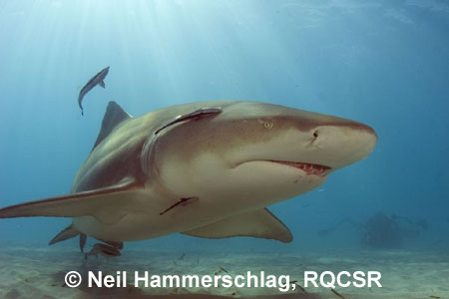
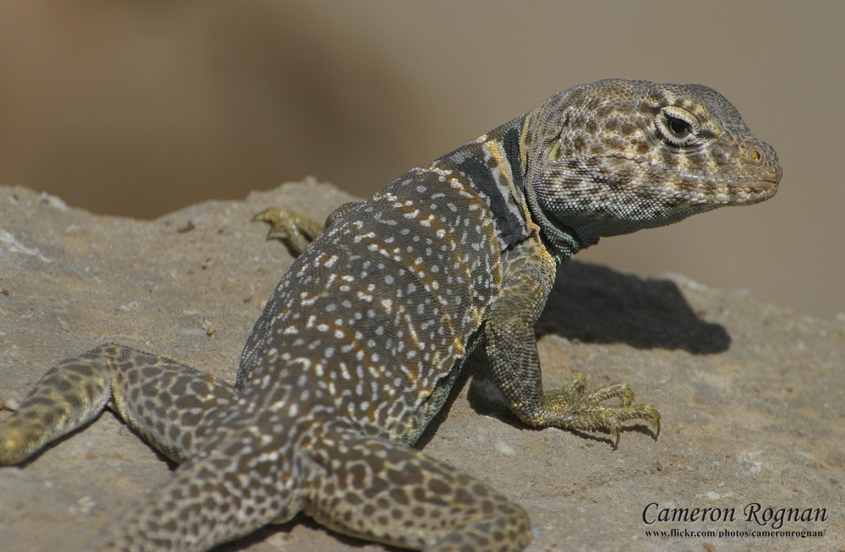
Math & Nature
Life in Fluids
Water versus air
Body Temperature
Water
Air

Slide 9
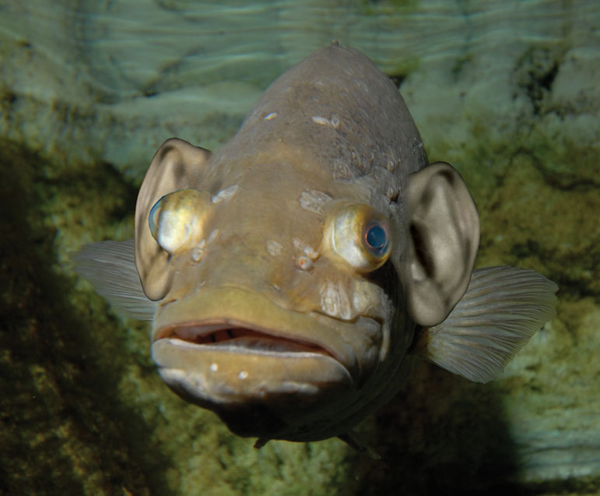
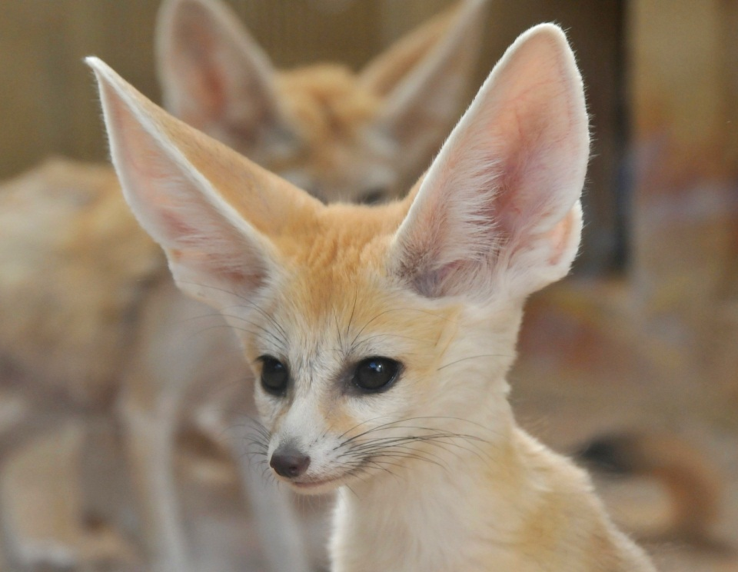
Math & Nature
Life in Fluids
Water versus air
Sensory systems
Water
Air
www.mustanggallery.com
www.animalgalleries.org

Slide 10
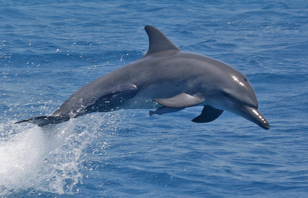
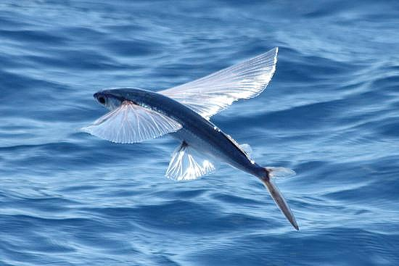
Math & Nature
Life in Fluids
Life on the edge of water and air
Porpoising behavior
Dolphins
Flying fish
© C.G. Summers Jr.
© www.ra-re.org

Slide 11
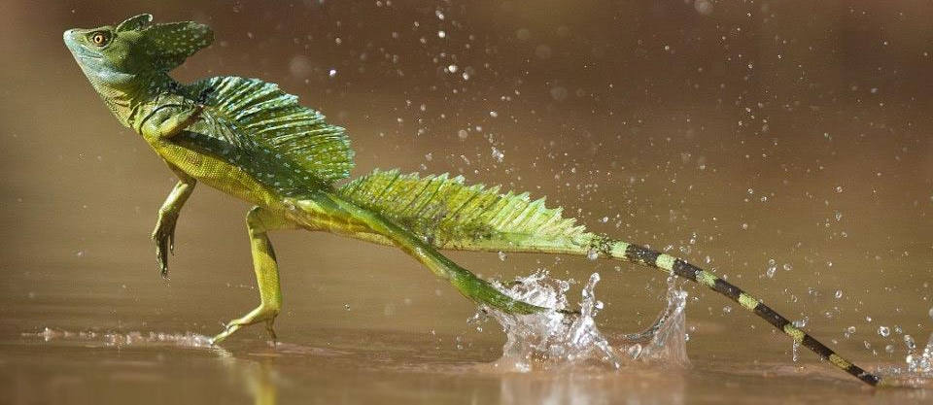
Math & Nature
Life in Fluids
Life on the edge of water and air
Basilisk lizard
www.laughingbug.com, Hsieh (2003)

Slide 12
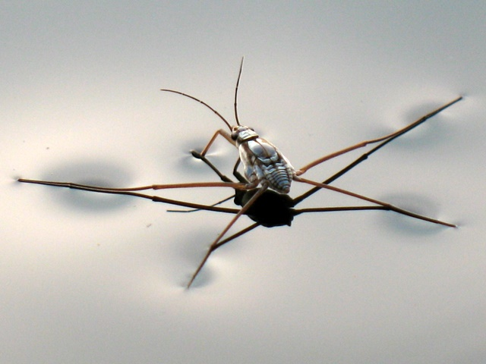
Math & Nature
Life in Fluids
Life on the edge of water and air
Water striders
~1700 species
Habitat
Locomotion
© Meng Meng
Notes:
Water striders
~1700 species
Habitat
90% freshwater
10% marine
Locomotion
Hydrophobic leg hairs
Food
Insects
Plankton
Reproduction
Robotics

Slide 13
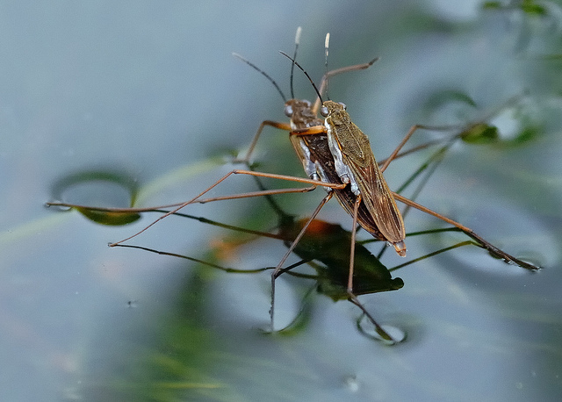
Math & Nature
Life in Fluids
Life on the edge of water and air
Water striders
~1700 species
Habitat
Locomotion
Reproduction
© C. Hoyle

Slide 14
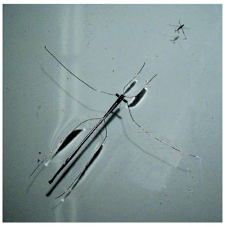
Math & Nature
Life in Fluids
Life on the edge of water and air
Water striders
~1700 species
Habitat
Locomotion
Reproduction
Robotics
Hu et al. (2003)

Slide 15
Math & Nature
Life in Fluids
Life on the edge of water and air
Balance of forces
$M_{c}=\frac{body weight}{surface tension force}=\frac{mg}{σP}$
$m=body mass$
$g=gravitational acceleration$
$=surface tension of water$
$P=contact perimeter$

Slide 16
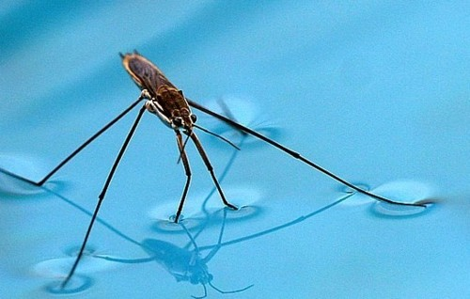
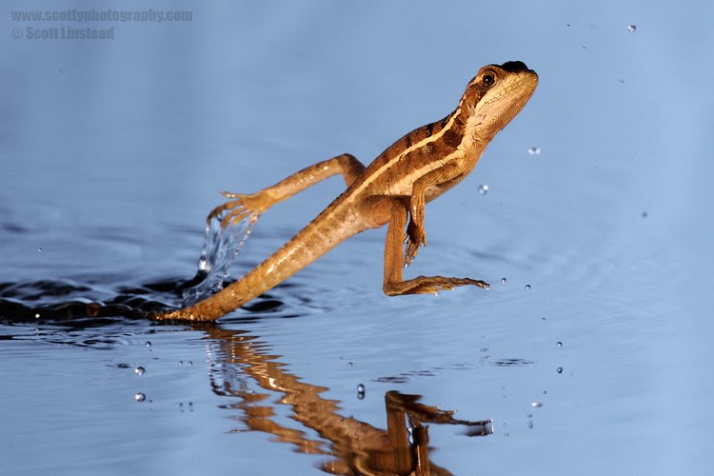
Math & Nature
Life in Fluids
Life on the edge of water and air
Balance of forces
$$M_{c}<1$$
$$M_{c}>1$$
© Cohesive Blue Inc.
© S. Linstead

Slide 17
Math & Nature
Life in Fluids
Life on the edge of water and air
Questions
What is the balance of forces for the average water strider?
How big can a water strider get and still stay afloat?
© Cohesive Blue Inc.

Slide 18
Math & Nature
Geometry & Biology
NGSSS
MA.912.G.7.5 Explain and use formulas for lateral area, surface area and volume of solids.
MA.912.G.7.7 Determine how changes in dimension affect the surface area and volume of common geometric solids.
MA.912.G.8.2 Use a variety of problem-solving strategies such as drawing a diagram, making a chart, guess-and-check, solve a simpler problem, writing an equation and working backwards.

Slide 19
Math & Nature
Geometry & Biology
CCSS
G.MG.1 Use geometric shapes, their measures, and their properties to describe objects (e.g., modeling a tree trunk or a human torso as a cylinder).
G.MG.2 Apply concepts of density based on area and volume in modeling situations (e.g., persons per square mile, BTUs per cubic foot).
G.MG.3 Apply geometric methods to solve design problems (e.g., designing an object or structure to satisfy physical constraints or minimize cost; working with typographic grid systems based on ratios).

Slide 20
Math & Nature
Geometry & Biology
CCSS
G.GMD.3 Use volume formulas for cylinders, pyramids, cones, and spheres to solve problems.
G.GMD.4 Identify the shapes of two-dimensional cross-sections of three-dimensional objects, and identify three-dimensional objects generated by rotations of two-dimensional objects.

Slide 21
Math & Nature
Water striders
Body
Head Hemisphere: R = 0.55
Body Cylinder: R = 0.55, L = 6.4
Tail Cone: R = 0.55, L = 2.6
Leg 1
Segment 1: R = 0.08, L = 1.5
Segment 2: R = 0.04, L = 1.5
Segment 3: R = 0.02, L = 1.0
Leg 2
Segment 1: R = 0.08, L = 4.5
Segment 2: R = 0.04, L = 4.5
Segment 3: R = 0.02, L = 3.0
Leg 3
Segment 1: R = 0.04, L = 3.0
Segment 2: R = 0.02, L = 3.0
Segment 3: R = 0.02, L = 2.0
*All measurements in millimeters (mm)
Notes:
P = 4(L₁ + L₂ + L₃)

Slide 22
Math & Nature
Water striders
Given
Only the tarsal segments (segment 3) of each leg are in contact with the water.
Contact Perimeter
$P=2×2(L_{1}+L_{2}+L_{3})$
Notes:
P = 4(L₁ + L₂ + L₃)

Slide 23
Math & Nature
Water striders
Given
Only the tarsal segments (segment 3) of each leg are in contact with the water.
Contact Perimeter
$P=2×2(L_{1}+L_{2}+L_{3})$
Find the contact perimeter of the water strider.
Notes:
P = 4(L₁ + L₂ + L₃)

Slide 24
Water Strider Body Segment Dimensions
Body |  | Radius (mm) | Length (mm) | Contact Perimeter (mm) | Volume (mm³)
Head Hemisphere |  | 0.55 | --- | ---
Body Cylinder |  | 0.55 | 6.4 | ---
Tail Cone |  | 0.55 | 2.6 | ---
Leg 1
Segment 1 |  | 0.08 | 1.5 | ---
Segment 2 |  | 0.04 | 1.5 | ---
Segment 3 |  | 0.02 | 1.0
Leg 2
Segment 1 |  | 0.08 | 4.5 | ---
Segment 2 |  | 0.04 | 4.5 | ---
Segment 3 |  | 0.02 | 3.0
Leg 3
Segment 1 |  | 0.04 | 3.0 | ---
Segment 2 |  | 0.02 | 3.0 | ---
Segment 3 |  | 0.02 | 2.0
 | Total Contact Perimeter*
 | Total Volume**
 | Body Mass (g)
*Contact perimeter for Legs 1, 2, & 3 must be multiplied by 2 to account for the legs on either side of the body.
**Total volume must include the volume of the body and the volume of the legs multiplied by 2 to account for the legs on either side of the body.
Notes:
P = 4(L₁ + L₂ + L₃)

Slide 25
Water Strider Body Segment Dimensions
Body |  | Radius (mm) | Length (mm) | Contact Perimeter (mm) | Volume (mm³)
Head Hemisphere |  | 0.55 | --- | ---
Body Cylinder |  | 0.55 | 6.4 | ---
Tail Cone |  | 0.55 | 2.6 | ---
Leg 1
Segment 1 |  | 0.08 | 1.5 | ---
Segment 2 |  | 0.04 | 1.5 | ---
Segment 3 |  | 0.02 | 1.0 | 2
Leg 2
Segment 1 |  | 0.08 | 4.5 | ---
Segment 2 |  | 0.04 | 4.5 | ---
Segment 3 |  | 0.02 | 3.0 | 6
Leg 3
Segment 1 |  | 0.04 | 3.0 | ---
Segment 2 |  | 0.02 | 3.0 | ---
Segment 3 |  | 0.02 | 2.0 | 4
 | Total Contact Perimeter* |  |  | 24
 | Total Volume**
 | Body Mass (g)
*Contact perimeter for Legs 1, 2, & 3 must be multiplied by 2 to account for the legs on either side of the body.
**Total volume must include the volume of the body and the volume of the legs multiplied by 2 to account for the legs on either side of the body.
Notes:
P = 4(L₁ + L₂ + L₃)

Slide 26
Math & Nature
Water striders
Given
Dimensions of all body segments
Density of the water strider body = 0.0012 g/mm³
$Density=\frac{Mass}{Volume}$
Find the body mass of the water strider.
Notes:
Body mass ranges from 0.0001 g – 1.0 g, with average at about 0.01 g.
Muscle density = 1.06 g/cm3
Chitin density = 1.43 g/cm3

Slide 27
Water Strider Body Segment Dimensions
Body |  | Radius (mm) | Length (mm) | Contact Perimeter (mm) | Volume (mm³)
Head Hemisphere |  | 0.55 | --- | ---
Body Cylinder |  | 0.55 | 6.4 | ---
Tail Cone |  | 0.55 | 2.6 | ---
Leg 1
Segment 1 |  | 0.08 | 1.5 | ---
Segment 2 |  | 0.04 | 1.5 | ---
Segment 3 |  | 0.02 | 1.0 | 2
Leg 2
Segment 1 |  | 0.08 | 4.5 | --- | 0.090
Segment 2 |  | 0.04 | 4.5 | --- | 0.023
Segment 3 |  | 0.02 | 3.0 | 6 | 0.004
Leg 3
Segment 1 |  | 0.04 | 3.0 | --- | 0.015
Segment 2 |  | 0.02 | 3.0 | --- | 0.004
Segment 3 |  | 0.02 | 2.0 | 4 | 0.003
 | Total Contact Perimeter* |  |  | 24
 | Total Volume**
 | Body Mass (g)
*Contact perimeter for Legs 1, 2, & 3 must be multiplied by 2 to account for the legs on either side of the body.
**Total volume must include the volume of the body and the volume of the legs multiplied by 2 to account for the legs on either side of the body.
Notes:
P = 4(L₁ + L₂ + L₃)

Slide 28
Water Strider Body Segment Dimensions
Body |  | Radius (mm) | Length (mm) | Contact Perimeter (mm) | Volume (mm³)
Head Hemisphere |  | 0.55 | --- | --- | 0.348
Body Cylinder |  | 0.55 | 6.4 | --- | 6.082
Tail Cone |  | 0.55 | 2.6 | --- | 0.824
Leg 1
Segment 1 |  | 0.08 | 1.5 | --- | 0.030
Segment 2 |  | 0.04 | 1.5 | --- | 0.008
Segment 3 |  | 0.02 | 1.0 | 2 | 0.001
Leg 2
Segment 1 |  | 0.08 | 4.5 | --- | 0.090
Segment 2 |  | 0.04 | 4.5 | --- | 0.023
Segment 3 |  | 0.02 | 3.0 | 6 | 0.004
Leg 3
Segment 1 |  | 0.04 | 3.0 | --- | 0.015
Segment 2 |  | 0.02 | 3.0 | --- | 0.004
Segment 3 |  | 0.02 | 2.0 | 4 | 0.003
 | Total Contact Perimeter* |  |  | 24
 | Total Volume** |  |  |  | 7.61
 | Body Mass (g) |  |  |  | 0.009132
*Contact perimeter for Legs 1, 2, & 3 must be multiplied by 2 to account for the legs on either side of the body.
**Total volume must include the volume of the body and the volume of the legs multiplied by 2 to account for the legs on either side of the body.
Notes:
P = 4(L₁ + L₂ + L₃)

Slide 29
Math & Nature
Water striders
Given
$m=0.009132 grams$
$g=0.0098 mm/{ms}^{2}$
$=0.000067 N/mm$
$P=24 mm$
Find the ratio of body weight to surface tension force for the water strider.

Slide 30
Math & Nature
Water striders
Given
$m=0.009132 grams$
$g=0.0098 mm/{ms}^{2}$
$=0.000067 N/mm$
$P=24 mm$
Find the ratio of body weight to surface tension force for the water strider.
$M_{c}=\frac{body weight}{surface tension force}=\frac{mg}{σP}=\frac{0.009132×0.0098}{0.000067×24}=0.056$

Slide 31
Math & Nature
Water striders
Given
$M_{c}=\frac{body weight}{surface tension force}<1=Floating$
$M_{c}=\frac{body weight}{surface tension force}>1=Sinking$
How big can a water strider get and still stay afloat?

Slide 32
Water Strider Body Segment Dimensions x 2
Body |  | Radius (mm) | Length (mm) | Contact Perimeter (mm) | Volume (mm³)
Head Hemisphere |  | 1.1 | --- | ---
Body Cylinder |  | 1.1 | 12.8 | ---
Tail Cone |  | 1.1 | 5.2 | ---
Leg 1
Segment 1 |  | 0.16 | 3.0 | ---
Segment 2 |  | 0.08 | 3.0 | ---
Segment 3 |  | 0.04 | 2.0
Leg 2
Segment 1 |  | 0.16 | 9.0 | --- | 0.724
Segment 2 |  | 0.08 | 9.0 | --- | 0.181
Segment 3 |  | 0.04 | 6.0 |  | 0.030
Leg 3
Segment 1 |  | 0.08 | 6.0 | --- | 0.121
Segment 2 |  | 0.04 | 6.0 | --- | 0.030
Segment 3 |  | 0.04 | 4.0 |  | 0.020
 | Total Contact Perimeter*
 | Total Volume**
 | Body Mass (g)
*Contact perimeter for Legs 1, 2, & 3 must be multiplied by 2 to account for the legs on either side of the body.
**Total volume must include the volume of the body and the volume of the legs multiplied by 2 to account for the legs on either side of the body.
Notes:
P = 4(L₁ + L₂ + L₃)

Slide 33
Water Strider Body Segment Dimensions x 2
Body |  | Radius (mm) | Length (mm) | Contact Perimeter (mm) | Volume (mm³)
Head Hemisphere |  | 1.1 | --- | --- | 2.788
Body Cylinder |  | 1.1 | 12.8 | --- | 48.657
Tail Cone |  | 1.1 | 5.2 | --- | 6.589
Leg 1
Segment 1 |  | 0.16 | 3.0 | --- | 0.241
Segment 2 |  | 0.08 | 3.0 | --- | 0.060
Segment 3 |  | 0.04 | 2.0 | 4 | 0.010
Leg 2
Segment 1 |  | 0.16 | 9.0 | --- | 0.724
Segment 2 |  | 0.08 | 9.0 | --- | 0.181
Segment 3 |  | 0.04 | 6.0 | 12 | 0.030
Leg 3
Segment 1 |  | 0.08 | 6.0 | --- | 0.121
Segment 2 |  | 0.04 | 6.0 | --- | 0.030
Segment 3 |  | 0.04 | 4.0 | 8 | 0.020
 | Total Contact Perimeter* |  |  | 48
 | Total Volume** |  |  |  | 60.868
 | Body Mass (g) |  |  |  | 0.0730416
*Contact perimeter for Legs 1, 2, & 3 must be multiplied by 2 to account for the legs on either side of the body.
**Total volume must include the volume of the body and the volume of the legs multiplied by 2 to account for the legs on either side of the body.
Notes:
P = 4(L₁ + L₂ + L₃)

Slide 34
Water Strider Body Segment Dimensions x 4
Body |  | Radius (mm) | Length (mm) | Contact Perimeter (mm) | Volume (mm³)
Head Hemisphere |  | 2.2 | --- | ---
Body Cylinder |  | 2.2 | 25.6 | ---
Tail Cone |  | 2.2 | 10.4 | ---
Leg 1
Segment 1 |  | 0.32 | 6 | ---
Segment 2 |  | 0.16 | 6 | ---
Segment 3 |  | 0.08 | 4
Leg 2
Segment 1 |  | 0.32 | 18 | --- | 5.791
Segment 2 |  | 0.16 | 18 | --- | 1.448
Segment 3 |  | 0.08 | 12 |  | 0.241
Leg 3
Segment 1 |  | 0.16 | 12 | --- | 0.965
Segment 2 |  | 0.08 | 12 | --- | 0.241
Segment 3 |  | 0.08 | 8 |  | 0.161
 | Total Contact Perimeter*
 | Total Volume**
 | Body Mass (g)
*Contact perimeter for Legs 1, 2, & 3 must be multiplied by 2 to account for the legs on either side of the body.
**Total volume must include the volume of the body and the volume of the legs multiplied by 2 to account for the legs on either side of the body.
Notes:
P = 4(L₁ + L₂ + L₃)

Slide 35
Water Strider Body Segment Dimensions x 4
Body |  | Radius (mm) | Length (mm) | Contact Perimeter (mm) | Volume (mm³)
Head Hemisphere |  | 2.2 | --- | --- | 22.301
Body Cylinder |  | 2.2 | 25.6 | --- | 389.256
Tail Cone |  | 2.2 | 10.4 | --- | 52.712
Leg 1
Segment 1 |  | 0.32 | 6 | --- | 1.930
Segment 2 |  | 0.16 | 6 | --- | 0.483
Segment 3 |  | 0.08 | 4 | 8 | 0.080
Leg 2
Segment 1 |  | 0.32 | 18 | --- | 5.791
Segment 2 |  | 0.16 | 18 | --- | 1.448
Segment 3 |  | 0.08 | 12 | 24 | 0.241
Leg 3
Segment 1 |  | 0.16 | 12 | --- | 0.965
Segment 2 |  | 0.08 | 12 | --- | 0.241
Segment 3 |  | 0.08 | 8 | 16 | 0.161
 | Total Contact Perimeter* |  |  | 96
 | Total Volume** |  |  |  | 486.949
 | Body Mass (g) |  |  |  | 0.5843388
*Contact perimeter for Legs 1, 2, & 3 must be multiplied by 2 to account for the legs on either side of the body.
**Total volume must include the volume of the body and the volume of the legs multiplied by 2 to account for the legs on either side of the body.
Notes:
P = 4(L₁ + L₂ + L₃)

Slide 36
Water Strider Body Segment Dimensions x 8
Body |  | Radius (mm) | Length (mm) | Contact Perimeter (mm) | Volume (mm³)
Head Hemisphere |  | 4.4 | --- | ---
Body Cylinder |  | 4.4 | 51.2 | ---
Tail Cone |  | 4.4 | 20.8 | ---
Leg 1
Segment 1 |  | 0.64 | 12 | ---
Segment 2 |  | 0.32 | 12 | ---
Segment 3 |  | 0.16 | 8
Leg 2
Segment 1 |  | 0.64 | 36 | --- | 46.325
Segment 2 |  | 0.32 | 36 | --- | 11.581
Segment 3 |  | 0.16 | 24 |  | 1.930
Leg 3
Segment 1 |  | 0.32 | 24 | --- | 7.721
Segment 2 |  | 0.16 | 24 | --- | 1.930
Segment 3 |  | 0.16 | 16 |  | 1.287
 | Total Contact Perimeter*
 | Total Volume**
 | Body Mass (g)
*Contact perimeter for Legs 1, 2, & 3 must be multiplied by 2 to account for the legs on either side of the body.
**Total volume must include the volume of the body and the volume of the legs multiplied by 2 to account for the legs on either side of the body.
Notes:
P = 4(L₁ + L₂ + L₃)

Slide 37
Water Strider Body Segment Dimensions x 8
Body |  | Radius (mm) | Length (mm) | Contact Perimeter (mm) | Volume (mm³)
Head Hemisphere |  | 4.4 | --- | --- | 178.409
Body Cylinder |  | 4.4 | 51.2 | --- | 3114.047
Tail Cone |  | 4.4 | 20.8 | --- | 421.694
Leg 1
Segment 1 |  | 0.64 | 12 | --- | 15.442
Segment 2 |  | 0.32 | 12 | --- | 3.860
Segment 3 |  | 0.16 | 8 | 16 | 0.643
Leg 2
Segment 1 |  | 0.64 | 36 | --- | 46.325
Segment 2 |  | 0.32 | 36 | --- | 11.581
Segment 3 |  | 0.16 | 24 | 48 | 1.930
Leg 3
Segment 1 |  | 0.32 | 24 | --- | 7.721
Segment 2 |  | 0.16 | 24 | --- | 1.930
Segment 3 |  | 0.16 | 16 | 32 | 1.287
 | Total Contact Perimeter* |  |  | 192
 | Total Volume** |  |  |  | 3895.588
 | Body Mass (g) |  |  |  | 4.6747056
*Contact perimeter for Legs 1, 2, & 3 must be multiplied by 2 to account for the legs on either side of the body.
**Total volume must include the volume of the body and the volume of the legs multiplied by 2 to account for the legs on either side of the body.
Notes:
P = 4(L₁ + L₂ + L₃)

Slide 38
Math & Nature
Water striders
How big can a water strider get and still stay afloat?
At 2X
$M_{c}=\frac{body weight}{surface tension force}=\frac{mg}{σP}=\frac{0.0730416×0.0098}{0.000067×48}=0.223$
At 4X
$M_{c}=\frac{body weight}{surface tension force}=\frac{mg}{σP}=\frac{0.5843388×0.0098}{0.000067×96}=0.890$
At 8X
$M_{c}=\frac{body weight}{surface tension force}=\frac{mg}{σP}=\frac{4.6747056×0.0098}{0.000067×192}=3.561$

Slide 39
Math & Nature
Water striders
Geometric scaling
Lengths, areas, and volumes increase at different rates because
$Area≈{Length}^{2}$
$Volume≈{Length}^{3}$

Slide 40
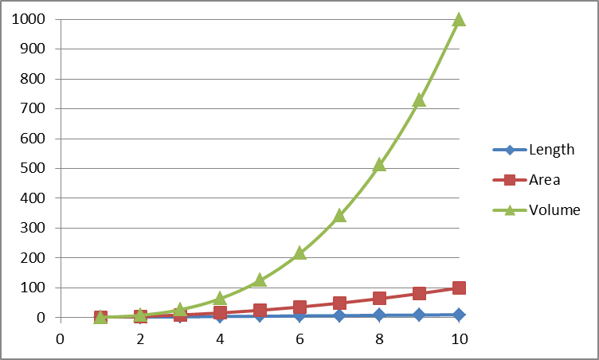
Math & Nature
Water striders
Geometric scaling
Lengths, areas, and volumes increase at different rates because
$Area≈{Length}^{2}$
$Volume≈{Length}^{3}$

Slide 41
Math & Nature
Water striders
Geometric scaling
Lengths, areas, and volumes increase at different rates because
$Area≈{Length}^{2}$
$Volume≈{Length}^{3}$
Therefore, body weight increases more rapidly than the ability of the legs to support that weight on the surface of the water.
Limits the ultimate size that a water strider can be

Slide 42
Math & Nature
References
Galileo Galilei, The Assayer, as translated by Stillman Drake (1957), Discoveries and Opinions of Galileo pp. 237 - 238. New York: Doubleday & Company.
Merrill, M.D. (2002). First principles of instruction. Educational Technology Research and Development. 50 (3): 43 – 59.
Hu, D.L., Chan, B., and Bush, J.W.M. (2003). The hydrodynamics of water strider locomotion. Nature. 424: 663 – 666.

