Slide 1
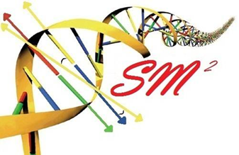
Bioinformatics
Lecture to accompany BLAST/ORF finder activity
Start with orientation to activity, for taking notes effectively
Slide difference between online and presentation

Slide 2
Genetics Review
Central Dogma
Transcription
Translation
Operon
Promoter
Shine Delgarno/Kozak Consensus Sequence

Slide 3
Source: Daniel Horspool, Wikipedia editor

Slide 4
What the heck is bioinformatics?
Interdisciplinary field combining statistics and computer science to understand biology.
Came about with the huge increase in biological data with the sequencing of proteins and genomes.
Essentially, we generate too much data for humans to parse through and interpret, so computers are used.

Slide 5
Know your -omics
Bioinformatics is primarily used to study the “omics”
Genomics: Study of gene sequences, functions, and dynamics. Genome: All DNA in a organism
Proteomics: Study of protein sequences, structures, and functions. Proteome: All Proteins in a organism
Transcriptomics: Study of RNA. Transcriptome: All RNA, including mRNA, tRNA, and rRNA in a organism
Metabolomics: Study of metabolites and biological processes. Metabolome: All metabolites in a organism

Slide 6
Why is this important in everyday life?
This kind of –omic research has far reaching implications for medicine and science.
Targeted cancer therapies, personalized medicine, rapid infection identification, genetic manipulation, etc. are already in use, though it is early.
In the future, who knows what we can find in the depths of the genome of humans and other organisms.

Slide 7
Infection
http://www.nytimes.com/2014/06/05/health/in-first-quick-dna-test-diagnoses-a-boys-illness.html?hpw&rref=us
14 year old male was infected by a bacteria they couldn’t culture. Sequencing and analysis has become fast enough for them to sequence the bacteria’s DNA to identify both the organism and the treatment – Penicillin.

Slide 8
Cancer
http://www.cbsnews.com/news/genetic-sequencing-could-change-cancer-treatment-forever/
http://www.scientificamerican.com/article/wolchok-video-who-knew-cancer-has-an-off-switch-video/
New cancer treatments sequence the cancer DNA to find out what went wrong or potential for “on/off switches” for specific, targeted therapies.

Slide 9
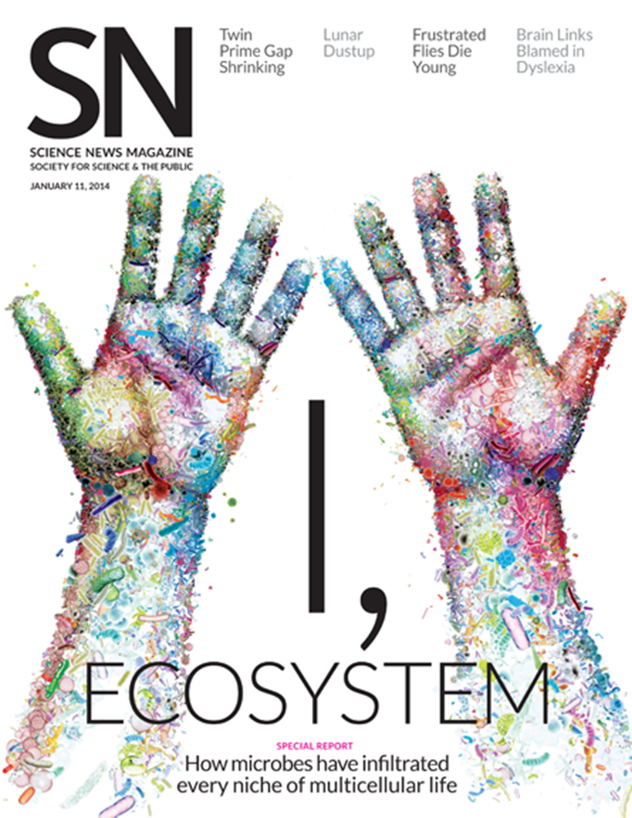
Microbiome
Many bacteria cannot be cultured.
Bioinformatics and metagenomic sequencing allows for insight into such systems as the gut, mouth, and skin microbiome.
Implications for treatment for diabetes, skin conditions, dentistry, gastrointestinal disorders etc.
http://www.genengnews.com/insight-and-intelligence/the-impact-of-human-microbiome-variations-on-systems-pharmacology-and-personalized-therapeutics/77900153/

Slide 11
SPIDERGOAT!!!
http://www.bbc.com/news/science-environment-16554357
HOLY CRAP! SPIDERGOAT!!!!
Utah State University managed to insert a gene into a goat that adds a protein that can be extracted to produce spider silk.

Slide 12
Genetics as a Discovery Science
The great new frontier in biology lies on the small scale
Bioinformatics is used to discover new genes, microorganisms, proteins, etc. by parsing through the gold mine of genetic data

Slide 13
Important Areas
Sequencing
Assembly
Gene Finding
Annotation
Alignment
Databases
Protein Structure/Interaction Prediction
Metagenomics

Slide 14
Sequencing
In order to obtain genetic information, the DNA must be sequenced first.
There are many methods of doing this, each with their own strengths and weaknesses.
Most don’t read the DNA continuously, but build it in fragments, which has to be assembled in to longer reads called contigs.

Slide 15
Sanger Sequencing
This was the first method of sequencing and was the standard for 25 years. Now supplanted by next gen sequencing, but is still used for small scale projects.
Works by adding in a small amount of fluorescent or radioactively labeled nucleotides that cannot be bonded to again, producing fragments of varying length. These fragments then undergo gel electrophoresis to separate the fragments.

Slide 16
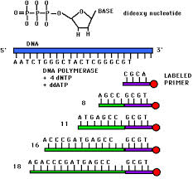
Source:http://www.bio.davidson.edu/Bio111/seq.html

Slide 17
Next Gen Sequencing and the 1000$ genome
Right now, sequencing is still too expensive for entire genomes, so much of the work done now sequences smaller sections.
The goal of the 1000$ genome is to make sequencing cheap and fast enough so that every person could feasibly have their genome sequenced.

Slide 18
Assembly
Most sequencing technologies don’t produce one long read, so the fragments must be assembled.
This process often requires powerful computers to do in a timely fashion.
There are still a few problems with this, especially when the sequence has repeated regions.

Slide 19
Source: http://gcat.davidson.edu/phast/debruijn.html

Slide 20
Gene Finding
Once the section of DNA has been sequenced, genes are found using pattern recognition.
They look for a start codon downstream of a Shine-Delgarno (prokaryotes) or Kozak (eukaryotes) consensus sequence.
Then looks for the potential stop codons as well as introns and exons (eukaryotes)

Slide 21
Annotation
Experimentally figuring out what a particular gene does is costly and at times difficult or impossible to do.
Annotation is used to make an educated guess about what it does by comparing it to similar sequences, following the axiom of structure yielding function i.e. something with a similar sequence is likely to have a similar function

Slide 22
Protein Structure Prediction
Like with gene prediction, the prediction of a proteins structure is difficult and costly, so many algorithms have been developed to attempt to predict structure from a sequence.
Pretty good at predicting secondary structure. Not as good at tertiary or quaternary.
Also working on predicting protein interactions.

Slide 23
Alignment
In order to search for, annotate, or find genes, they have to be aligned against others. This is where things like BLAST come in.
BLAST, or Basic Local Alignment Search Tool, uses an pairwise alignment algorithm to compare a sequence to other sequences one at a time in a particular database, whether that sequence be protein or gene. BLAST is the most commonly used one, but isn’t the best.

Slide 24
Multiple Alignment
By aligning multiple sequences at once, phylogeny of organisms or proteins can be determined, as long as those sequences really are similar.
16S multiple alignments is often what is used to determine prokaryotic phylogeny, where the definition of species is funky. 16S is used as it is highly conserved and is found in all prokaryotic organisms.
Later we will do one with a eukaryotic phylogeny

Slide 25
Databases
Bioinformatics also seeks to compile huge collections of similar data in order to consolidate information in one place.
It also has to be organized in such a way that is useful to other scientists.
These databases include things like UniProt, SEED, KEGG, RCSB/PDB etc. All of those listed make great resources for creating your own activities

Slide 26
Metagenomics
Many bacteria can’t be cultured, so much of the picture of the microbiome is hazy.
Metagenomics is the shotgun or grenade approach
Sequence everything below a certain size cell.
Gives insight into the genetics of unculturable organisms

Slide 27
Activity
Go on the SM² website and locate the instructions for the activity
There are 6 different prokaryotic operons, each containing multiple gene sequences.
Organize yourselves into 6 groups and try to figure out the probable function of each gene and what organism it comes from.
Then search NCBI for papers on one of the genes functions. Discuss with the group and the class what you learned.

Slide 28
NCBI ORF Finder
This looks for potential genes in a particular DNA sequence
Does this by looking for Shine-Delgarno Sequences upstream of a start codon, then continues until it hits a stop codon
Searches in 6 “frames” as codons are triplets and for “backwards sequences”. All are possible sites for translation.

Slide 29
What do the BLAST scores mean?
E- Value: The probability of finding an equal or better match by chance.
Query Cover: % of the query sequence length that is included in the aligned segment with that result.
Identity: percent similarity
Total score: Sum of the alignment scores from all segments from the same database that match the query sequence. This will only differ from the mx score if several parts of the database sequence match different parts of the query sequence.
Blast Page

Slide 30
Take home message
With faster sequencing and increased genetic and proteomic research, bioinformatics becomes more and more important.
Right now we are literally producing too much data to go through.
Bioinformatics provides computational methods to utilize these massive datasets for practical use in medicine and science.
This is the direction that all genetic and proteomic research is going and will eventually become standard practice to teach when teaching genetics.
For now, this makes a great addition for teaching genetics by getting the students working with sequences. Activities can be designed around Central Dogma to teach how genetic information flows in living systems and how scientists today gather and use that information.

